Slide 1
greedy algorithms

Slide 2
Greedy selection
Learning point
Understand the concept of greedy algorithms.
Master the basics of greedy algorithms
(1) optimal substructure property (2) greedy selection property
Understand the differences between greedy algorithms and dynamic programming algorithms
Understand the general theory of greedy algorithms
Learn greedy design strategies by applying examples.
(1) Activity arrangement;
(2) Optimal loading problem;
(3) Huffman coding;
(4) Single-source shortest path;
(5) Minimum spanning tree;

Slide 3
Change-Making Problem
Change-Making Problem：假设有4种硬币，它们的面值分别为二角五分，一角，五分和一分，单位是角，现在要找给某顾客六角三分。
Solution：先拿出2个二角五分，一个一角的硬币和3个一分的硬币。与其他方案相比，拿出的硬币个数最少。
That's the greedy algorithm

Slide 4
Greedy algorithm concept
As the name suggests, greedy algorithms always do what seems best at the moment. In other words, the greedy algorithm does not consider the overall optimal, and the choices it makes are only local optimal choices in a sense. Of course, hopefully the final result of the greedy algorithm is also the overall optimal. Although the greedy algorithm cannot get global optimal solutions for all problems, it can produce global optimal solutions for many problems. Such as single source shortest path problem, minimum spanning tree problem. In some cases, even if the greedy algorithm cannot obtain the overall optimal solution, the final result is a good approximation of the optimal solution.
局部最优
全局最优
单源最短路径问题
最小生成树问题

Slide 5
Activity arrangement problem
The activity arrangement problem is to select the maximum compatible activity sub-set from the given activity set. It is a good example that can be solved effectively by greedy algorithm. This problem requires the efficient scheduling of a series of activities that compete for a common resource. The Greedy algorithm provides a simple way to make as many activities as possible compatible with common resources.
活动安排问题
相容的
争抢

Slide 6
Activity arrangement problem
活动安排问题

Slide 7
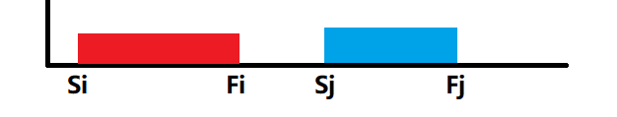
Activity arrangement problem
Let E={1,2,…,n} be a set of n activities, where each activity requires the use of the same resource, such as a lecture venue, and only one activity can use this resource at the same time. Each activity i has a start time (si) and an end time (fi) at which the resource is required to be used, and si<fi. If activity i is selected, it occupies resources in the half-open time interval [si, fi). If interval [si, fi) and interval [sj, fj) do not intersect, activity i is said to be compatible with activity j. In other words, when si≥fj or sj≥fi, activity i is compatible with activity j.
演讲会场
不相交
相容的

Slide 8
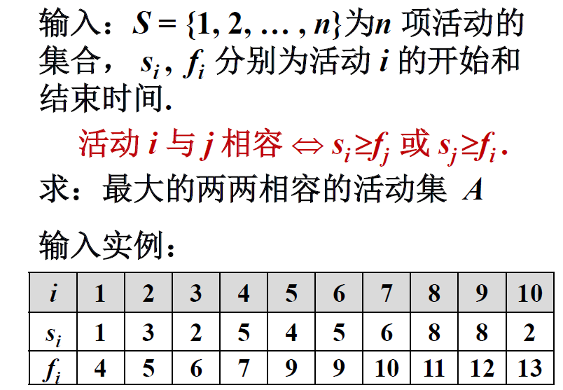
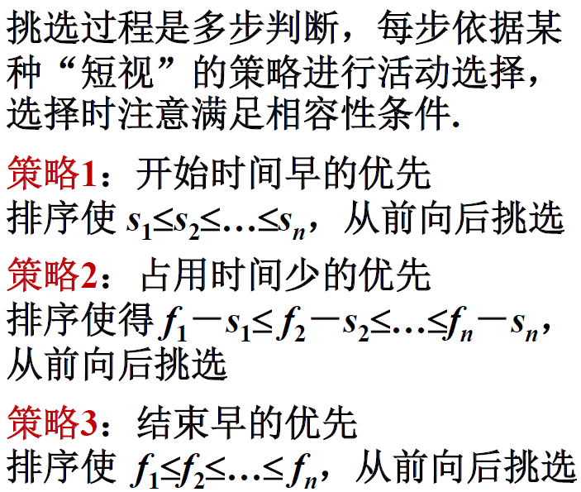
Activity arrangement problem

Slide 9
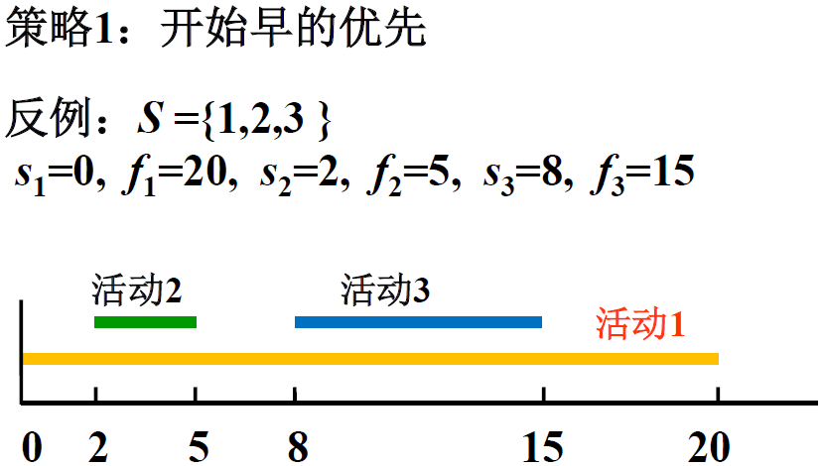
Activity arrangement problem
解：1
最优解：2和3

Slide 10
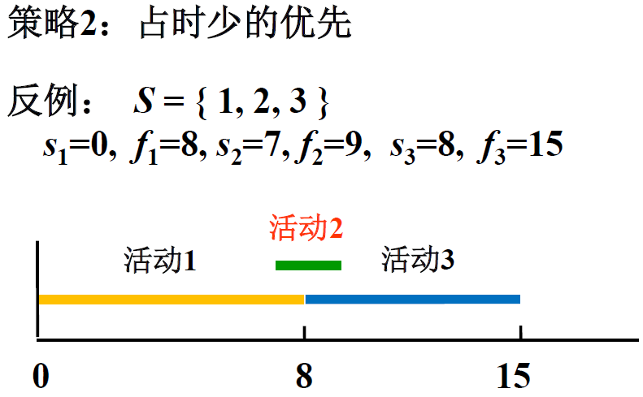
Activity arrangement problem
解：2
最优解：1和3

Slide 11
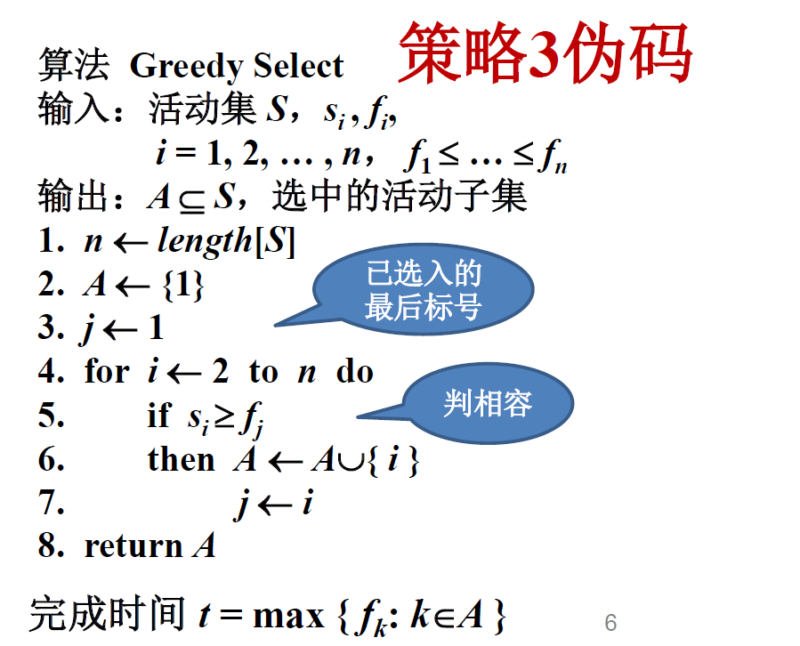
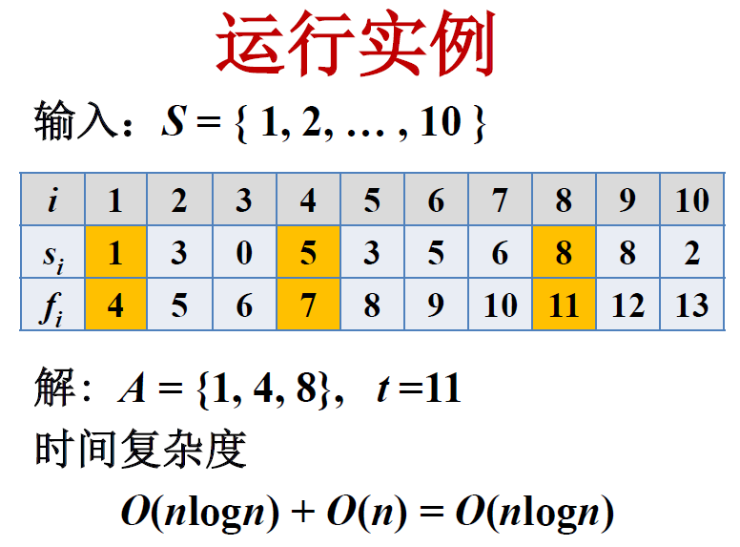
Activity arrangement problem
结束时间早的优先
排序

Slide 12
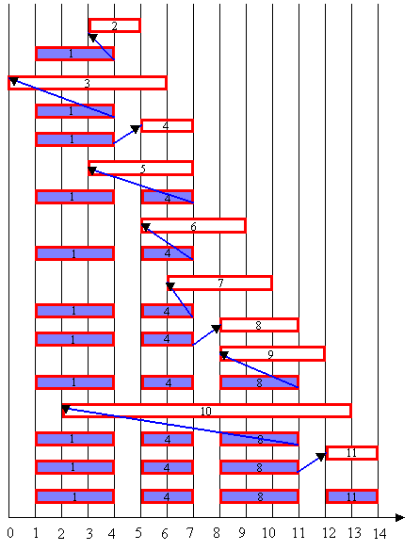
Activity arrangement problem
i | 1 | 2 | 3 | 4 | 5 | 6 | 7 | 8 | 9 | 10 | 11
s[i] | 1 | 3 | 0 | 5 | 3 | 5 | 6 | 8 | 8 | 2 | 12
f[i] | 4 | 5 | 6 | 7 | 8 | 9 | 10 | 11 | 12 | 13 | 14
The calculation process of greedy algorithm is shown in the figure on the right. Each row in the figure corresponds to an iteration of the algorithm. The shaded bar represents the activity that has been selected into set A, while the blank bar represents the activity that is currently being checked for compatibility
代表
迭代

Slide 13
Characteristics of greedy algorithms
Design Elements:
(1) Greedy method is suitable for combinatorial optimization problems.
(2) The solution process is a multi-step judgment process, and the final judgment sequence corresponds to the optimal solution of the problem.
(3) According to a certain "myopic" greedy choice nature judgment, the quality of the algorithm determines the success or failure.
(4) Greedy method must be proved correct.
(5) Techniques to prove that the greedy method is not correct: give counter examples.
Advantages of greedy method: simple algorithm, low time and space complexity
组合优化
多步判断过程
对应
短视的
贪心选择性质
举反例

Slide 14
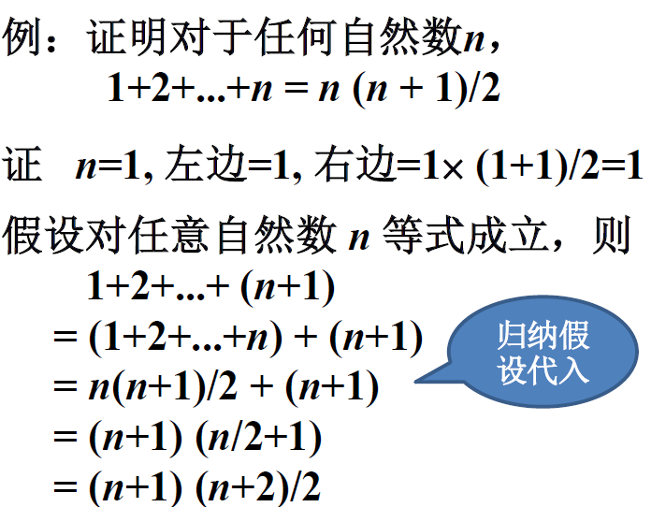
Mathematical induction certificate greedy algorithm is correct

Slide 15
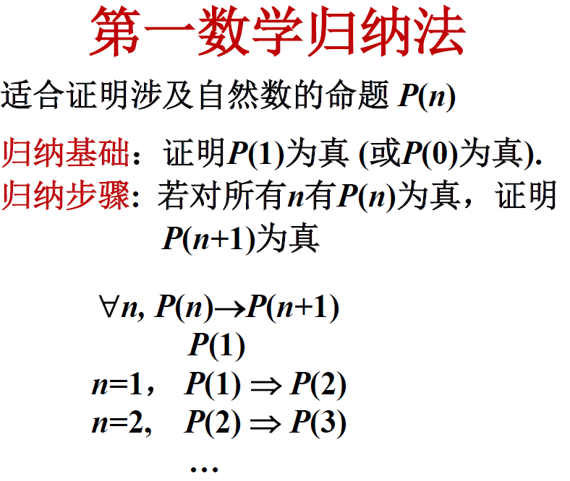
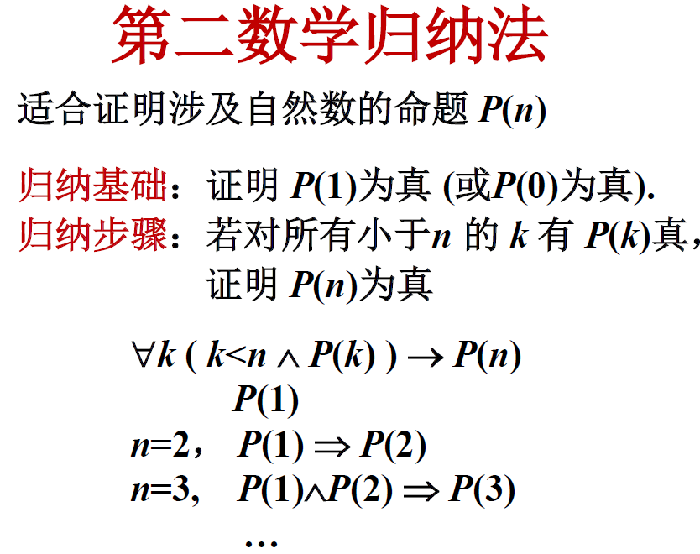
Mathematical induction

Slide 16
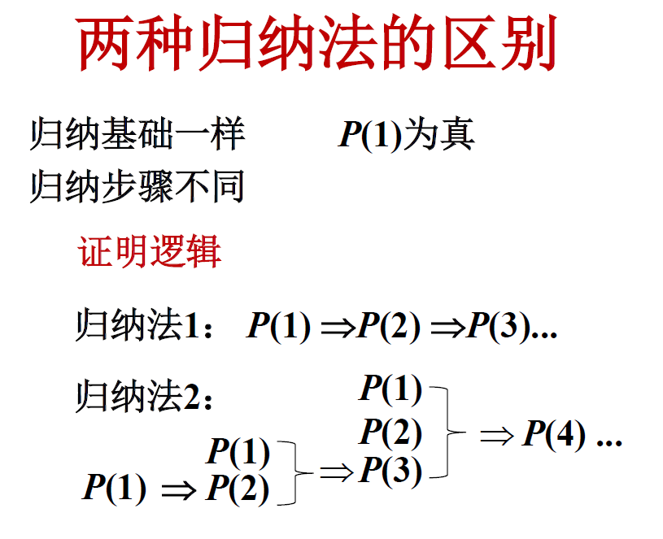
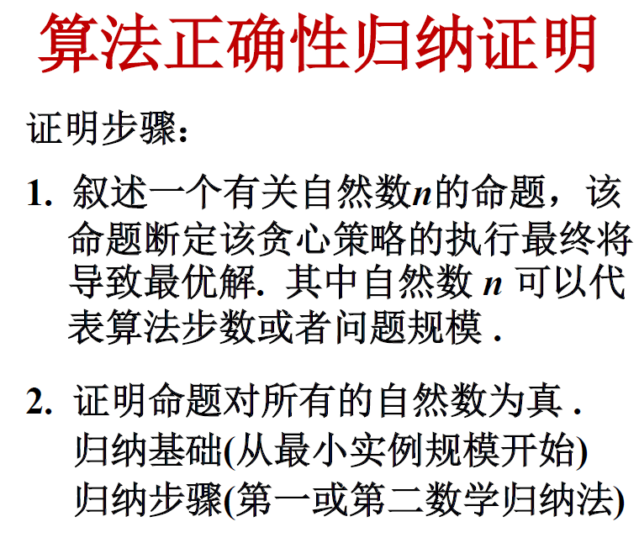
Mathematical induction

Slide 17
Activity arrangement problem of greedy selection algorithm
命题
算法Select执行到第k 步, 选择k 项活动
i₁ = 1, i₂ , … , i_{k}。
则存在最优解A包含活动i₁=1, i₂ ,…, i_{k} .
根据上述命题：对于任何k，算法前k 步的选择都将导致最优解，至多到第n 步将得到问题实例的最优解。

Slide 18
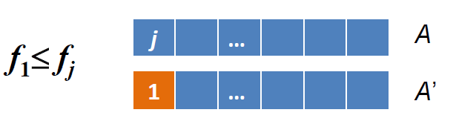
Activity arrangement problem of greedy selection algorithm
归纳证明：归纳基础
令S={1,2,…,n}是活动集,且f₁≤…≤f_{n}
归纳基础: k=1, 证明存在最优解包含活动1
证：任取最优解A，A中活动按截止时间递增排列. 如果A的第一个活动为j，j ≠1, 用1替换A的活动j 得到解A'，即A'= (A−{ j }) ∪{1},
由于f1 ≤fj, A' 也是最优解，且含有1.

Slide 19
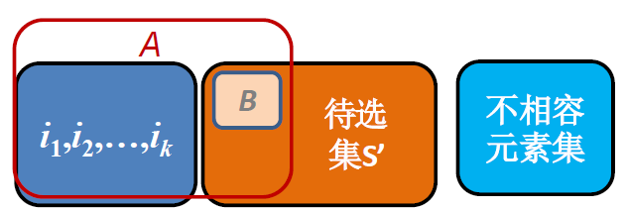
Activity arrangement problem of greedy selection algorithm
归纳证明：归纳步骤
假设命题对k为真, 证明对k+1也为真
证明：算法执行到第k 步, 选择了活动i₁=1, i₂, …, i_{k} , 根据归纳假设存在最优解A包含i₁=1,i₂,…,i_{k} , A中剩下活动选自集合S'
S' = { i| i∈S, s_{i} ≥f_{k} }，A = { i₁, i₂, … , i_{k} } ∪B

Slide 20
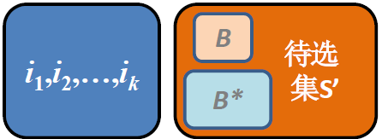
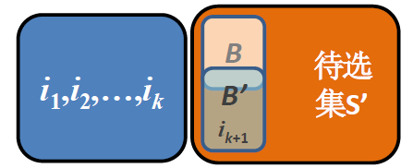
Activity arrangement problem of greedy selection algorithm
B是S’的最优解（若不然, S’ 的最优解为B*, B*的活动比B多，那么B*∪{1,i₂,…,i_{k} }是S 的最优解，且比A的活动多，与A 的最优性矛盾）
将S' 看成子问题，根据归纳基础，存在S' 的最优解B' 有S' 中的第一个活动ik+1, 且|B'| = |B|, 于是{ i1, i2, ... , ik} ∪B'= { i1, i2, ... , ik, ik+1 } ∪( B'−{ ik+1})也是原问题的最优解

Slide 21
The basic elements of a greedy algorithm
For a specific problem, how do we know whether a greedy algorithm can be used to solve the problem, and whether we can get an optimal solution to the problem? It's hard to say.
However, from many problems that can be solved by greedy algorithms, we can see that these problems generally have two important properties: greedy choice property and optimal substructure property
具体的
贪心选择性质

Slide 22
Greedy-choice property
The so-called greedy choice property means that the overall optimal solution of the problem can be achieved by a series of local optimal choices, that is, greedy choice. This is the first basic element for greedy algorithms to be feasible, and it is also the main difference between greedy algorithms and dynamic programming algorithms.
贪心选择性质
可行的

Slide 23
Greedy-choice property
Dynamic programming algorithms usually solve each subproblem in a bottom-up way, while greedy algorithms are usually carried out in a top-down way, making successive greedy choices in an iterative way. Each greedy choice simplifies the problem to smaller subproblems.
For a specific problem, to determine whether it has the greedy choice property, it must be proved that the greedy choice made at each step eventually leads to the overall optimal solution of the problem.
迭代的

Slide 24
Optimal substructure properties
When the optimal solution of a problem includes the optimal solution of its subproblems, the problem is said to have the optimal substructure property.
The optimal substructure property of the problem is the key feature that can be solved by dynamic programming algorithm or greedy algorithm.
关键特征

Slide 25
Classical combinatorial optimization problem
Both greedy algorithms and dynamic programming algorithms require optimal substructure property, which is a common point of the two algorithms. However, should greedy algorithm or dynamic programming algorithm be used to solve the problem with optimal substructure? Can a problem that can be solved by a dynamic programming algorithm also be solved by a greedy algorithm? Next, we’ll study two classic combinatorial optimization problems to show the main differences between greedy algorithms and dynamic programming algorithms.
组合优化问题

Slide 26
Classical combinatorial optimization problem
0-1 knapsack problem:
Given n items and a knapsack. The weight of item i is Wi, its value is Vi, and the capacity of the knapsack is C. How should we choose what to put in our knapsack so that the total value of what we put in our knapsack is maximum?
When selecting items to pack in the knapsack, there are only 2 choices for each item i, namely to pack in the knapsack or not. Item i cannot be loaded into the knapsack more than once, nor can only part of item i be loaded.
容量

Slide 27
Classical combinatorial optimization problem
Knapsack problem:
Similar to the 0-1 knapsack problem, the difference is that when choosing item i to load into the knapsack, we can choose a part of item i, but not necessarily the whole of the item into the knapsack, 1≤i≤n.
These two kinds of problems have the properties of optimal substructure and are very similar, but knapsack problem can be solved by greedy algorithm, while 0-1 knapsack problem cannot be solved by greedy algorithm.

Slide 28
Classical combinatorial optimization problem
The basic steps of solving knapsack problem with greedy algorithm are as follows:
First calculate the value Vi/Wi per unit weight of each item, and then, following the greedy selection strategy, pack as many items as possible with the highest value per unit weight. If this kind of items are loaded into the knapsack, the total weight of items in the knapsack does not exceed C, then choose the unit weight value of the second highest items and as much as possible into the knapsack. Continue this strategy until the pack is full.

Slide 29
Classical combinatorial optimization problem
For the 0-1 knapsack problem, the greedy choice fails to achieve the optimal solution, because in this case, it is not guaranteed to eventually fill the knapsack, and the partially idle knapsack space reduces the value per kilogram of knapsack space. In fact, when considering the 0-1 knapsack problem, compare the final solution resulting from choosing the item with not choosing the item, and then make the best choice. This leads to many overlapping subproblems. This is another important feature of the problem that can be solved by dynamic programming algorithms.
In fact, the dynamic programming algorithm can effectively solve the 0-1 knapsack problem.

Slide 30
Optimal loading problem

Slide 31
The optimal loading
We want to load n containers, labeled 1, 2, …, n, onto a ship. Container i has weight wᵢ. The ship has a maximum weight capacity of C, but there is no limit on volume. The goal is to load as many containers as possible onto the ship. Assume that the weight of each container wᵢ ≤ C.
This problem is a subproblem of the 0-1 knapsack problem. The container is equivalent to the item, the weight of the item is w_{i}, the value of v_{i} is equal to 1, the ship's load limit C is equivalent to the knapsack weight limit.
集装箱

Slide 32
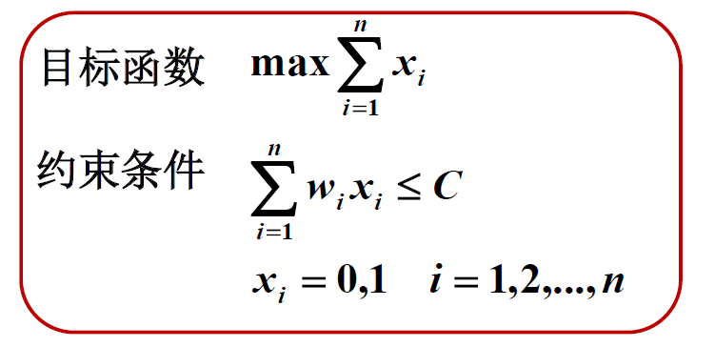
The optimal loading
Set the <x₁, x₂, ..., x_{n}> represents the solution vector, x_{i}=0,1, xi=1 is the i-th container is loaded on board

Slide 33
The optimal loading
Greedy strategy: The lighter is first
Algorithm design: sort the containers so that w₁ ≤w₂≤... ≤w_{n}
Then load them onto the ship in order, starting from container 1, then 2, and so on. Stop when adding the next container would make the total weight exceed the ship's weight limit C .

Slide 34
正确性证明思路
命题：
对装载问题任何规模为n 的输入实例，算法得到最优解.
设集装箱从轻到重记为1, 2, … , n.
归纳基础证明对任何只含1个箱子的输入实例，贪心法得到最优解. 显然正确。
归纳步骤证明：假设对于任何n个箱子的输入实例贪心法都能得到最优解，那么对于任何n+1个箱子的输入实例贪心法也得到最优解.

Slide 35
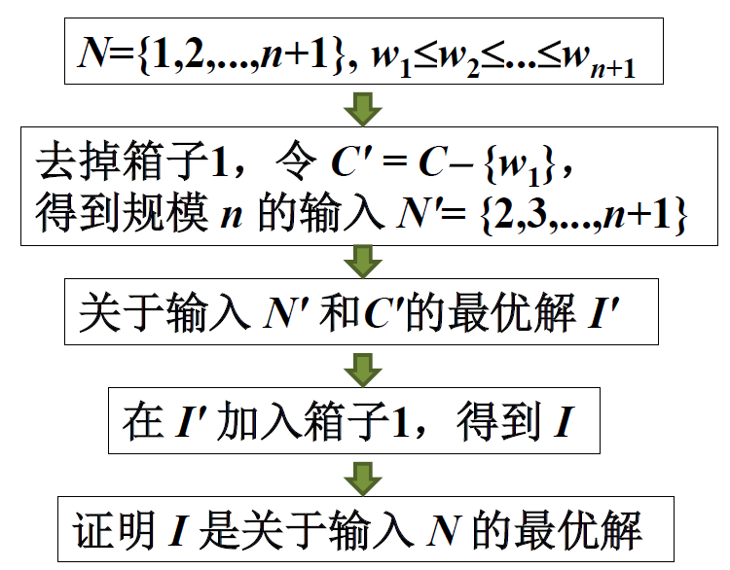
Inductive steps prove ideas

Slide 36
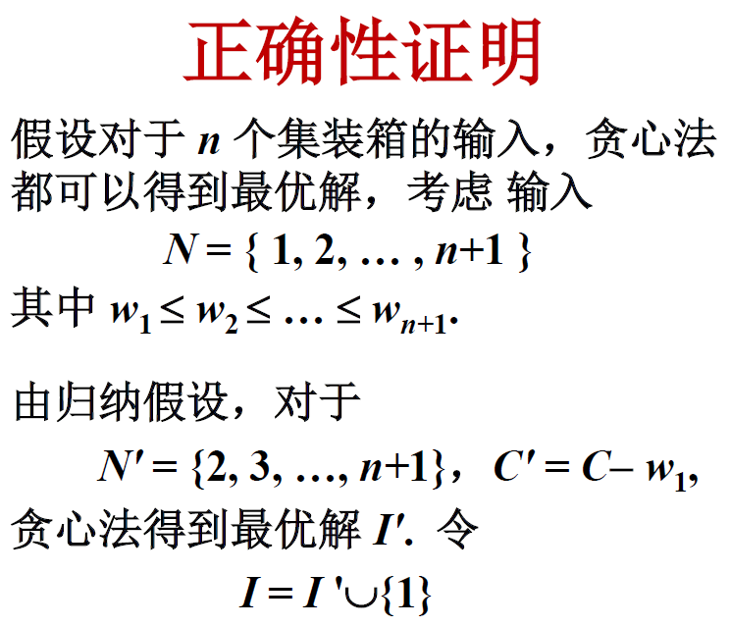
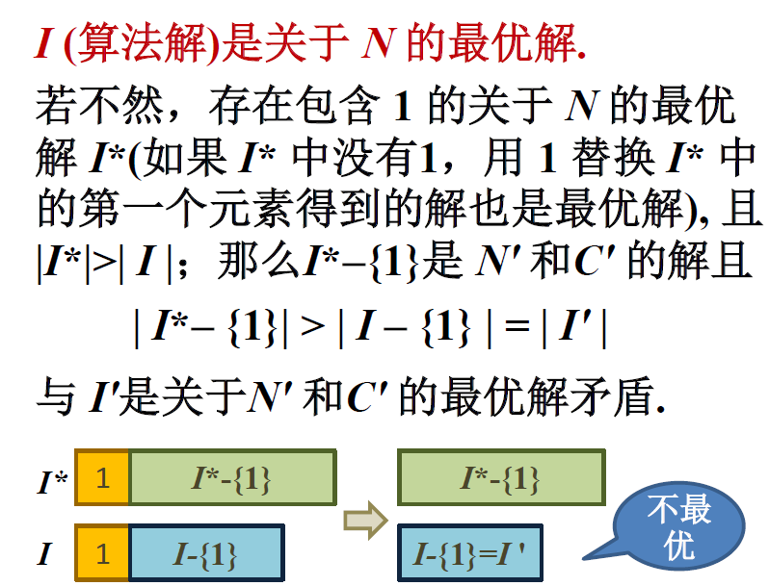
Inductive steps prove ideas

