Slide 1
Single-source shortest path

Slide 2
Single-source shortest path
Given a weighted directed graph G =(V,E), where the weight of each edge is a nonnegative real number. given a vertex in V, called a source. Now we want to calculate the shortest length from the source to all the other vertices. The length of a route is the sum of the weights of each side of the route. This problem is often called the single-source shortest path problem.
带权有向图
非负的
顶点

Slide 3
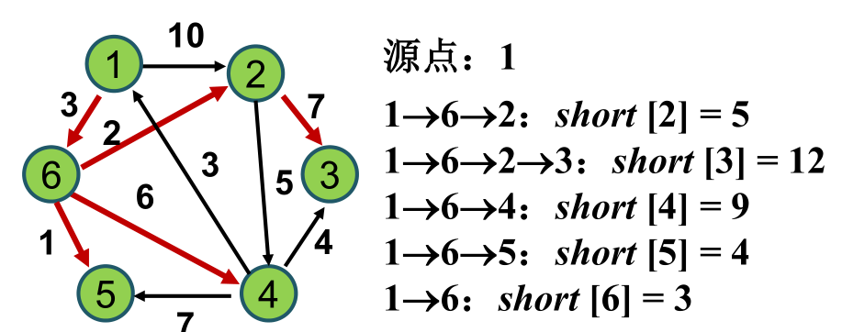
Single-source shortest path
解包括两部分：路径所经过的顶点和路径长度

Slide 4
Single-source shortest path
Dijkstra algorithm is a greedy algorithm to solve the single-source shortest path problem.
Its basic idea is: set up a vertex set S, and keep adding vertices to S using greedy choices.
A vertex belongs to S if and only if we already know the shortest path length from the source to that vertex.

Slide 5
Single-source shortest path
At the start, S only has the source vertex.
Let u be a vertex of G, the path from the source to u, which only passes through the vertices in S, is called the special path from the source to u.
the array “dist” is used to record the shortest special path length to each vertex.

Slide 6
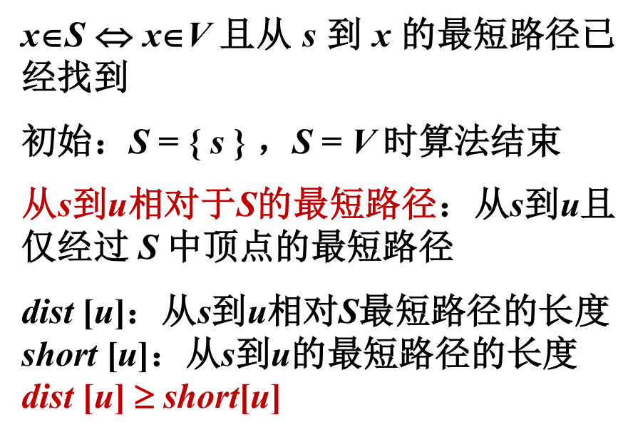
Single-source shortest path

Slide 7
Single-source shortest path
Dijkstra算法每次从V-S中取出具有最短特殊路长度的顶点u，将u添加到S中，同时对数组dist作必要的修改。一旦S包含了所有V中顶点，dist就记录了从源到所有其它顶点之间的最短路径长度。

Slide 8
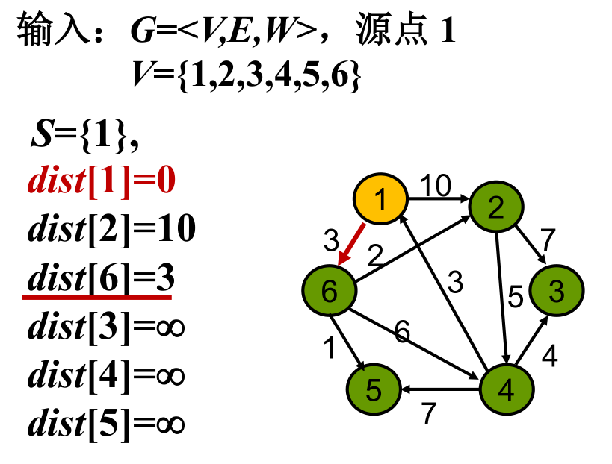
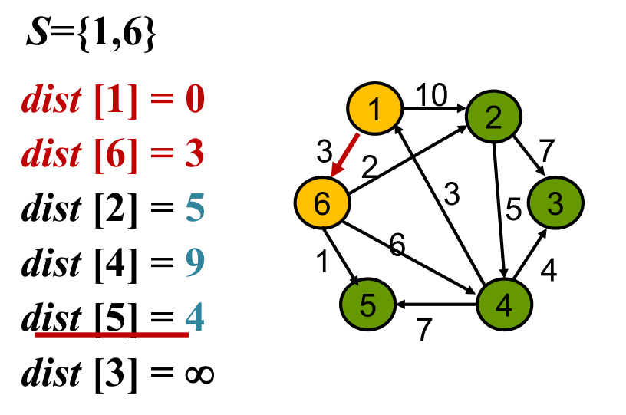
Single-source shortest path

Slide 9
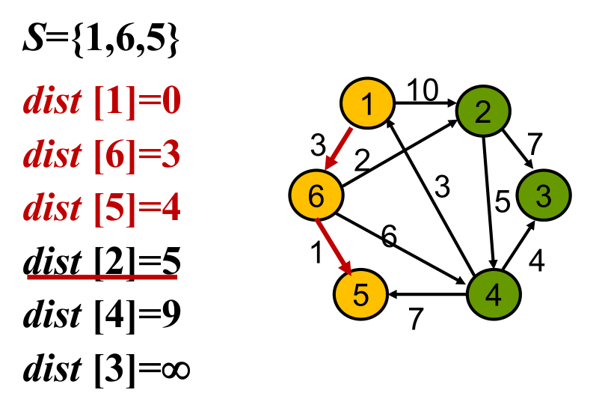
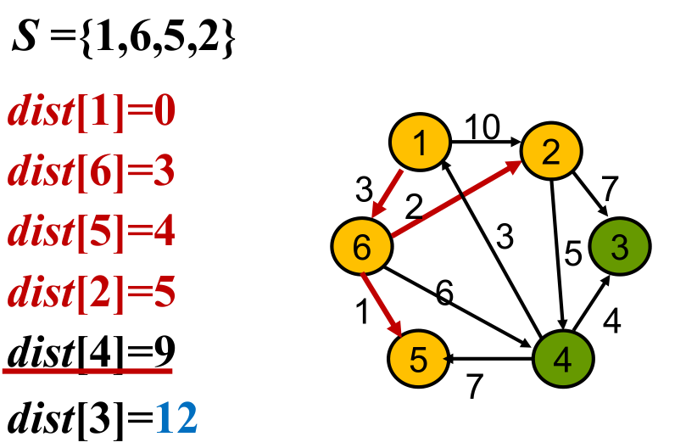
Single-source shortest path

Slide 10
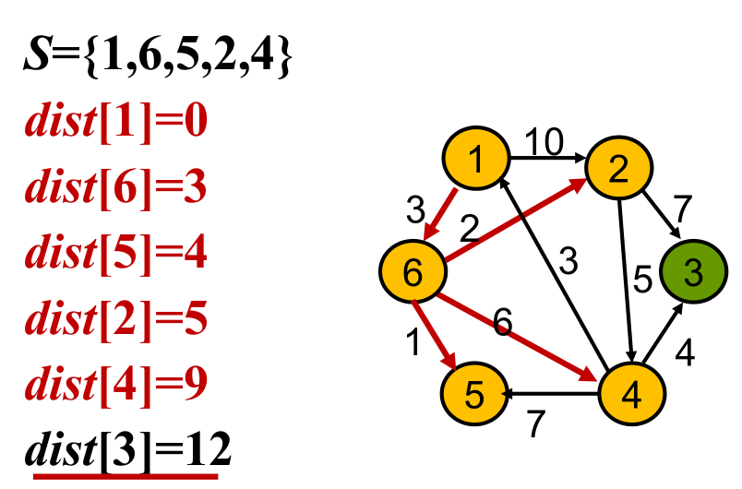
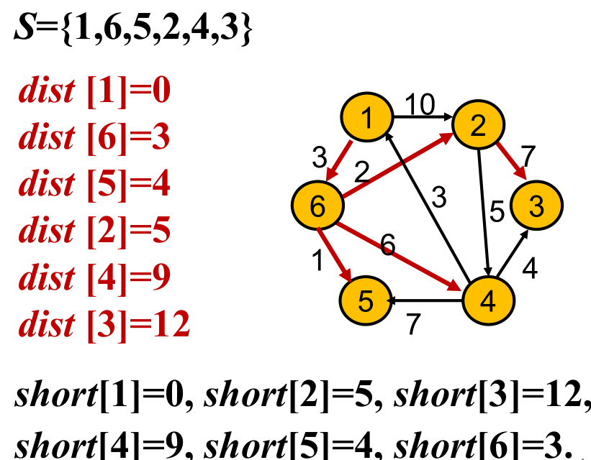
Single-source shortest path

Slide 11
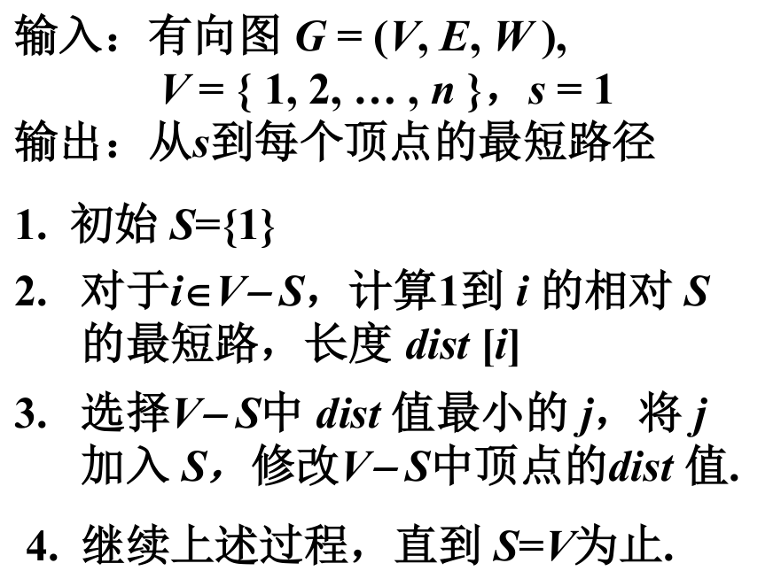
Single-source shortest path

Slide 12
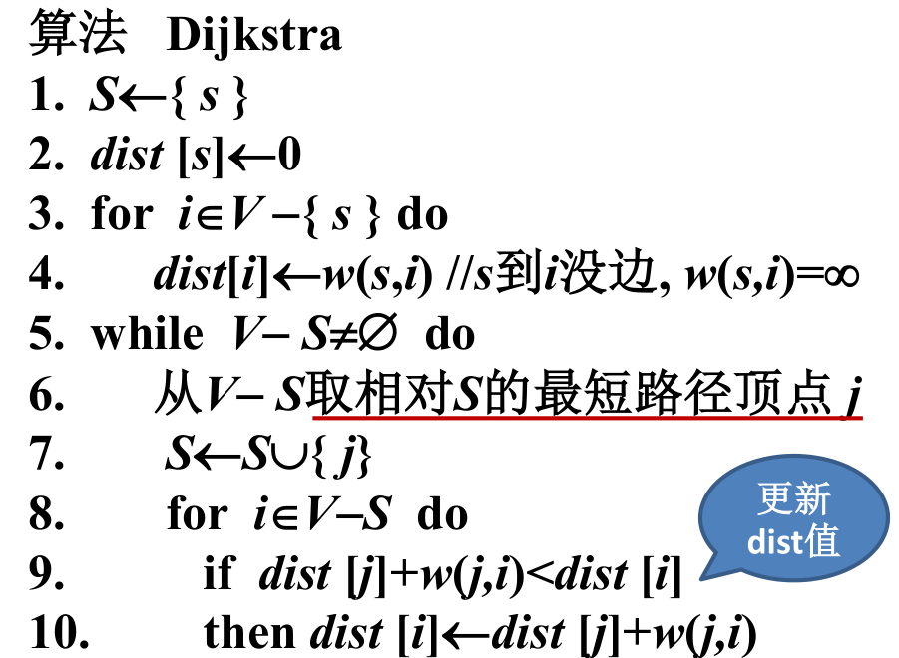
Single-source shortest path

Slide 13
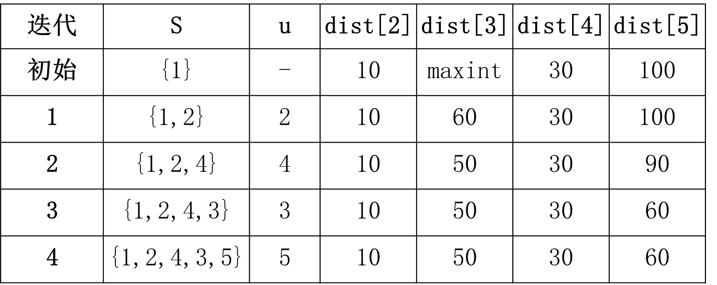
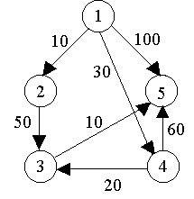
Single-source shortest path
Dijkstra算法的迭代过程：

Slide 14
Minimum spanning tree

Slide 15
Minimum spanning tree
Let G =(V,E) be an undirected connected weighted graph, that is, a network.
The weight of each edge (v,w) in E is c[v][w].
A subgraph G' of G is said to be a spanning tree of G if it is a tree containing all the vertices of G.
The sum of edge weights on a spanning tree is called the cost of the spanning tree. Among all the spanning trees of G, the spanning tree with the lowest cost is called the minimum spanning tree of G.
无向连通带权图
生成树

Slide 16
Minimum spanning tree
The minimum spanning tree of network is widely used in practice.
For example, in the design of communication network, the vertex of the graph is used to represent the city, and the weight c[v][w] of edge (v,w) is used to represent the cost of building the communication line between city v and city w. Then the minimum spanning tree gives the most economical scheme for building the communication network.

Slide 17
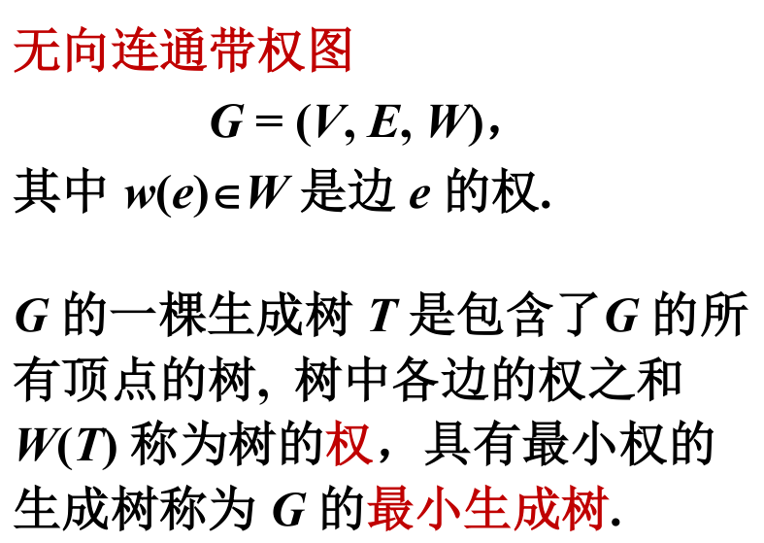
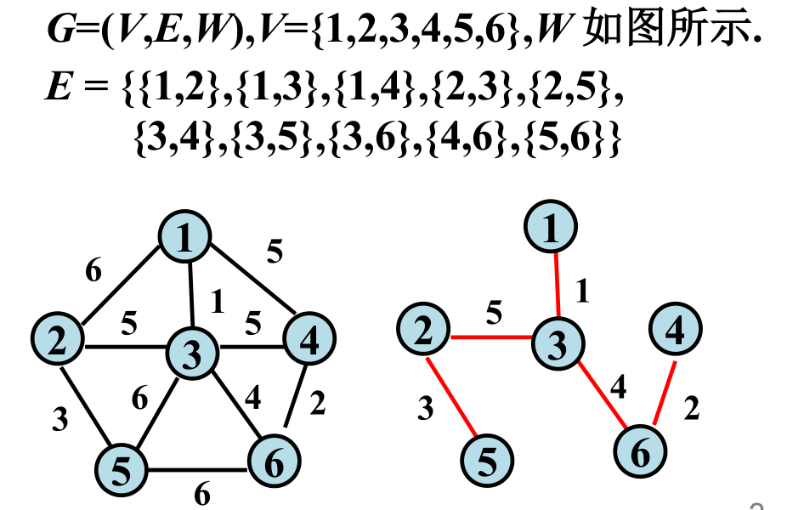
Minimum spanning tree

Slide 18
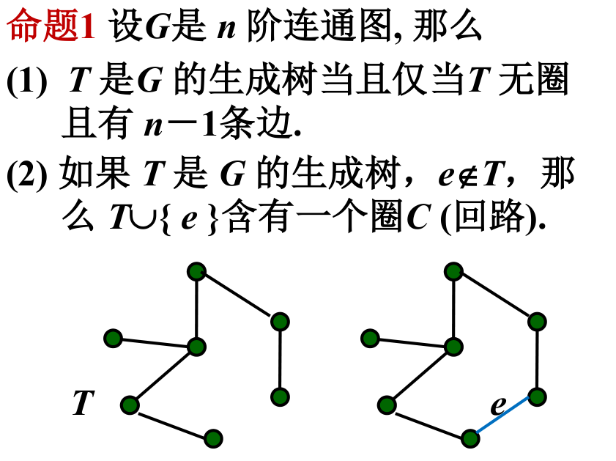
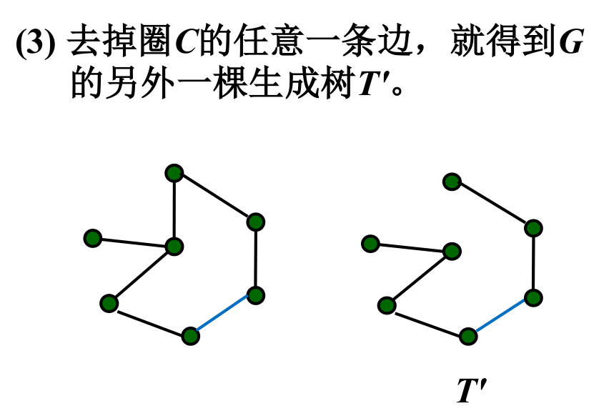
Minimum spanning tree
Properties of spanning trees

Slide 19
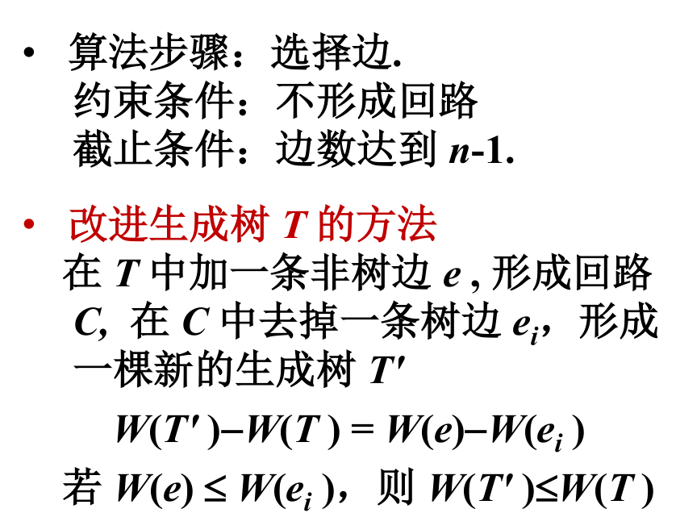
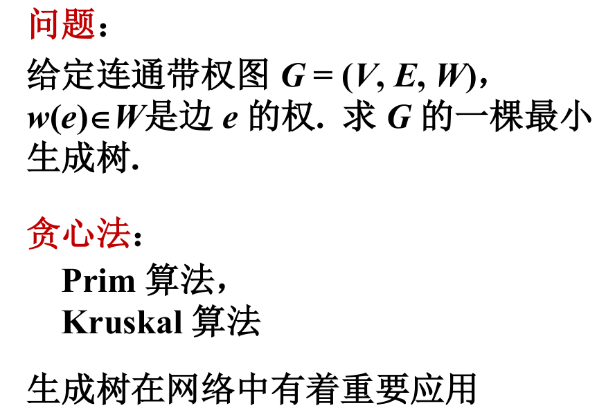
Minimum spanning tree

Slide 20
Prim algrithm
Let G=(V,E) be a connected weighted graph, V={1,2... , n}.
The basic idea of the Prim algorithm for constructing the minimum spanning tree of G is:
First set S={1}, and then, as long as S is a proper subset of V, make the following greedy choice: select the edge that satisfies the condition i∈S, j∈V-S, and c[i][j] is the smallest, and add a vertex j to S. And this process continues until S=V.
All the edges picked in this process exactly form a minimum spanning tree of G.

Slide 21
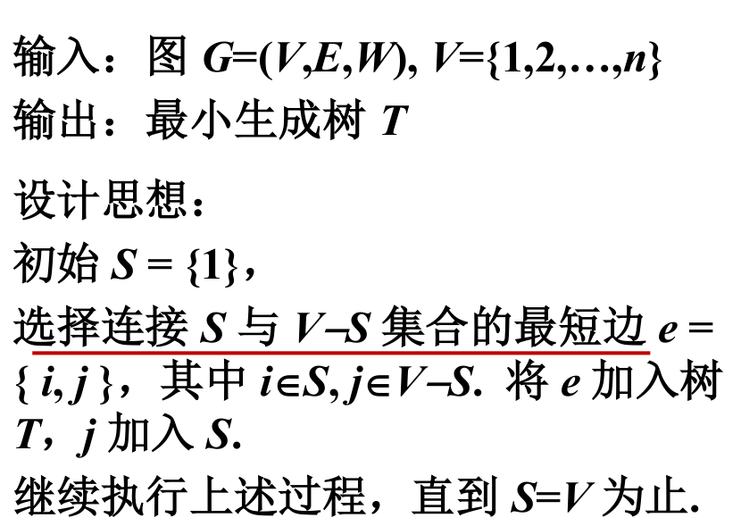
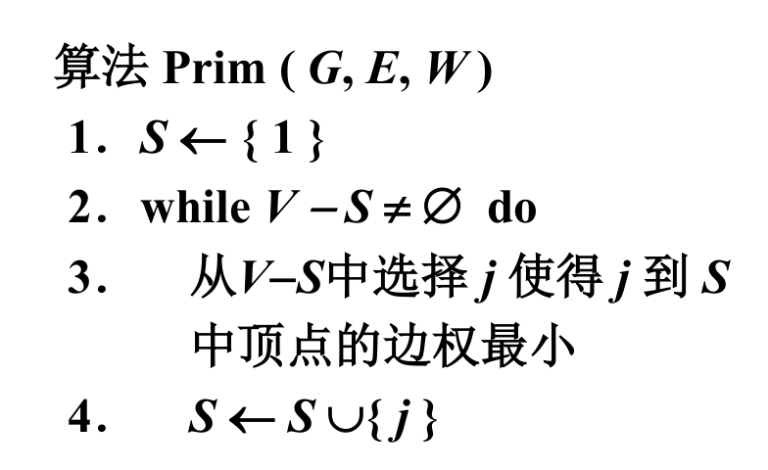

Slide 22
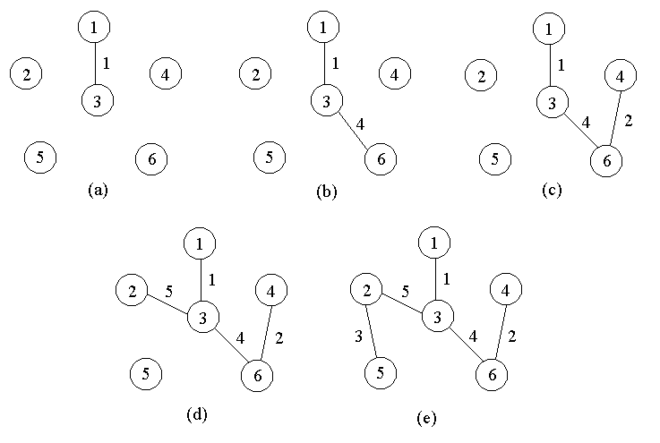
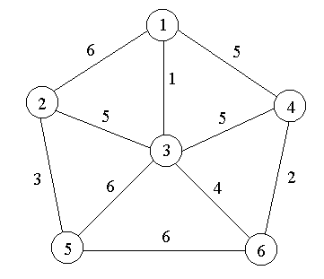

Slide 23
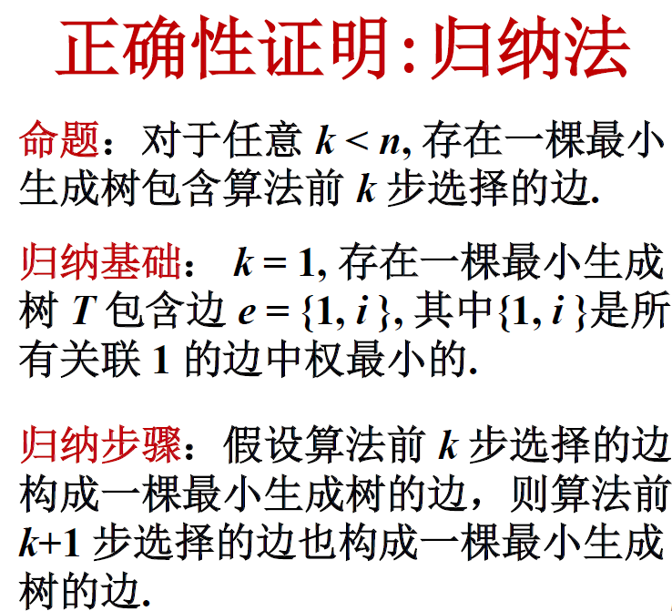
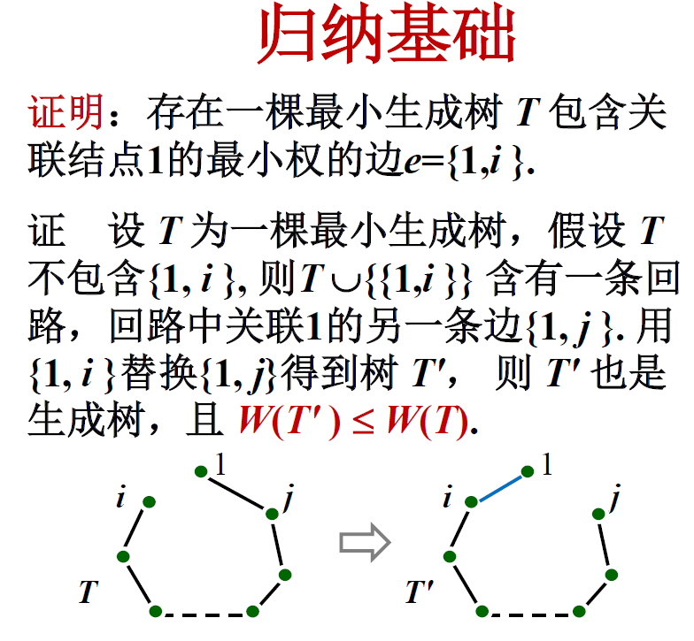

Slide 24
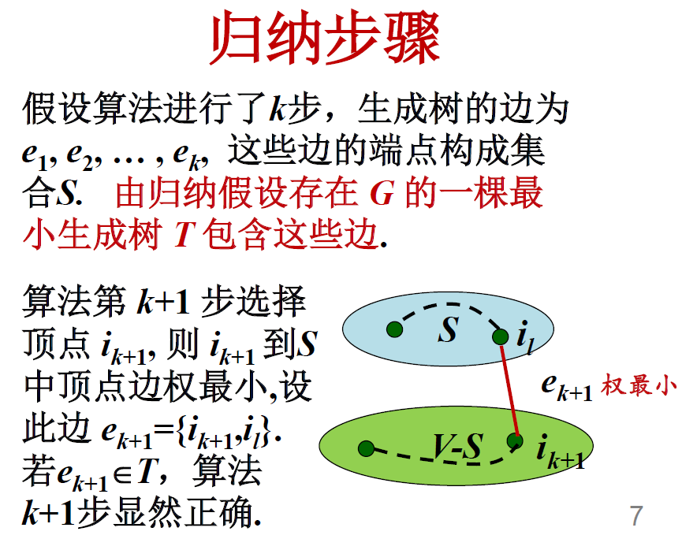
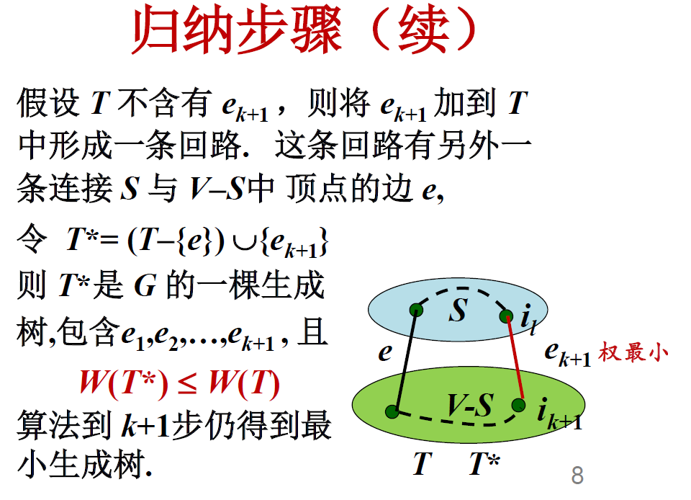

Slide 25
Kruskal algrithm
The basic idea of Kruskal algorithm for constructing the minimum spanning tree of G is:
first treat the n vertices of G as n isolated branches. Sort all edges by weight from smallest to largest.
Then, starting from the first edge, view each edge in the order of increasing edge weight, and connect two different connected branches in the following way:
孤立的

Slide 26
Kruskal algrithm
when checking the k-th edge (v,w), if the endpoints v and w are vertices in the current two different connected branches T1 and T2, then connect T1 and T2 into a connected branch with edge (v,w), and then continue to check the k+1 edge.
If the endpoints v and w are in the same connected branch, then go straight to the k+1 edge. This process continues until there is only one connected branch left.

Slide 27
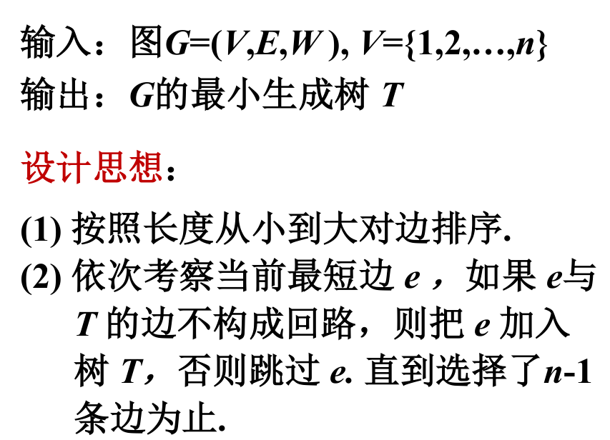
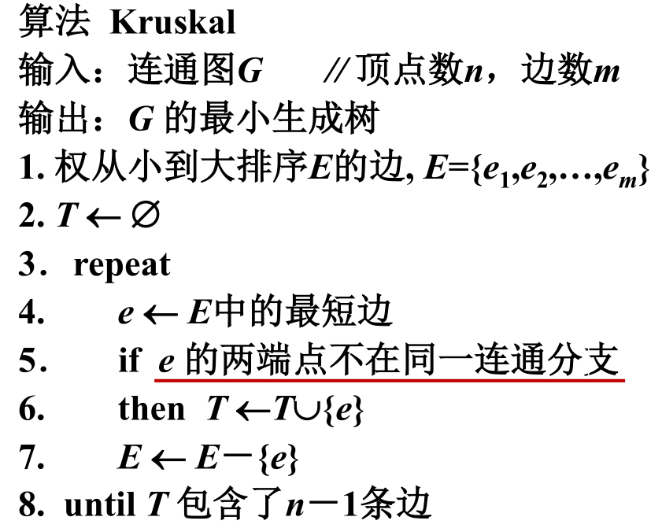

Slide 28
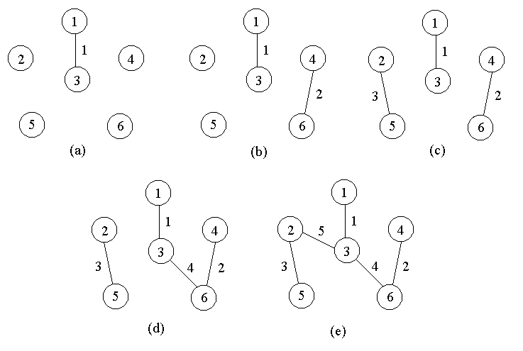

Slide 29
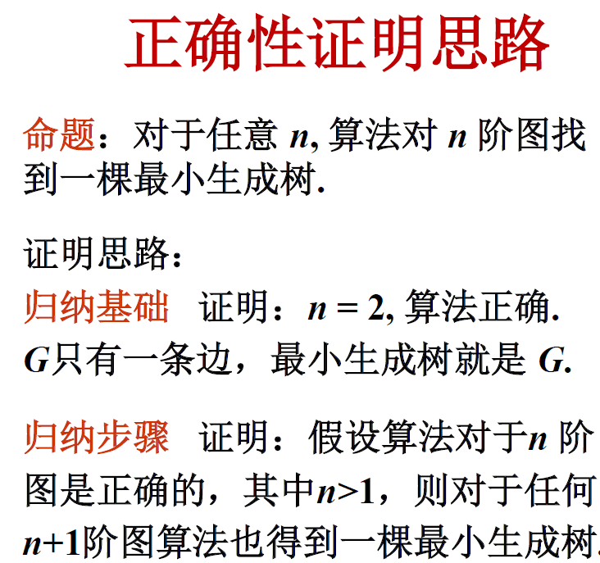
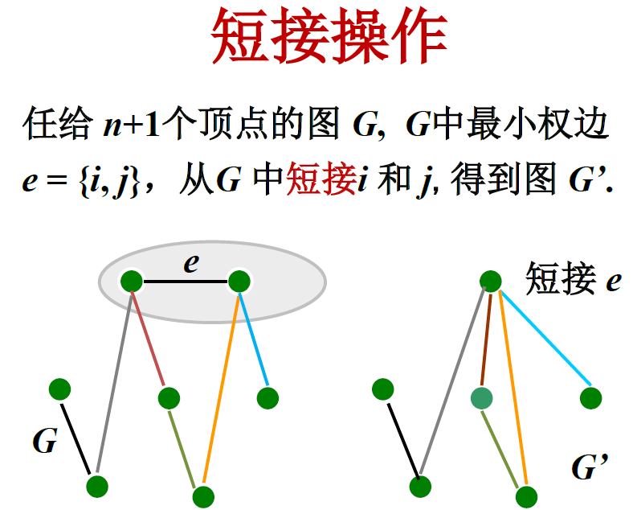
i和j合并

Slide 30
