Slide 1
Huffman coding

Slide 2
Huffman coding
Huffman coding is a very effective coding method widely used in data file compression. The compression rate is usually between 20% and 90%. The Huffman coding algorithm uses a table of the frequency of characters in a file to create an optimal representation of each character with a string of 0,1. Characters that appear more often get shorter codes, while those that appear less often get longer codes. This greatly reduces the total length of the encoded message.
压缩
表示方式

Slide 3
Huffman coding
1. Prefix code
Each character is assigned a unique string of 0s and 1s as its code, with the rule that no character’s code is the beginning (prefix) of another character’s code. This kind of coding is called a prefix code.
前缀码
指定

Slide 4
Binary prefix code
Binary prefix code: The 0-1 string is used as the code to represent the character, requiring that the code of any character cannot be used as the prefix of other character codes
Examples of non-prefix codes
a:001, b:00, c:010, d:01
Decoding ambiguities, such as string 0100001
Decode 1: 01, 00, 001 d, b, a
Decode 2: 010, 00, 01 c, b, d

Slide 5
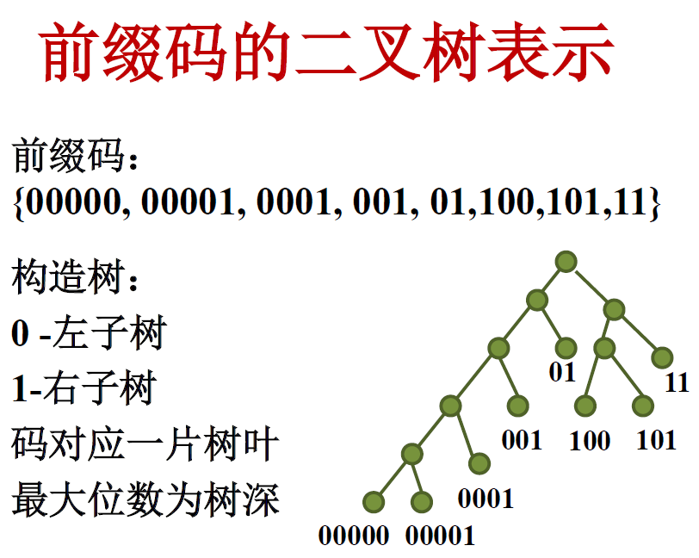
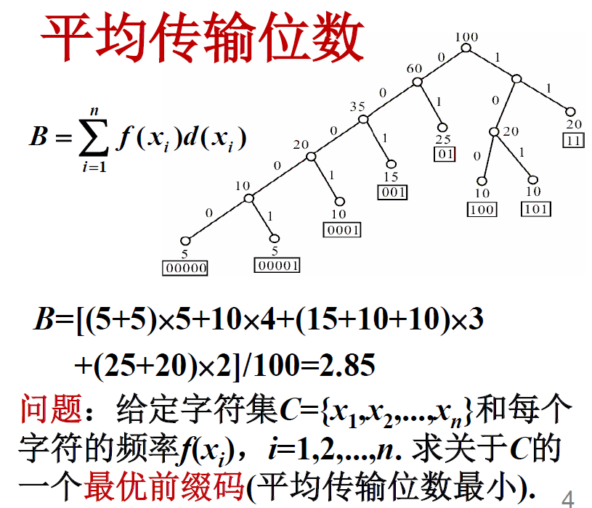
Binary prefix code

Slide 6
The prefix property of the code makes decoding very simple.
The binary tree that represents an optimal prefix code is always a full binary tree, this means every node in the tree has exactly two children. The average code length is defined as：
A prefix code that gives the smallest possible average code length is called an optimal prefix code for the given set of characters C.
最优前缀码
满二叉树

Slide 7
2、Construct Huffman codes
Huffman proposed a greedy algorithm to construct the optimal prefix code, and the resulting coding scheme is called Huffman coding. The Huffman algorithm constructs a binary tree T representing the optimal prefix code in a bottom-up manner.
Algorithm begins with |C| leaves node, execute |C|－1 "merge" required to produce the final tree T after operation.
提出

Slide 8
In the algorithm huffmanTree, the frequency of each character c in the encoding character set is f(c).
The priority queue Q with the key f is used in greedy selection to efficiently determine the 2 trees with the minimum frequency to be currently merged by the algorithm.
Once the two trees with the minimum frequency are merged, a new tree whose frequency is the sum of the frequencies of the two merged trees is generated, and the new tree is inserted into the priority queue Q.
After n−1 merges, there is only one tree left in the priority queue, which is the required tree T.

Slide 9
f:5
e:9
c:12
b:13
d:16
a:45

Slide 10
c:12
b:13
d:16
a:45
14
f:5
e:9

Slide 11
c:12
b:13
14
d:16
a:45
f:5
e:9

Slide 12
c:12
b:13
14
d:16
a:45
f:5
e:9

Slide 13
14
d:16
a:45
25
f:5
e:9
c:12
b:13

Slide 14
14
d:16
25
a:45
f:5
e:9
c:12
b:13

Slide 15
14
d:16
25
a:45
f:5
e:9
c:12
b:13

Slide 16
25
a:45
30
c:12
b:13
14
d:16
f:5
e:9

Slide 17
25
30
a:45
c:12
b:13
14
d:16
f:5
e:9

Slide 18
25
30
a:45
c:12
b:13
14
d:16
f:5
e:9

Slide 19
a:45
55
25
30
c:12
b:13
14
d:16
f:5
e:9

Slide 20
a:45
55
25
30
c:12
b:13
14
d:16
f:5
e:9

Slide 21
100
a:45
55
25
30
c:12
b:13
14
d:16
f:5
e:9

Slide 22
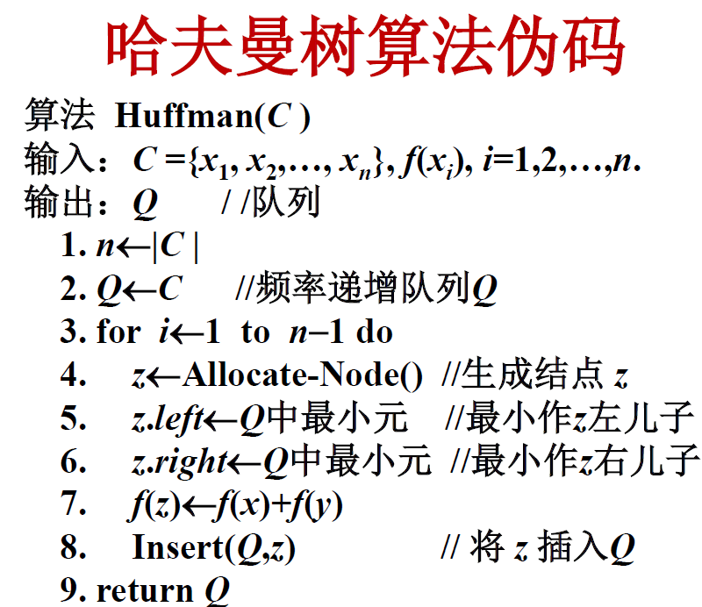
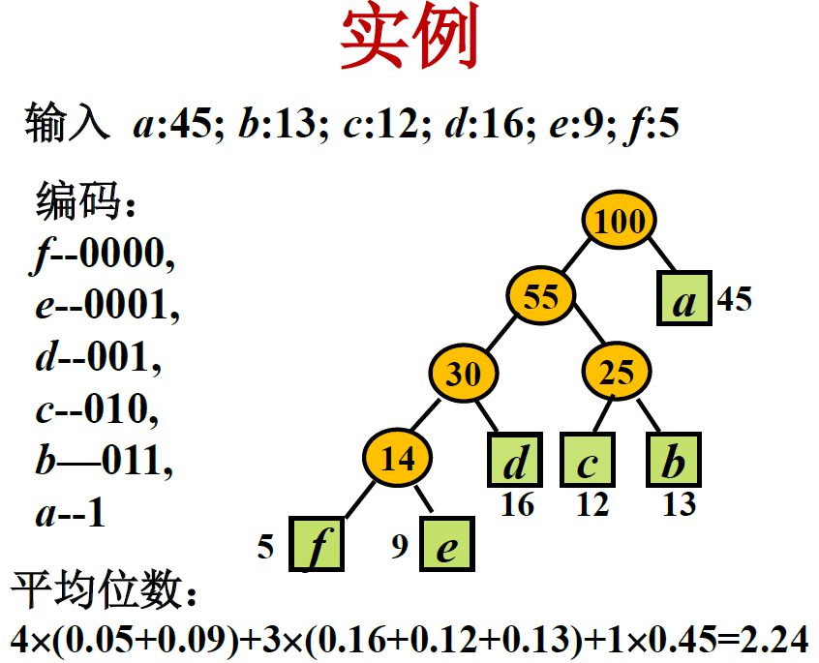
Notes:
1、先生成空姐点
2、找到最小的两个子节点
3、插入父节点，去掉子节点，最后只剩下一个。

Slide 23
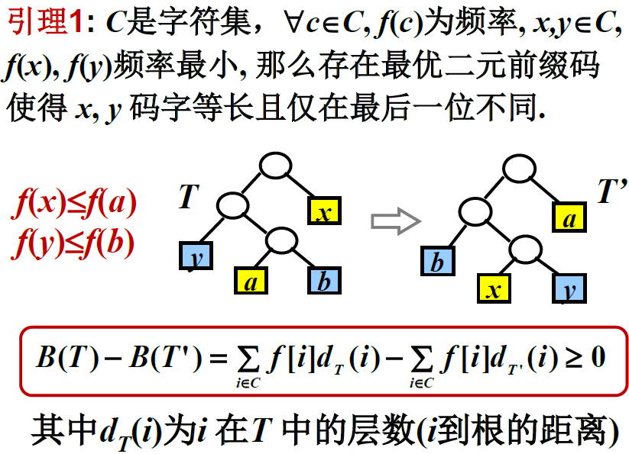
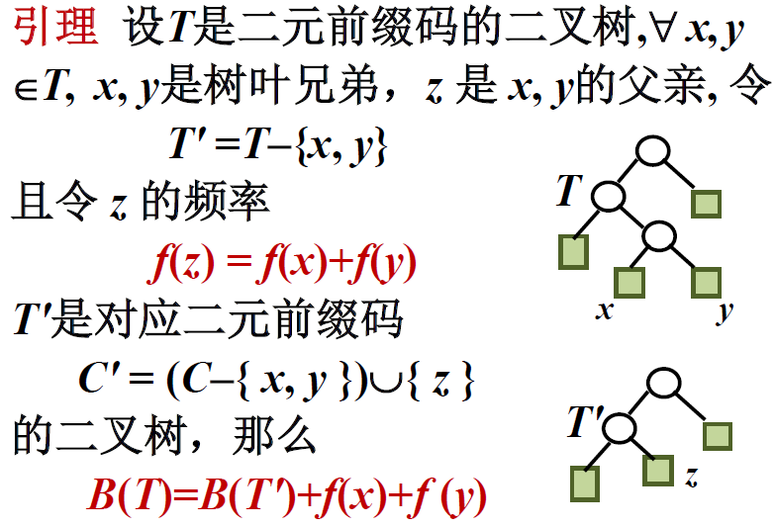
Properties of optimal prefix codes
引理1
引理2

Slide 24
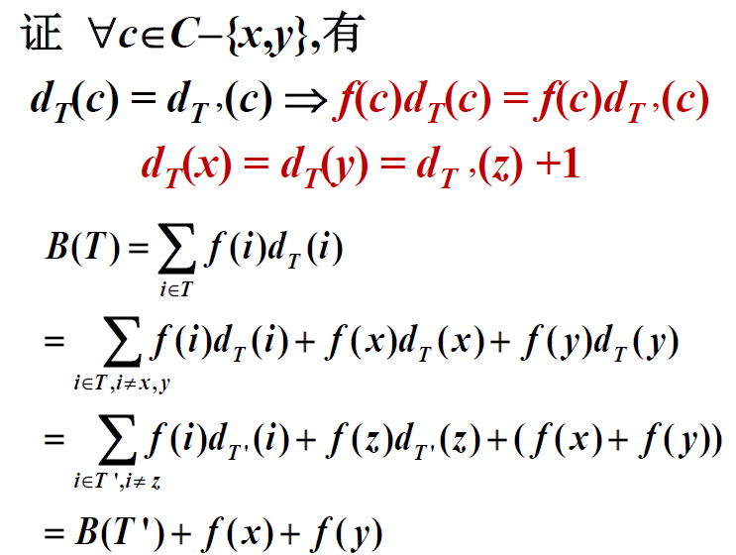
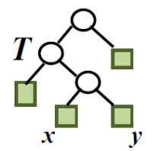
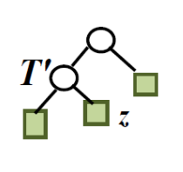

Slide 25
The idea of proving the correctness of Huffman algorithm
定理 Huffman 算法对任意规模为n（n≥2）的字符集C 都得到关于C 的最优前缀码的二叉树.
归纳基础 证明：对于n=2的字符集,Huffman算法得到最优前缀码.
归纳步骤 证明：假设Huffman算法对于规模为k 的字符集都得到最优前缀码，那么对于规模为k+1的字符集也得到最优前缀码.

Slide 26
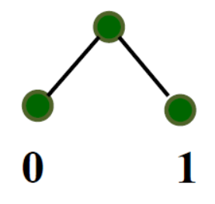
Inductive basis
n = 2，字符集C = {x₁, x₂}，
对任何代码的字符至少都需要1位二进制数字. Huffman算法得到的代码是0 和1，是最优前缀码.

Slide 27
Induction step
假设Huffman算法对于规模为 k 的字符集都得到最优前缀码. 考虑规模为 k+1 的字符集
C = {x₁, x₂, ..., x_{k+1}},
设：x₁, x₂∈C 是频率最小的两个字符.
令
C' = (C－{x₁, x₂})∪{z}，
f(z) = f(x₁) + f(x₂)
根据归纳假设，算法得到一棵关于字符集C’, 频率 f(z) 和 f(x_{i}) (i = 3, 4, ..., k+1)的最优前缀码的二叉树T'.

Slide 28
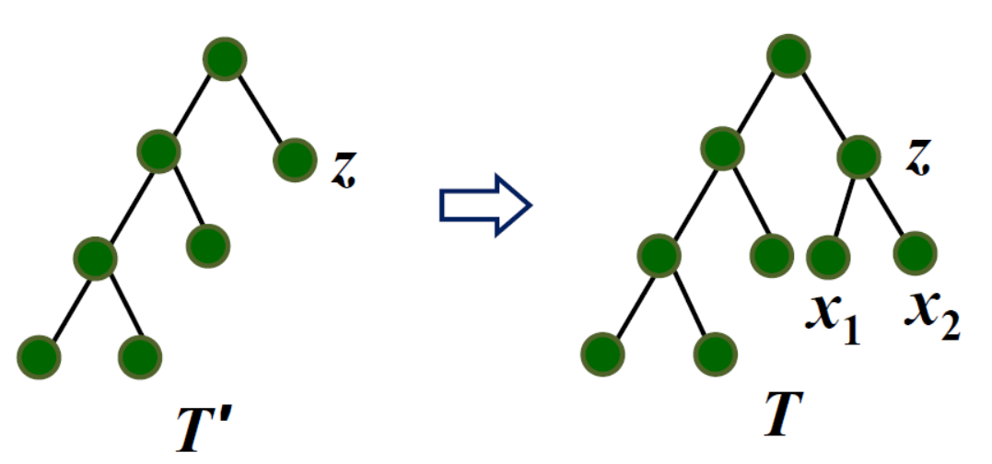
Induction step (continued)
把x₁, x₂作为z 的儿子附到T'上，得到树T，那么T是关于C = (C'－{z})∪{x₁, x₂} 的最优前缀码的二叉树.

Slide 29
Induction step (continued)
如若不然, 存在更优树T*, B(T*) < B(T), 且由引理1，其树叶兄弟是x₁和x₂.
去掉T* 中x₁和x₂，得到T*'. 根据引理2
B(T*’) ＝ B(T*) － ( f(x1) + f(x2))
< B(T) － ( f(x1) + f(x2))
= B(T' )
与T'是一棵关于C'的最优前缀码的二叉树矛盾.
Notes:
可应用到文件归并上

