Slide 1
Branch and Bound method

Slide 2
Branch and bound method
Understand the pruning search strategy of branch and bound method.
Master the algorithm framework of branch and bound method
(1) Queue type (FIFO) branch and bound method;
(2) Priority queue branch and bound method;
Learn the design strategy of branch and bound method by applying examples.
(1) 0-1 knapsack problem; (2) Traveling salesman problem;
剪枝
优先队列

Slide 3
Concepts related to combinatorial optimization problems
Objective function (maximization or minimization)
Constraints (conditions satisfied by the solution)
Feasible solution: the solution whose search space satisfies the constraints
Optimal solution: A feasible solution that maximizes (or minimizes) the objective function
目标函数
约束条件
可行解
最优解

Slide 4
The basic idea of branch and bound method
(1) Goal:
Backtracking: finds all solutions that meet constraints.
Branch and bound: finds one solution or the optimal solution (best among all feasible ones).
(2) Search method:
Backtracking: Depth-first search.
Branch and bound: Breadth-first or least-cost-first search.
约束条件

Slide 5
The basic idea of branch and bound method
In branch and bound:
Each live node becomes an expansion node only once.
It then generates all its child nodes at once.
Infeasible or non-optimal child nodes are discarded; the rest are added to the live node list.
Then, pick the next node from the list (using a bound value) as the new expansion node (the most promising one).
Repeat until a solution is found or the live node list is empty.
活节点
扩展节点
不可行的
舍弃
有利的

Slide 6
Two common branch and bound methods
(1) Queue type (FIFO) branch and bound
Chooses the next node as first-in, first-out (queue order).
(2) Priority queue branch and bound
Chooses the node with the highest priority as the next expansion node.

Slide 7
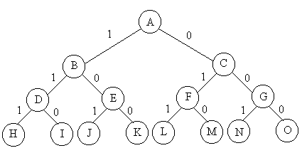
0-1 Knapsack problem
Queued branch and bound method（FIFO）
算法从根节点A开始，初始时，活结点队列为空，A时当前的扩展结点，结点A的两个儿子B和C均为可行结点，按照从左往右顺序，放入活结点队列，并舍弃当前扩展结点A。
按照先进先出的原则，B首先成为扩展结点，一次生成所有的儿子结点，但D为不可行结点，保留E，并加入活结点队列中，C为当前扩展结点，一次性生产F和G两个结点，放入队列中。
以此搜索，得到L表示最优值50的解。
N=3
w = [16, 15, 15]
v= [45, 25, 25]
c=30
Notes:
队列式分支限界法与广度优先搜索方法极为相似

Slide 8
0-1 Knapsack problem
Priority queue branch and bound method
极大堆表示活结点表的优先队列；
初始时堆为空，扩展结点A得到两个儿子结点，B和C，均为可行结点，加入到堆中，结点A被舍弃。
B的当前价值为45，结点C的当前价值为0，因为结点B的价值大于结点C的价值，所以B的价值是堆中最大元素，从而称为下一个扩展结点；
B扩展得到D和E，D不是可行结点，舍去，E是可行结点，放入堆中，E的价值为45，称为当前堆中的最大元素，因而成为下一个扩展结点，扩展得到J和K，J是不可行结点，k是可行叶节点，一个可行解，价值为45。
N=3
w = [16, 15, 15]
v= [45, 25, 25]
c=30
Notes:
队列式分支限界法与广度优先搜索方法极为相似

Slide 9
0-1 Knapsack problem
Priority queue branch and bound method
此时堆中，只剩下一个活结点C，成为当前扩展结点，2个儿子F和G均为可行结点，插入到堆中
结点F的价值为25，是堆中最大的元素，成为下一个扩展结点，结点L和M均为叶结点，L对应最优解50，M对应可行解25.
最后结点G成为扩展结点，其儿子为N和O，价值分别为25和0，接下来存储活结点的堆已空。
N=3
w = [16, 15, 15]
v= [45, 25, 25]
c=30
Notes:
队列式分支限界法与广度优先搜索方法极为相似

Slide 10
0-1 Knapsack problem
Add pruning function (cost function) to speed up search:
For a node in the search tree:
Maximization problem: compute the upper bound of all feasible solutions in its subtree.
Minimization problem: compute the lower bound of all feasible solutions in its subtree.
“bound" means: the current largest value found so far (opposite for minimization).
(1) If the upper bound of a node is not better than the current best value, prune that subtree (it contains no optimal solution).
(2) Use the upper bound value as priority. Expand nodes in non-increasing order of this priority.
上界
下界
界
剪枝
优先级

Slide 11
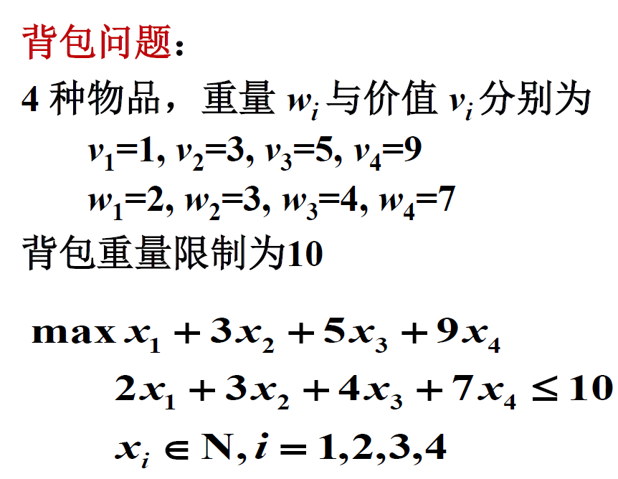
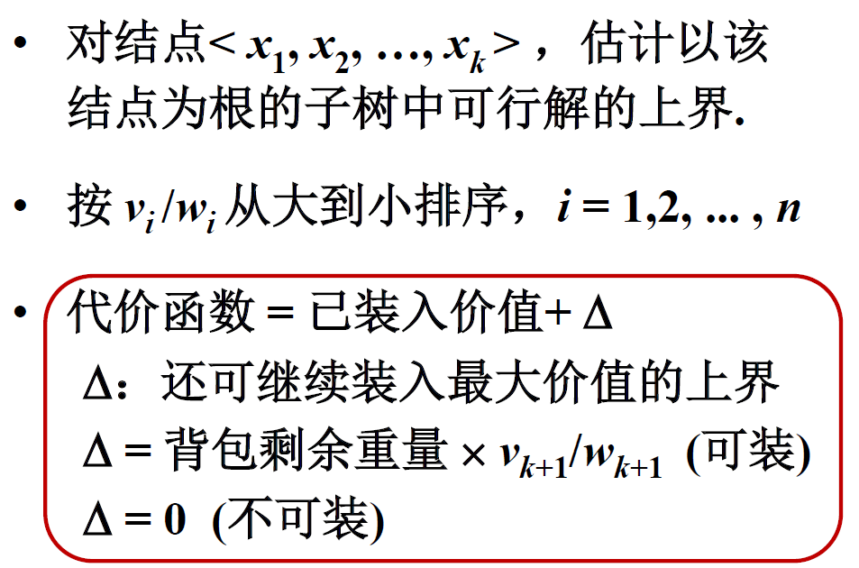

Slide 12
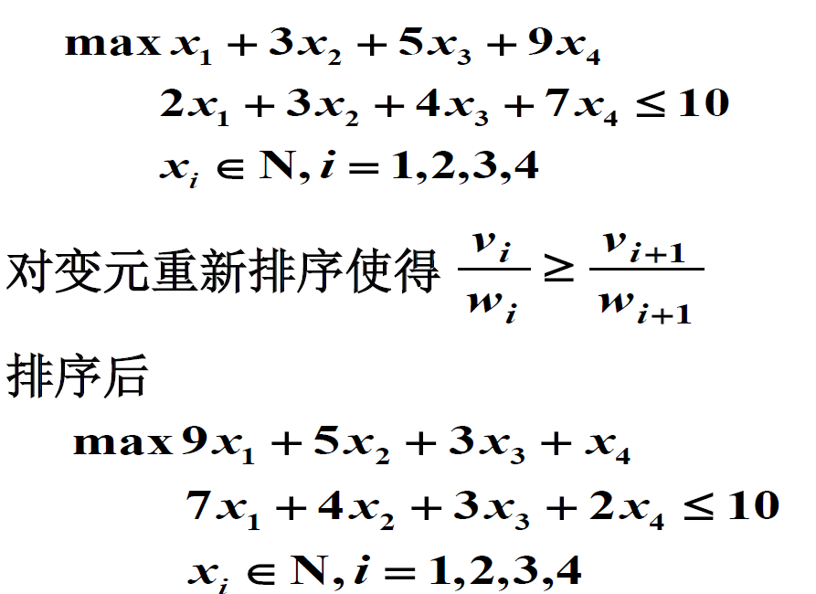
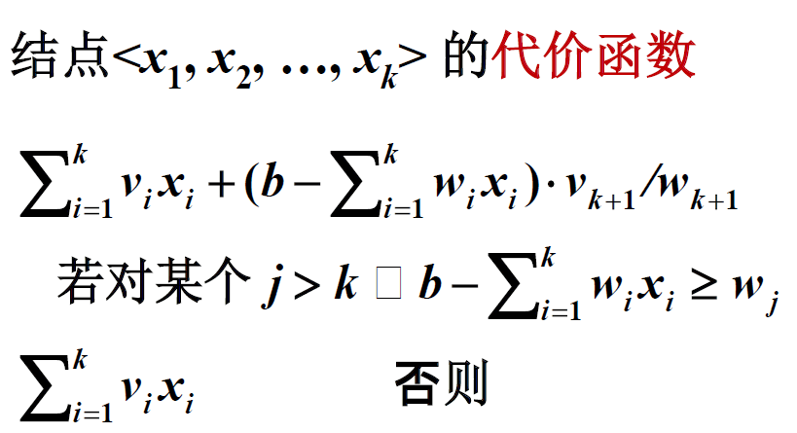
已装入物品的价值
背包剩余重量*剩余物品最大价值
说明存在一个物品可以放进去一半，不能完全放入

Slide 13
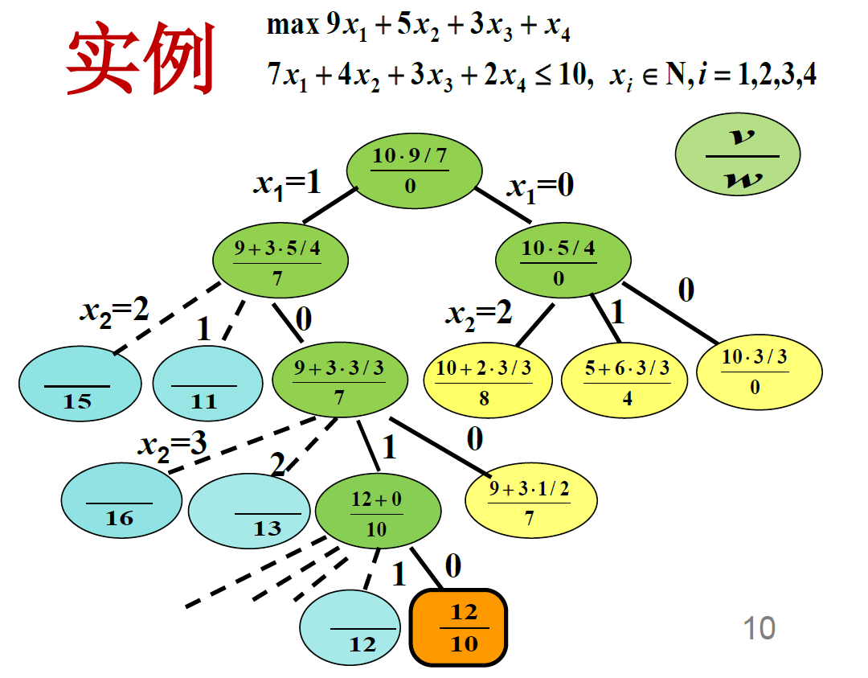
上界
1号物品，相对于10来说
最多能装1个
深度优先
队列式分支限界
优先队列式分支限界
2号物品，最多能装2个
3号物品，最多能装3个
不需要再搜索了
4号物品，最多能装5个
对极大化问题父结点代价不小于子结点的代价(极小化问题相反)
Notes:
黄色表示达不到最优解，没必要继续搜索，蓝色表示不可行解，棕色为最好的解

Slide 14
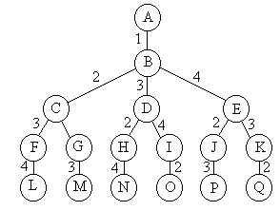
The salesman problem
队列式分支限界法（FIFO）
结点B作为初始扩展结点，活结点队列为空，其儿子结点C, D, E均为可行结点，它们被加入到活结点队列中，并舍去当前结点B。
C为下一个扩展结点，以此生成F和G，加入到队列中，然后D和E分别作为扩展结点，将其儿子结点，F，G，H，I，J和K依次放入扩展结点。
F为下一个扩展结点。。。。。。。
30
1
2
5
6
10
4
3
4
20

Slide 15
The salesman problem
优先队列式分支限界法
极小堆来存储活结点表，其优先级是结点的当前费用。
算法还是从结点B和空优先队列开始，结点B扩展，三个子儿子C D和E依次放入队列中，E是堆中具有最小当前费用（4）的结点，所以处在堆顶位置，其儿子结点J和K被插入到当前堆中，其费用分别是14和24
下一个，堆顶的元素为D，它成为下一个扩展结点，两个儿子H和I，加入到堆中，此时堆中还有元素，C，H，I，J，K，在这些结点中，H具有最小费用，成为下一个扩展结点，。。。。。
30
1
2
5
6
10
4
3
4
20

Slide 16
The salesman problem
可用限界函数在搜索中裁剪子树：
（1）当前剪枝函数，是当前结点扩展后得到的最小费用的下界，如果在当前扩展结点处，这个下界不比当前最优值更小，则剪去以该结点为根的子树。
（2）另一方面，可以每个结点的下界作为优先级，依非减序从活结点优先队列中抽取下一个扩展结点。

Slide 17
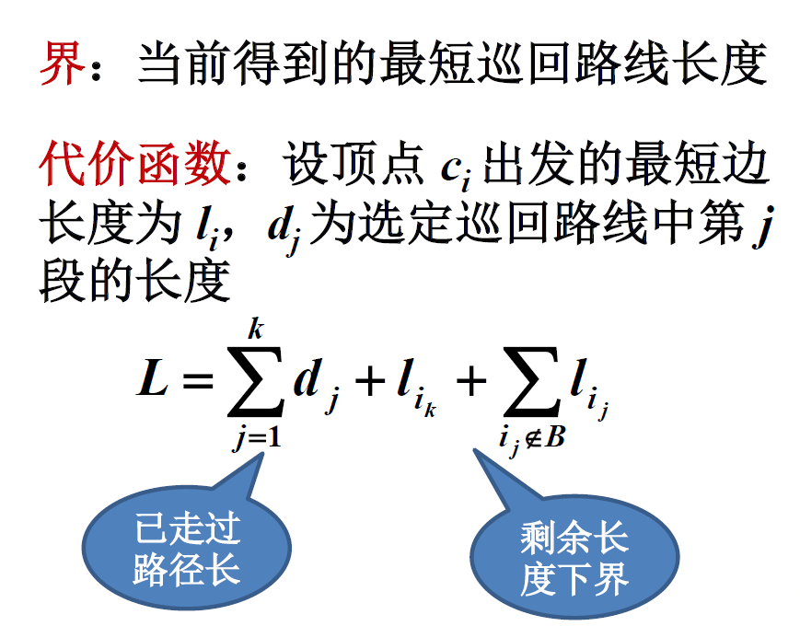
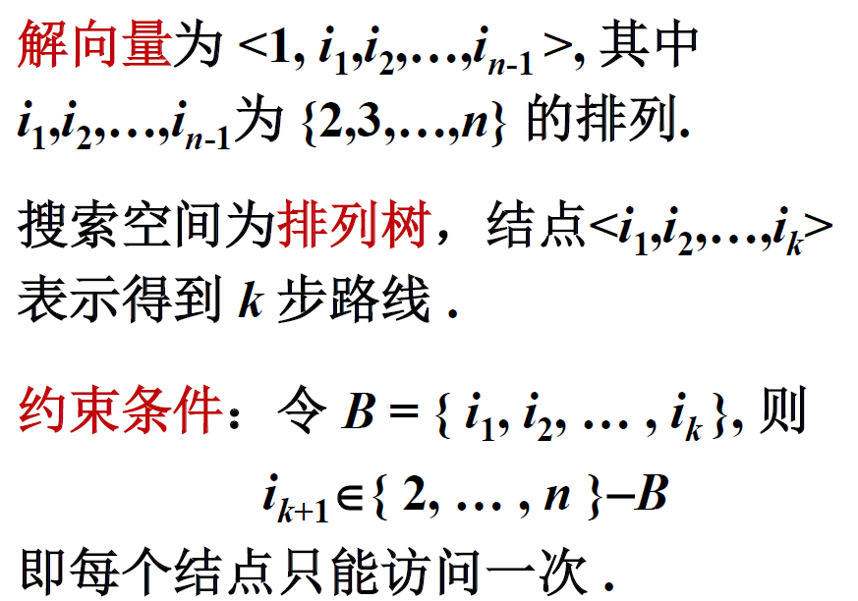
第k个城市到第k+1个城市的最小边长

Slide 18
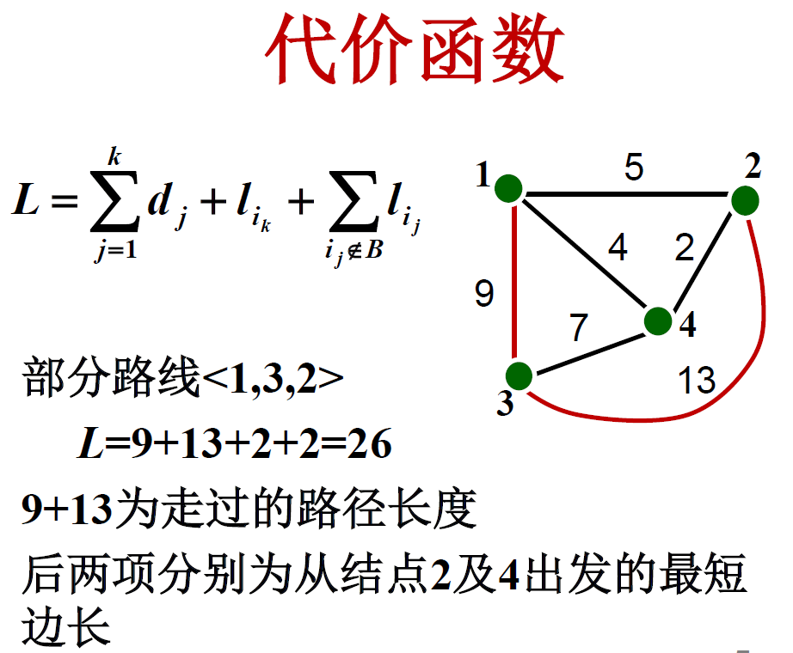

Slide 19
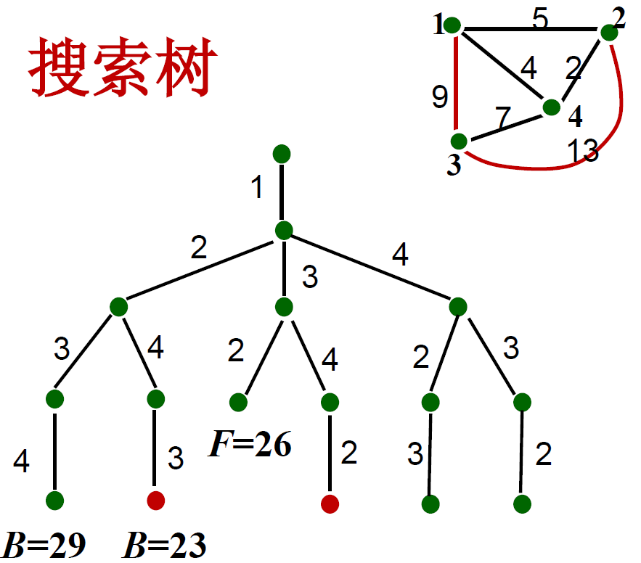
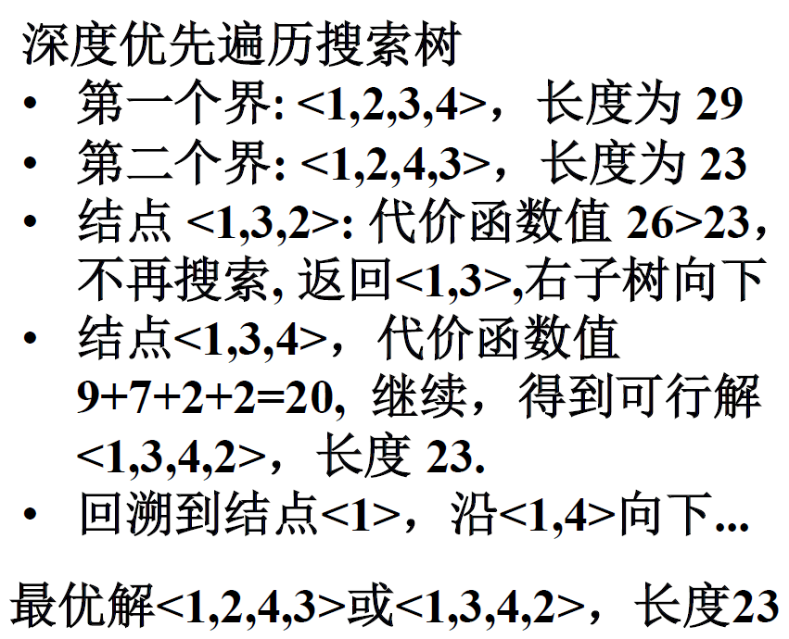

Slide 20
Branch and bound searches the solution tree using:
breadth-first or
least-cost (max-benefit) first
For each node, a bounding function estimates its possible value.
The node with the extreme value (max or min) is chosen next.
This keeps adjusting the search direction to find a solution quickly.
估算

Slide 21
Define a reasonable bounding function and set the target’s bounds [down, up].
Search the solution tree using breadth-first or least-cost (max-benefit) first.
At a branch node, expand all child nodes and estimate their possible values.
If a child’s estimated value is outside [down, up], discard it. Otherwise, add it to the pending node list.
From the list, pick the node with the extreme value as the next expansion node.
Repeat until the optimal solution is found.

Slide 22
How to determine the appropriate bound function. (Hint: easy to compute, reduced search space, no loss of solution)
How to organize the table of nodes to be processed. (Hint: it can be stored as a queue.)
How to determine the components of the optimal solution. (Hint: process nodes in the solution tree in a non-linear order, must store path information during the search.)

Slide 23
Branch and bound and backtracking are both brute-force exhaustive methods. In the worst case, their time complexity is exponential (since they may traverse an exponential-sized solution tree).
However, unlike backtracking, branch and bound:
Expands upper-level nodes first.
Uses a bounding function to enable large-scale pruning.
Continuously adjusts the search direction to prioritize the most promising subtree.
Therefore, with a good node expansion order and a well-designed bounding function, branch and bound can find a solution quickly in practice.
指数级的
遍历
优先处理

Slide 24
Branch and bound's higher efficiency comes at a cost, making algorithm design more complex:
Better bounding functions take more time to compute. Finding a good one often requires extensive experimentation for each problem instance.
Jumping node processing means that when an optimal leaf is found, we must reconstruct the solution path. This requires storing the path from root to node for each expanded node, or building a search tree — making design more complex.
Managing the pending node list (e.g., quickly finding extreme values) requires large storage.
In the worst case, space complexity is exponential.
大量的
指数级的

