Slide 1
Backtracking

Slide 2
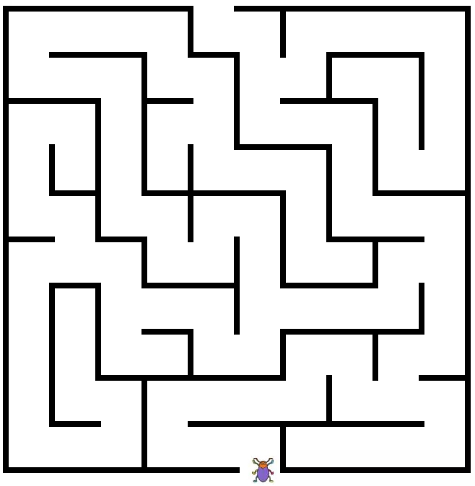
Backtracking

Slide 3
Backtracking
A few examples understand the backtracking framework
Understand the depth-first search strategy of backtracking
Master the algorithmic framework of using backtracking method to solve problems
(1) Recursive backtracking
(2) Iterative backtracking
(3) Framework of subset tree algorithm
(4) Permutation tree algorithm framework
排列

Slide 4
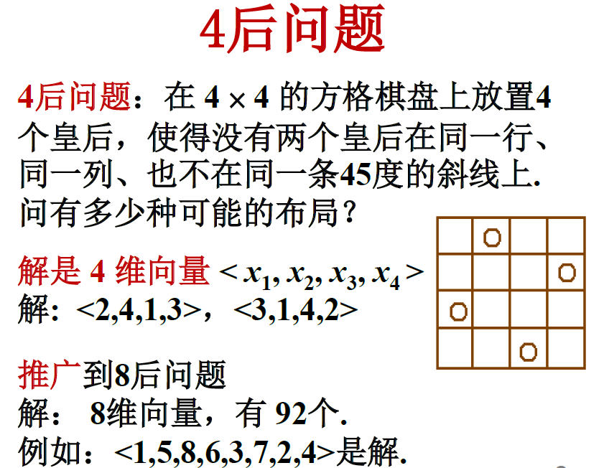
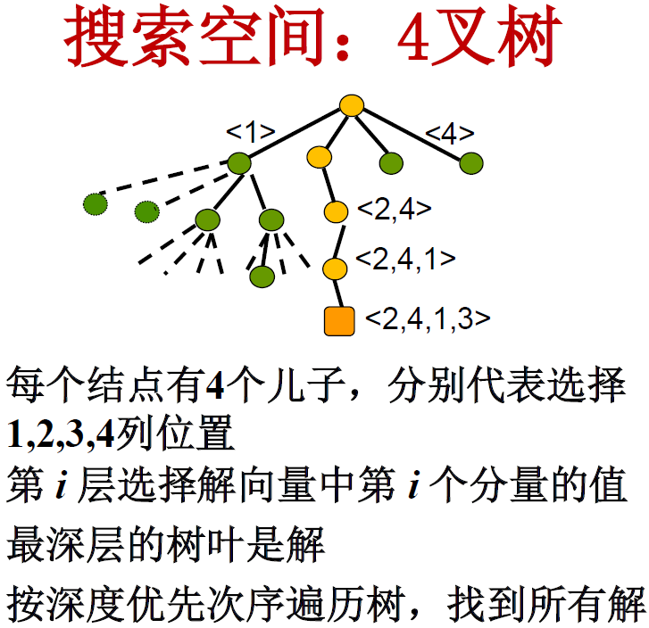
N queens problem
The search space is：n叉树

Slide 5
0-1 Knapsack problem
Problem：有n种物品，每种物品只有1个. 第i种物品价值为vi , 重量为wi, i=1,2,…, n. 问如何选择放入背包的物品，使得总重量不超过B, 而价值达到最大？
Instance：
V={12,11,9,8}, W={8,6,4,3}, B=13
The optimal solution：
<0,1,1,1>，价值: 28，重量: 13

Slide 6
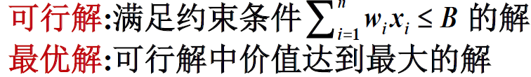
0-1 Knapsack problem
Solution：n维0-1向量<x1,x2,...,xn>，
Node：<x1,x2,...,xk>（部分向量)
Search space：0-1取值的二叉树, 称为子集树，有2^{n}片树叶.

Slide 7
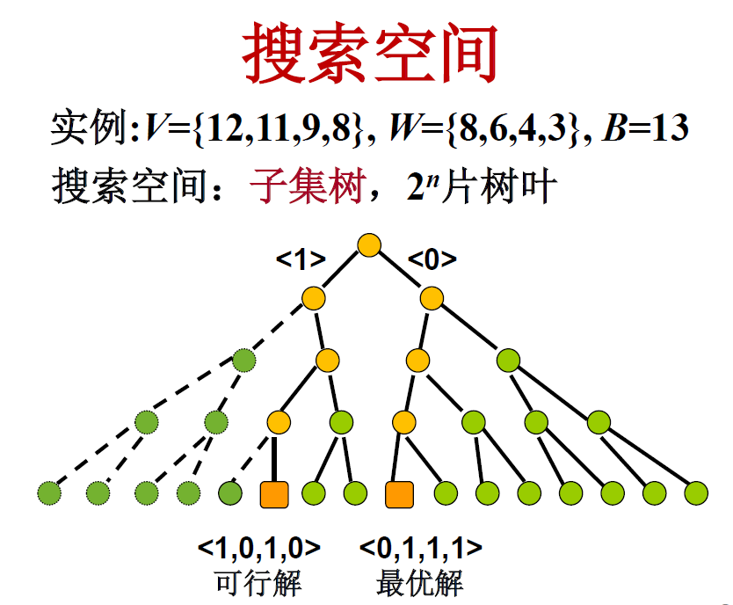
0-1 Knapsack problem
虚线表示不做搜索
The search space is：子集树

Slide 8
0-1 Knapsack problem
Input：
V={12,11,9,8}, W={8,6,4,3}, B=13
Two feasible solutions：
<0,1,1,1>, 选入物品2,3,4，价值为28，重量为13
<1,0,1,0>，选入物品1,3，价值为21，重量为12
The optimal solution：<0,1,1,1>

Slide 9

Traveling salesman problem
Problem：有n个城市，已知任两个城市之间的距离，求一条每个城市恰好经过一次的回路，使得总长度最小.
Modeling：城市集C={c1,c2,...,cn},距离 d(ci,cj)=d(cj,ci)∈Z+,1≤i<j≤n
求：1,2,...,n的排列k1,k2,...,kn使得
解是一个排列，具有有序的特征

Slide 10
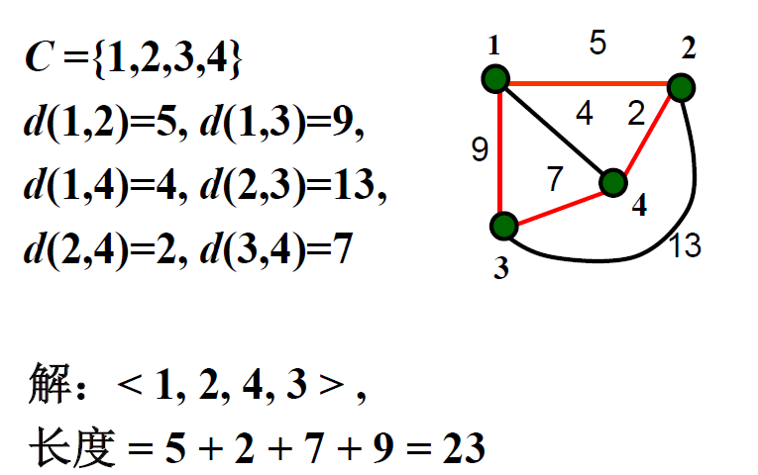
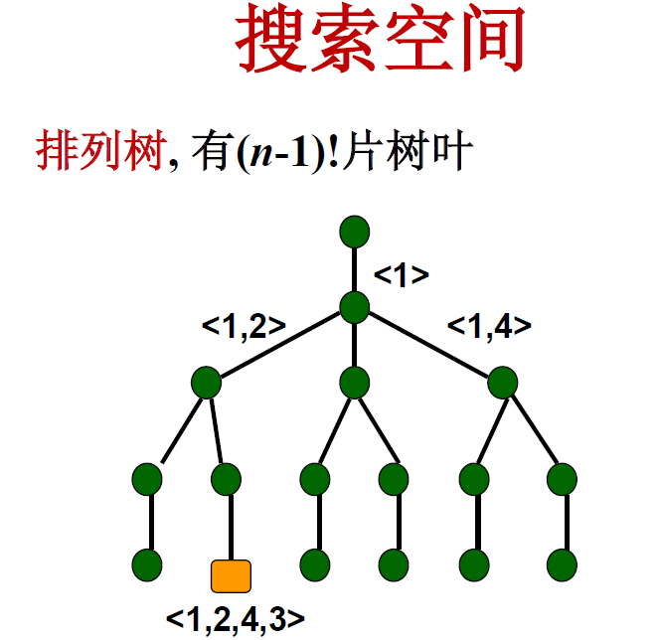
3分叉
2分叉
1分叉
The search space is：排列树

Slide 11
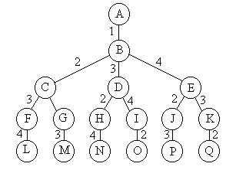
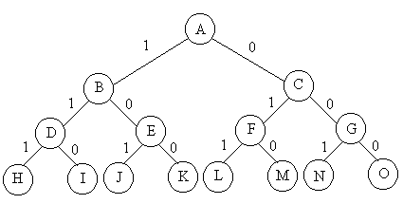
子集树与排列树
遍历子集树需O(2^{n})计算时间
遍历排列树需要O(n!)计算时间

Slide 12
Summary
Examples of backtracking algorithms：n后问题，0-1背包问题，货郎问题
Solution：向量
Search space：树，可能是n叉树、子集树、排列树等等，树的结点对应于部分向量，可行解在叶结点
Search method：深度优先, 宽度优先, ...
跳越式遍历搜索树，找到解

Slide 13
Backtracking is used when:
Finding all solutions, or
Finding the best solution under constraints.
Basic idea:
A well-organized exhaustive search.
Avoids unnecessary searching.
Best for:
Problems with large combinations.

Slide 14
Backtracking search process:
Uses depth-first strategy in the solution space tree.
Starts from the root.
At any node:
Check if it may contain a solution.
  If NO → skip its subtree and backtrack to ancestor.
  If YES → go deeper (depth-first).

Slide 15
问题的解向量：回溯法希望一个问题的解能够表示成一个n元式(x1,x2,…,xn)的形式。
显约束：对分量xi的取值限定。
隐约束：为满足问题的解而对不同分量之间施加的约束。
解空间：对于问题的一个实例，解向量满足显式约束条件的所有多元组，构成了该实例的一个解空间。

Slide 16
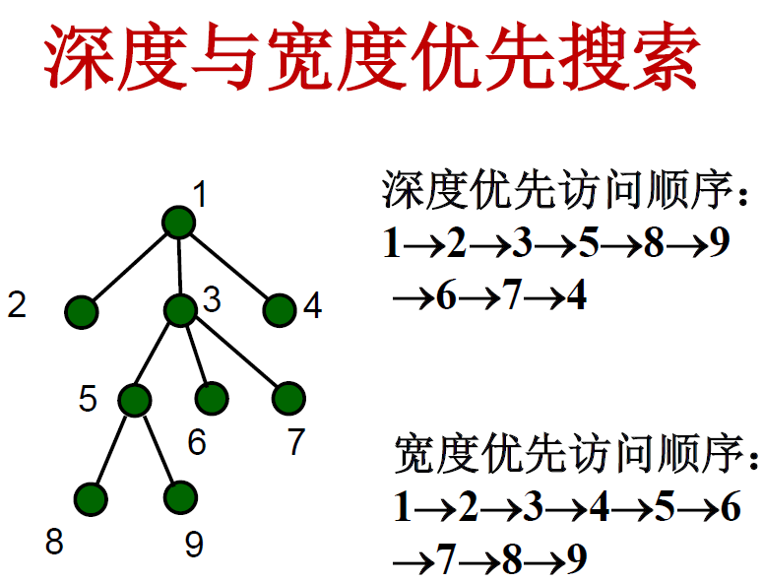
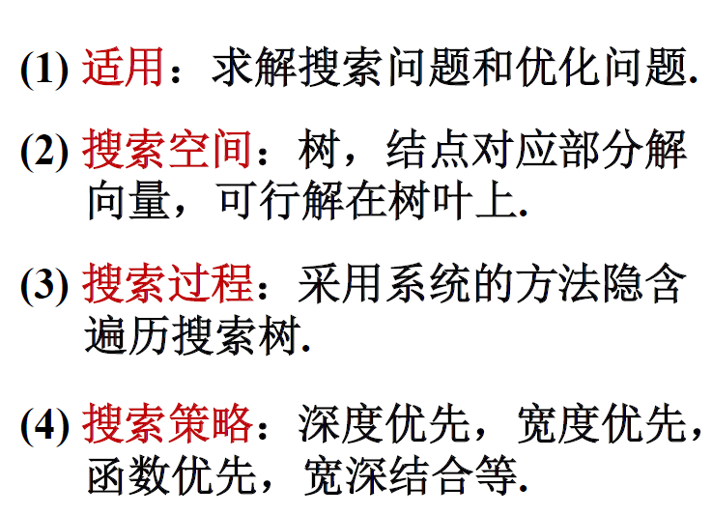
Depth-First-Search
Breadth-First-Search

Slide 17
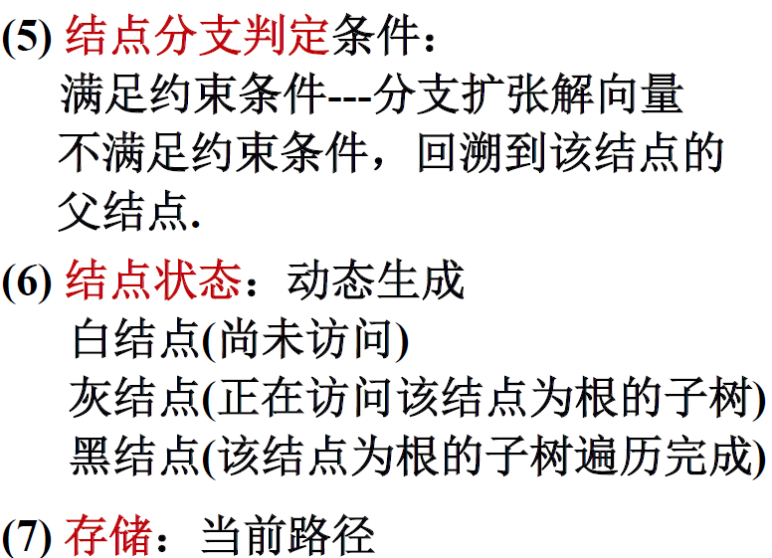
扩展结点:一个正在产生子结点的结点称为扩展结点
活结点:一个自身已生成但其子结点还没有全部生成的结点称做活结点
死结点:一个所有子结点已经产生的结点称做死结点

Slide 18
Breadth-First Search (BFS) processes vertices level by level — closest vertices first, farthest last.
Steps:
Choose a start vertex, color it gray; all others are white.
Put the start vertex into a queue.
While queue is not empty:
  Take a vertex from the front of the queue.
  Find all its neighbors: If a neighbor is white (not yet found), add it to the rear of the queue and color it gray.
  Color the current vertex black (fully processed).
Color meanings:
White: not discovered yet.
Gray: discovered and in the queue.
Black: processed (removed from queue).

Slide 19
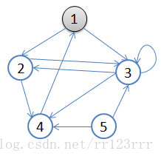
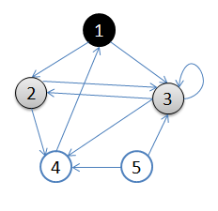
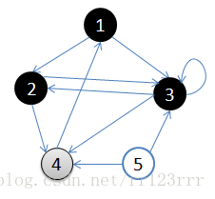
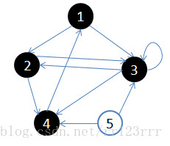
初始状态，从顶点1开始，队列={1}
访问1的邻接顶点，1出队变黑，2,3入队，队列={2,3}
访问2的邻接顶点，2出队，4入队，队列={3,4}
访问3的邻接顶点，3出队，队列={4}
访问4的邻接顶点，4出队，队列={空}
顶点5对于1来说不可达。

Slide 20
Depth-First Search (DFS) traversal
Steps:
Visit the starting vertex v.
Recursively (or using a stack) visit each unvisited neighbor of v — go as deep as possible along each path.
If there are still unvisited vertices in the graph, start DFS again from one of them.
Repeat until all vertices have been visited.

Slide 21
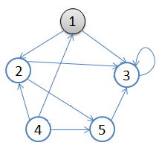
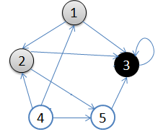
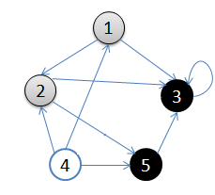
从v = 顶点1开始出发，先访问顶点1
按深度优先搜索递归访问v的某个未被访问的邻接点2，顶点2结束后，应该访问3或5中的某一个，这里为顶点3，此时顶点3不再有出路，因此回溯到顶点2，再访问顶点2的另一个邻接点5，由于顶点5的唯一一条边的弧头为3，已经访问了，所以此时继续回溯到顶点1，找顶点1的其他邻接点。

Slide 22
Thinking: What is the problem of weighted directed connected graph in greedy algorithms? What is the problem with weighted undirected connected graphs? What search methods are used?
Dijkstra algorithm, Prim algorithm and Kruskal algorithm all adopt breadth first search strategy.

Slide 23
Depth-first state generation
Generate a child C from node R, then expand C first.
After finishing C’s subtree, go back to R and generate its next child.
Breadth-first state generation
A node stays as the expansion node until it becomes dead.
Backtracking
Uses a bounding function to kill nodes that cannot lead to a solution.
This reduces computation.
= Depth-first generation + bounding function.

Slide 24
The basic idea of N queens problem
（1）最开始，根节点是唯一的活结点，也是当前的扩展结点；（可以沿着纵深方向延伸至，B, C, D, E）
（2）深度搜索，先延伸到B位置，此时，A和B均为活结点，B为当前的扩展结点(可扩展至F,G,H,I)。
（3）查找到F时，若是可行解，则继续往下搜索，若不是可行解，则剪去子树，回到B，再判断G，H，I。
（4）当以B为父结点的子树全部判断完后，此时，B结点变为死结点，回到A结点，再进入C接着判断。
A
B
C
D
E
F
G
H
I
K
J
当所有的第K层的结点的子树均搜索过，则回到其K-1层的父结点，以该父结点为根的所有的子树均搜索结束，则回到第K-2层父结点，依次向上搜索，直到K=1时，所有的可行解均可求出。
搜索到该层如第k层时，可扩展结点为4个，需要进行编号，分别遍历，通过判断当前结点是否满足约束和限界条件，进行纵向扩展，若当前结点不满足约束和限界条件，则剪去子树，回到其父结点，其父结点为扩展结点，向其他第K层的结点继续扩展。

Slide 25
Recursive backtracking
显然：递归回溯，是深度优先。
void backtrack (int t)
{
if (t>n) output(x);
else
for (int i=f(n,t);i<=g(n,t);i++) {
x[t]=h(i);
if (constraint(t)&&bound(t)) backtrack(t+1);
}
}
t>n时，算法已经搜索到叶节点；
f()和g()分别表示，当前扩展节点处，未搜索过的子树的起始和终止编号
h(i)表示当前扩展节点处，x[t]的第i个可选值
constraint(t)&&bound(t))分别表示，当前扩展节点处的约束函数和限界函数
不满足剪枝函数，可减去相应的子树，满足，则对下一层继续进行搜索，当t层执行完后，执行t-1层，直到t=1时，所有层均执行完毕。

Slide 26
Iterative backtracking
void iterativeBacktrack ()
{ int t=1;
while (t>0) {
if (f(n,t)<=g(n,t))
for (int i=f(n,t);i<=g(n,t);i++) {
x[t]=h(i);
if (constraint(t)&&bound(t)) {
if (solution(t)) output(x);
else t++;
}
}
else t--;
}
}
solution(t))判断当前扩展结点处，是否已经得到问题的可行解；
constraint(t)：约束函数，不满足则剪去相应的子树；
bound(t)：限界函数，当前扩展结点处的值是否越界，如果越界，则剪去相应的子树。

Slide 27
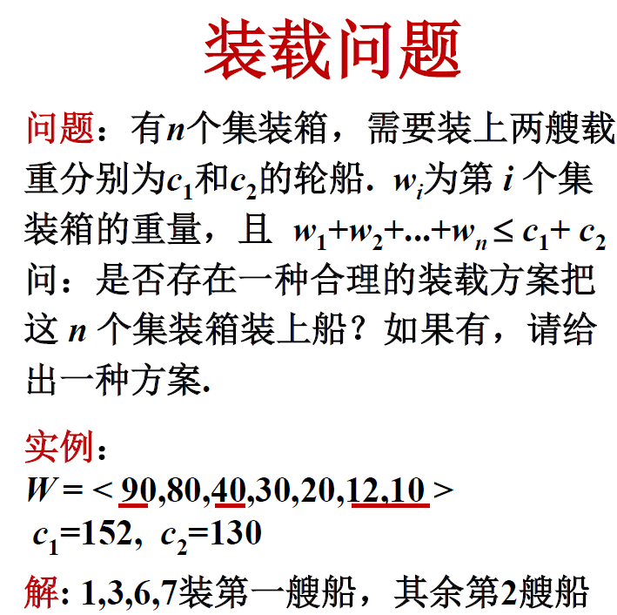
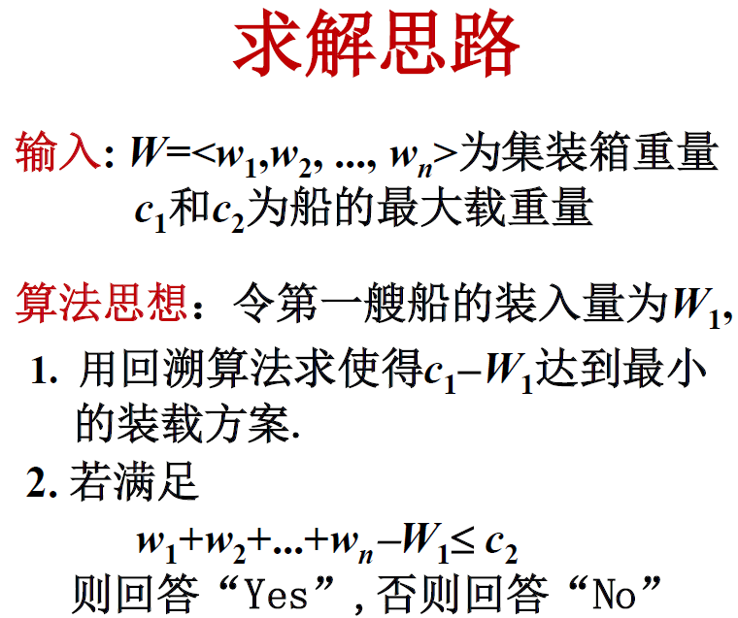

Slide 28
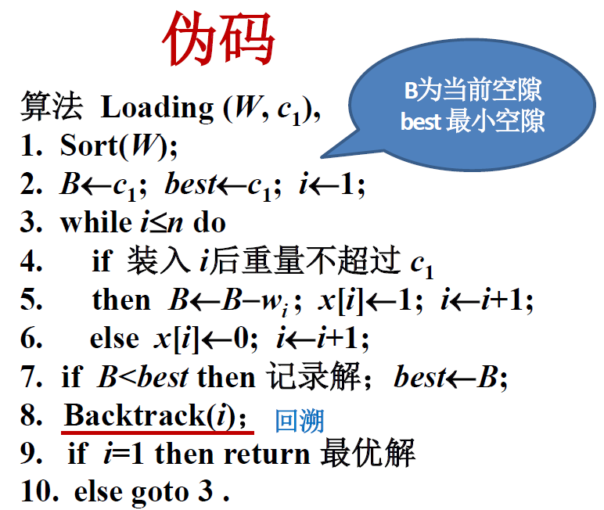
3-6行对第i个物品进行处理
装：x(i) = 1
不装：x(i) =0

Slide 29
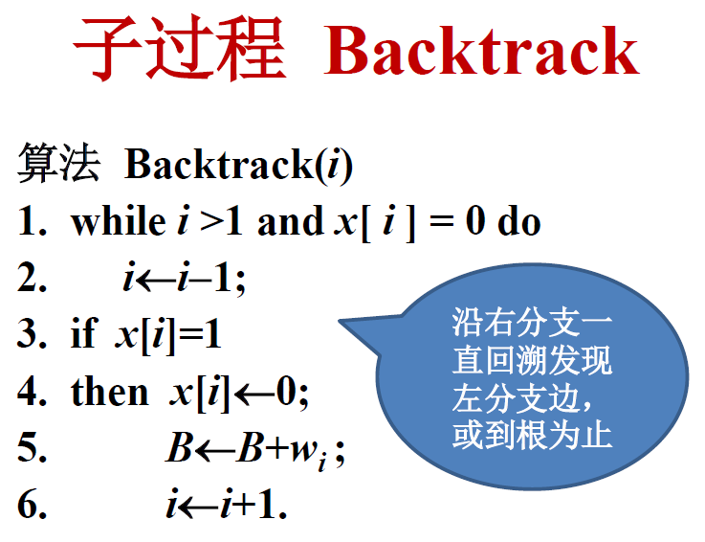
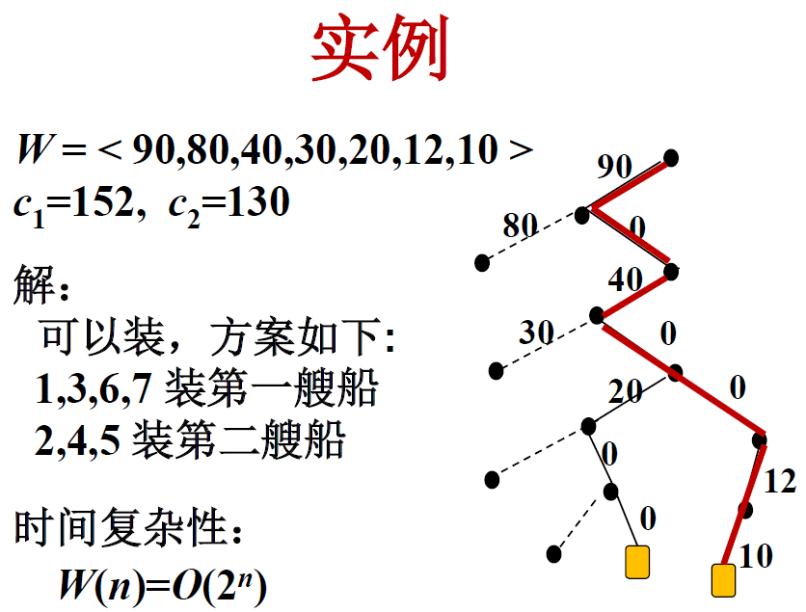
可行解
解更好
依次将树搜索完成

Slide 30
The basic idea of backtracking
(1) To define the solution space of the given problem;
(2) To determine the solution space structure which is easy to search;
(3) Search the solution space in a depth-first manner, and use pruning function to avoid invalid search.
Common pruning functions:
The constraint function is used to cut off the subtree that does not meet the constraint at the extension node.
The bounded function is used to cut out the subtrees that cannot obtain the optimal solution.

Slide 31
Implementation of backtracking algorithm
Recursive implementation, iterative implementation
Loading problem
Problem description
Algorithm pseudo-code
The worst-case is O(2^{n}).

