Slide 1
Recursion and divide-and-conquer strategies

Slide 2
Linear time selection algorithm
Closest point pair problem

Slide 3
Linear time selection algorithm

Slide 4
Chapter 2 Recursion and divide-and-conquer strategy - linear time selection algorithm
Given n elements in a linear ordering set and an integer k, 1≤k≤ n, it is required to find the kth smallest element among the n elements. That is, if the n elements are sorted linearly (ascending), the element in the kth position is the element to be found. When k=1, the smallest element, k=n, and the largest element, k=(n+1)/2, is the median.
Note: The linear set X, n elements, is not already sorted

Slide 5
Chapter 2 Recursion and divide-and-conquer strategy - linear time selection algorithm
Method 1: Sort first, then search. Searching time is O(1).
Method 2: Referring to the quicksort algorithm, decompose a segment continuously, the worst case is O(n²), and the average time is O(n).
(1) The target array is divided into two groups by randomly selecting the pivot using the random quick sort algorithm, in which the elements in the former group are not larger than those in the latter group. Count the number of elements in the previous group j,
(2) If k<=j, look for the kth element in the preceding subarray
(3) If k>j, it is necessary to search in the latter subarray, whose position is k-j.
Worst-case: When looking for the smallest element, always divide at the largest element
T(n) = T(n-1)+O(n)

Slide 6
Chapter 2 Recursion and divide-and-conquer strategy - linear time selection algorithm
Method 3: Improve Quicksort algorithm with O(n) time
If we can find a partition pivot in linear time such that the length of the two subarrays divided by this pivot is at least ε times the length of the original array (0<ε<1 is a positive constant), then we can complete the selection task in O(n) time in the worst case.
For example, if ε=9/10, the length of the subarray produced by the recursive call of the algorithm is shortened by at least 1/10. So, in the worst case, the computation time T(n) required by the algorithm satisfies the recurrence T(n)≤T(9n/10)+O(n). So T(n)=O(n).

Slide 7
Chapter 2 Recursion and divide-and-conquer strategy - linear time selection algorithm
Steps:
Divide n input elements into ⎡n/5⎤ groups of 5 elements, and there is only one group that is not 5 elements. With any sorting algorithm, the elements in each group are sorted, and the median of each group is taken out, a total of ⎡n/5⎤.
Recursively call SELECT to find the median of the ⎡n/5⎤ elements. If ⎡n/5⎤ is an even number, we find the larger of its two medians. Use this element as the pivot for partitioning.

Slide 8
Chapter 2 Recursion and divide-and-conquer strategy - linear time selection algorithm
Let all the elements be different. In this case, the found base x is at least larger than 3(n−5)/10 elements, since in each group two elements are less than the median of the group, and in turn (n−5)/10 of the n/5 medians are less than the base x. Similarly, the base x is at least less than 3(n-5)/10 elements. When n≥75, 3(n-5)/10≥n/4, so the length of the two subarrays divided by this pivot is shortened by at least 1/4.

Slide 9
Chapter 2 Recursion and divide-and-conquer strategy - linear time selection algorithm
n elements
⎡⎤：round up to an integer
⎣⎦：round down
⎡n/5⎤ groups，a total of ⎡n/5⎤ medians
x
The median of ⎡n/5⎤ medians is the base element X
The median less than x is about （⎣n/5⎦-1）/2, and rounding down ensures that the formula is strictly true, and that each median represents at least 5 elements in each group. Within each group there are at least three elements (including median itself) is less than x, get: 3 ⎣(n-5)/10⎦ elements less than x; Similarly, there are at least 3 ⎣(n-5)/10⎦ element greater than x

Slide 10
Chapter 2 Recursion and divide-and-conquer strategy - linear time selection algorithm
At least 3 ⎣(n-5)/10⎦ elements less than x;
At least 3 ⎣(n-5)/10⎦ element greater than x
Then：when n≥75， 3 ⎣(n-5)/10⎦ ≥n/4
At least n/4 elements are less than x;
At least n/4 elements greater than x
The problem is to find the kth minimum:
When the kth minimum value is greater than x, it is searched on the right side of x. Since the minimum value less than x is n/4 (that is, there are at least n/4 values on the left side), the right side is at most 3n/4.
When the kth minimum value is less than x, it is searched on the left side of x. Since the minimum value greater than x is n/4 (that is, there are at least n/4 values on the right side), the left side is at most 3n/4.

Slide 11
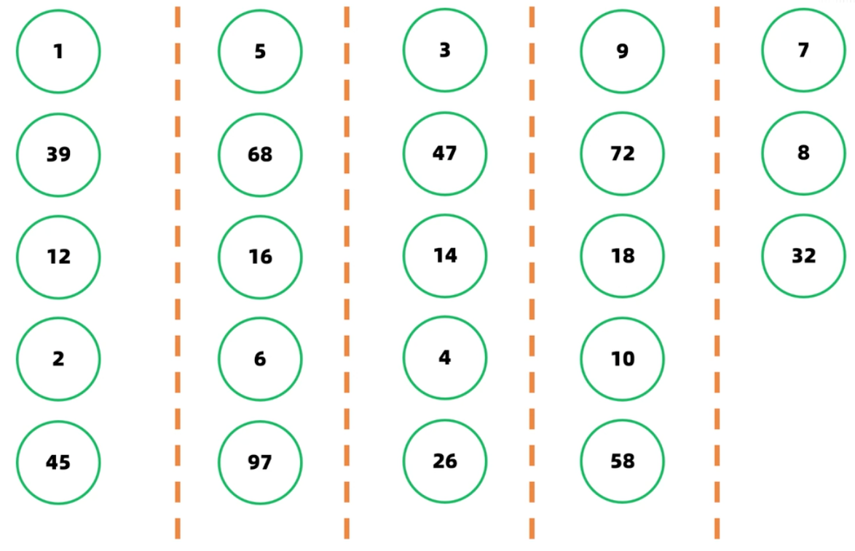
Chapter 2 Recursion and divide-and-conquer strategy - linear time selection algorithm

Slide 12
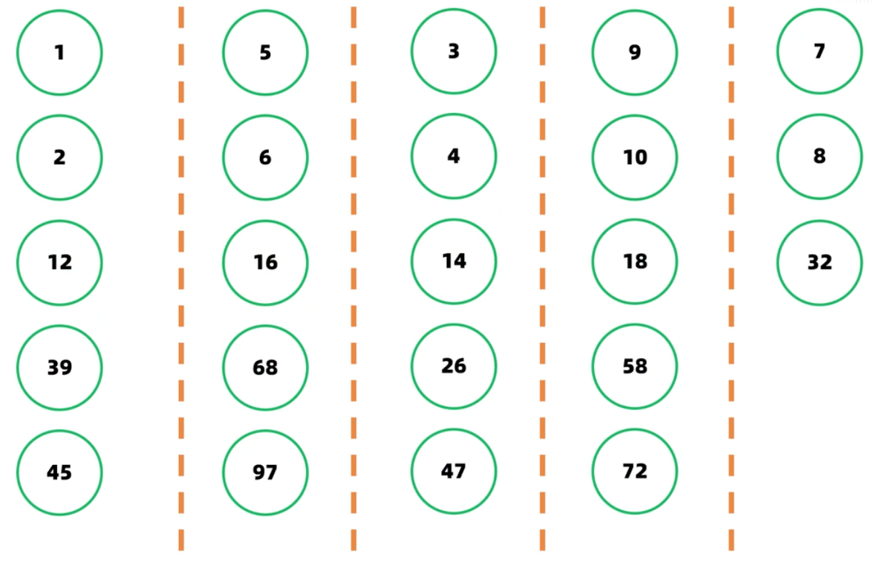
Chapter 2 Recursion and divide-and-conquer strategy - linear time selection algorithm

Slide 13
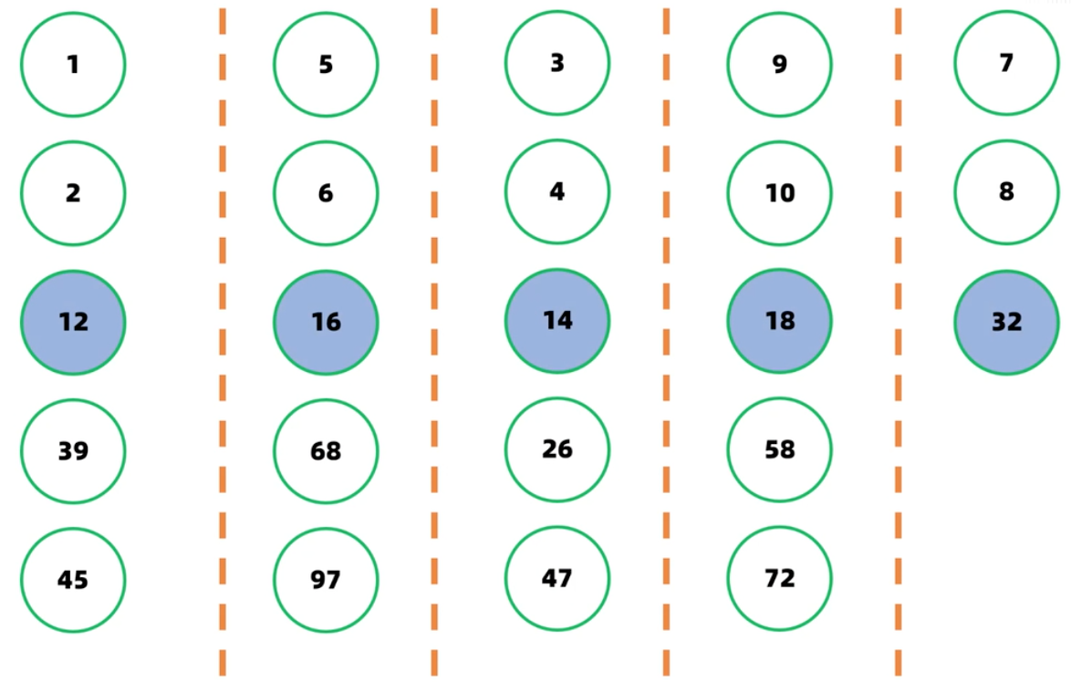
Chapter 2 Recursion and divide-and-conquer strategy - linear time selection algorithm

Slide 14
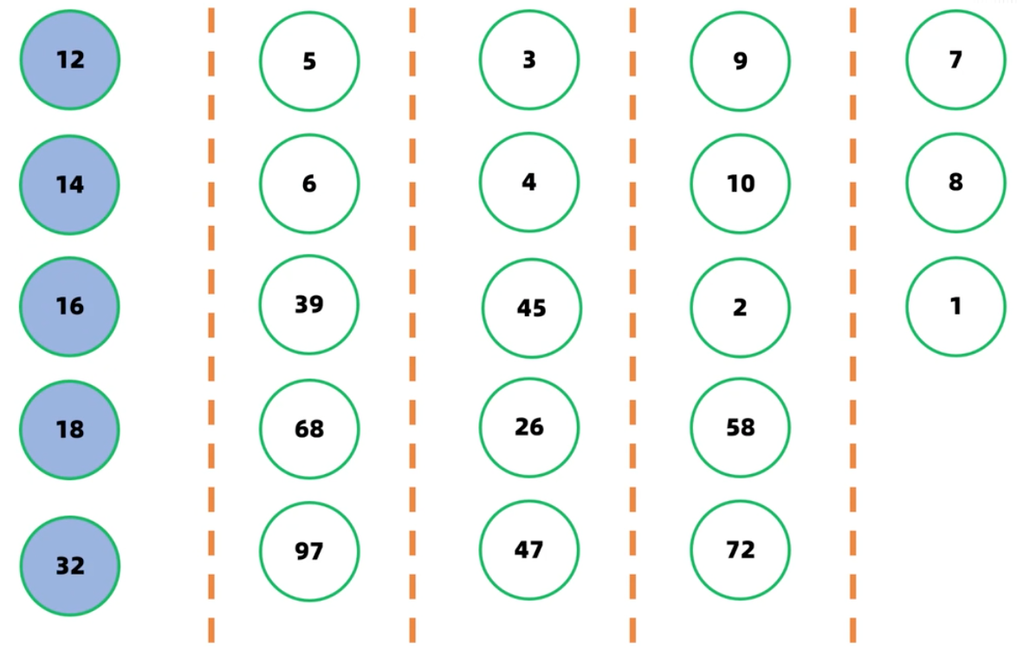
Chapter 2 Recursion and divide-and-conquer strategy - linear time selection algorithm

Slide 15
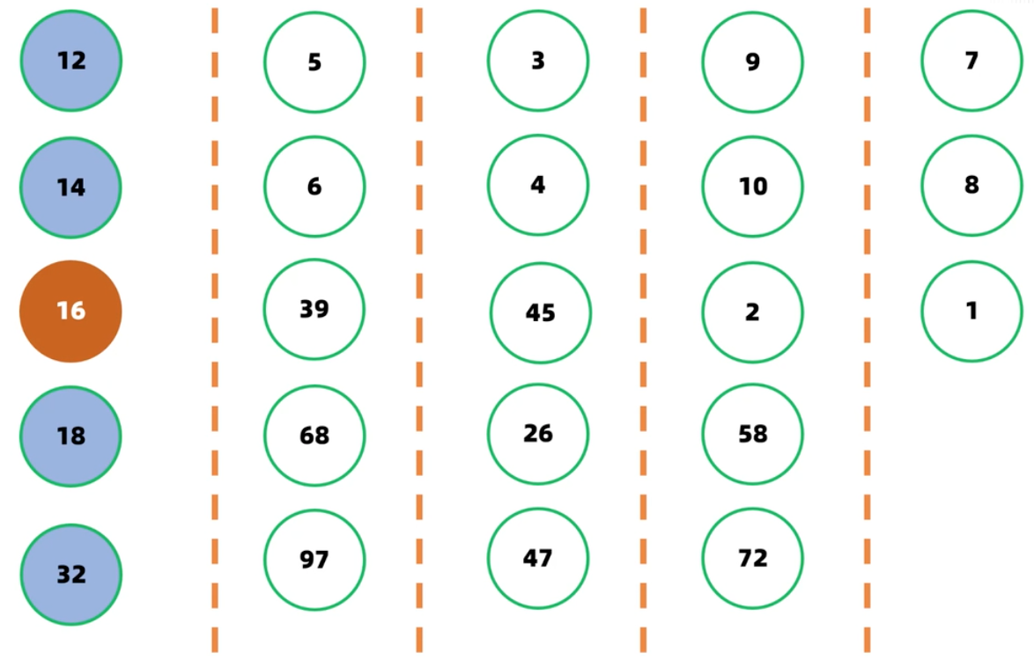
Chapter 2 Recursion and divide-and-conquer strategy - linear time selection algorithm

Slide 16
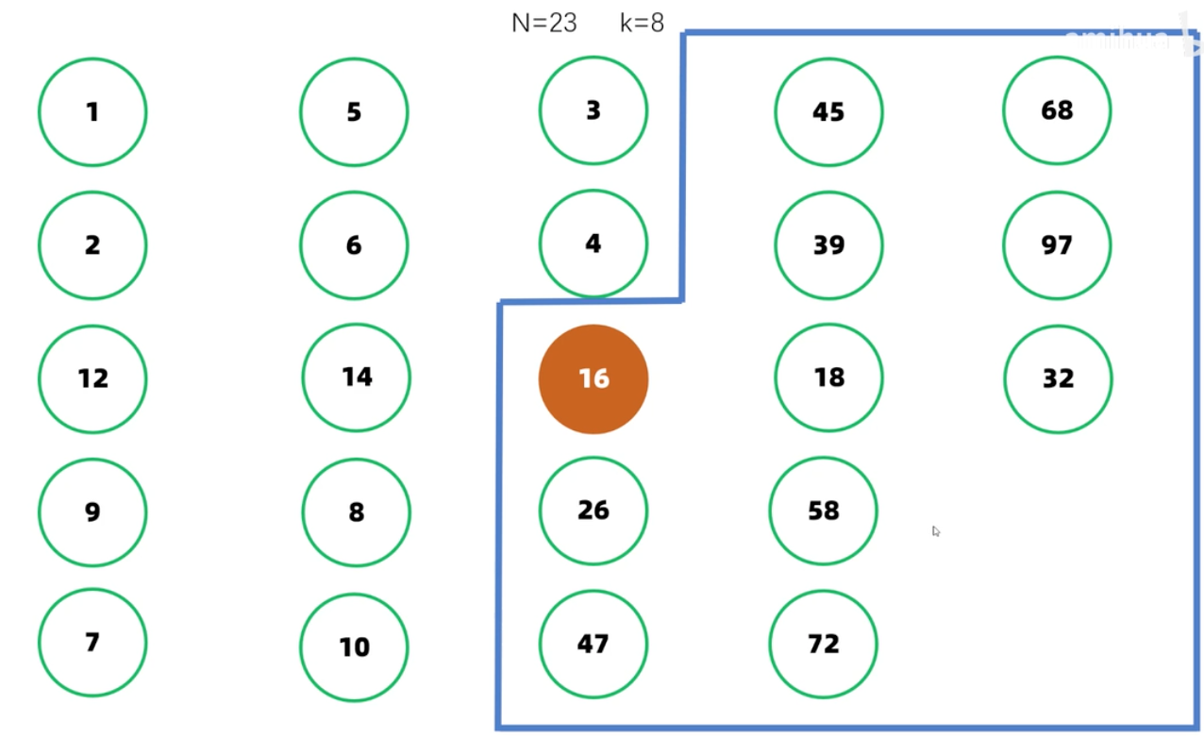
Chapter 2 Recursion and divide-and-conquer strategy - linear time selection algorithm

Slide 17
Chapter 2 Recursion and divide-and-conquer strategy - linear time selection algorithm
n = r-p+1 is the length of the input array
Type Select(Type a[], int p, int r, int k)
{
if (r-p<75) {
用某个简单排序算法对数组a[p:r]排序;
return a[p+k-1];
}
for ( int i = 0; i<=(r-p-4)/5; i++ ){
将a[p+5*i]至a[p+5*i+4]的第3小元素与a[p+i]交换位置;
//找中位数的中位数，r-p-4即上面所说的n-5
Type x = Select(a, p, p+(r-p-4)/5, (r-p-4)/10);
int i=Partition(a,p,r, x);
j=i-p+1;
if (k<=j) return Select(a,p,i,k);
else return Select(a,i+1,r,k-j);
}
}
n >=75 call recursion；n<75，algrithm SELECT takes no more than constant C1
Select for loop, n/5 times, each time takes O(1) time, total O(n) time.
After finding the median x, the algorithm takes x as the partition pivot and calls the function Partition to divide array a[p: r], which takes O(n) time
Complexity analysis
T(n)=O(n)

Slide 18
Closest point pair problem

Slide 19
Chapter 2 Recursion and divide-and-conquer Strategies - the Closest point-pair problem
Given a set S of n points on the plane, find a pair of points such that the distance between the pairs of points is the smallest among all pairs of points composed of n points.
To make the problem easier to understand and analyze, let's consider the one-dimensional case. In this case, the n points in S degenerate to n real numbers on the X-axis x1,x2... , xn. The closest pair of points is the two real numbers with the smallest difference among the N real numbers.

Slide 20
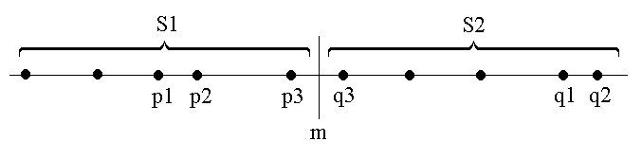
Chapter 2 Recursion and divide-and-conquer Strategies - the Closest point-pair problem
Suppose we use some point m on the X-axis to divide S into two subsets S1 and S2. Based on the idea of balanced subproblems, we use the median of coordinates of each point in S as the segmentation point.
Recursively find S1 and S2 on its closest point pair {p1, p2} and {q1, q2}, and set d=min{|p1-p2|,|q1-q2|}, the closest point in the S is either {p1, p2}, {q1, q2}, or {p3, q3}, p3∈S1 and q3∈S2.
Can we find p3,q3 in linear time?

Slide 21
Chapter 2 Recursion and divide-and-conquer Strategies - the Closest point-pair problem
if the closest point pair in S is {p3,q3}，that is |p3-q3|<d，then the distence between m and p3, q3 does not exceed d，that is p3∈(m-d,m]，q3∈(m,m+d].
Since every semi-closed interval of length d in S1 contains at most one point (otherwise there must be two points less than d), and m is the split point between S1 and S2, (m-d,m] contains at most one point in S.As can be seen from the figure, if there is a point in S in (m-d,m], then this point is the largest point in S1.

Slide 22
Chapter 2 Recursion and divide-and-conquer Strategies - the Closest point-pair problem
Therefore, we can find all points in the interval (m-d,m] and (m,m+d], namely p3 and q3, in linear time. So we can merge the solution to S1 and the solution to S2 into the solution to S in linear time.

Slide 23
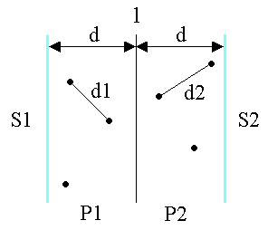
Chapter 2 Recursion and divide-and-conquer Strategies - the Closest point-pair problem
Let's consider the two-dimensional case:
A vertical line l:x=m is chosen as the dividing line. Where m is the median of x coordinates of each point in S. This splits S into S1 and S2.
Recursively find the minimum distance d1 and d2 on S1 and S2, and set d=min{d1,d2}, the closest point pair in S is either d or less than d (some {p,q}, where p∈P1 and q∈P2).

Slide 24
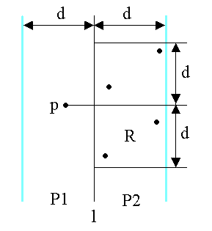
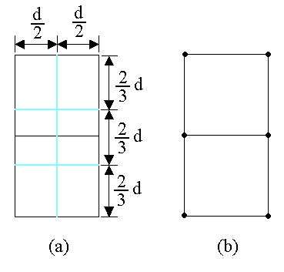
Chapter 2 Recursion and divide-and-conquer Strategies - the Closest point-pair problem
Considering any point p in P1, if it forms the candidate of the closest point pair with point q in P2, then distance(p, q)<d must be necessary. A point in P2 that satisfies this condition must lie in a d×2d rectangle R

Slide 25
Chapter 2 Recursion and divide-and-conquer Strategies - the Closest point-pair problem
From the meaning of d, we know that any two points in S in P2 are not less than d. It follows that there are at most 6 points in S in rectangle R. Thus, at most 6×n/2=3n candidates need to be checked in the merge step of the divide-and-conquer method

Slide 26
Chapter 2 Recursion and divide-and-conquer Strategies - the Closest point-pair problem
Why six points?
Take some point p on the left as an example, and the search area on the right is d*2d. In the search area on the right, let the candidate point to be searched be qi. The question is, looking for the maximum value of i, which is the right search area, how many candidate points qi exist at most?
d：The definition is the shortest distance
d = min{d1, d2}

Slide 27
Chapter 2 Recursion and divide-and-conquer Strategies - the Closest point-pair problem
Why six points?
The solution meets the following conditions:
(1) |p - q_{i}| ≤ d;The right search area was identified;
(2) On the right side of the search area, any two points meet|q_{i} - q_{j}| ≥ d；If and only if |q_{i} - q_{j}| = d, most candidate in search area.
In the search area, the point meets |q_{i} - q_{j}| = d, up to 6, if to 7 points, at least in the distance of two points less than d, does not meet the conditions (2).
Notice, there's a maximum of six points, it could be five, four or even less.
d：The definition is the shortest distance
d = min{d1, d2}

Slide 28
Chapter 2 Recursion and divide-and-conquer Strategies - the Closest point-pair problem
Pigeonhole Principle:
Principle 1: Divide n+1 elements into n classes. No matter how they are divided, there must be two or more elements in one class.
Principle 2: Put m elements into n sets (n<m, there must be a set that has at least k elements. Where k= ⎡m/n⎤ (⎡⎤ indicates rounding up).)

Slide 29
Chapter 2 Recursion and divide-and-conquer Strategies - the Closest point-pair problem
Proving:
Divide the 2d sides of the rectangle R into 3 equal parts, and its length is divided into two equal sides of d. From this, 6×(d/2)×(2d/3) rectangles are derived. If there are more than 6 points in S in the rectangle R, it is easy to know by the pigeonhole principle that there are more than 2 points in S in at least one small rectangle (d/2)×(2d/3).
Let u,v be two points in the same small rectangle, then distance(u,v)<d is in conflict with the meaning of d.

Slide 30
Chapter 2 Recursion and divide-and-conquer Strategies - the Closest point-pair problem
1. How do you get d1 and d2? (One-dimensional for example)
By recursion, as shown in the figure on the right, until there is only a two-point subproblem, then the solutions of the subproblem are merged continuously until the original problem is found, so the recursion method can be used to solve it.

Slide 31
Chapter 2 Recursion and divide-and-conquer Strategies - the Closest point-pair problem
2. How to get point p on the left?
p on the left is not unique, which is different from the one-dimensional case. All points in the range of (m-d, m] can be p. In the extreme case, if there are n/2 points in P1, then there are 3n points on the right.

Slide 32
Chapter 2 Recursion and divide-and-conquer Strategies - the Closest point-pair problem
To know exactly which 6 points to check, we can project p and all of the S2 points in P2 onto the vertical line l.
Since the midpoint of the candidates in S2 that can form the closest pair of points with p must be in the rectangle R, so their projection onto line l is less than d away from the projection of p onto l. According to the above analysis, there are only 6 such projection points at most.

Slide 33
Chapter 2 Recursion and divide-and-conquer Strategies - the Closest point-pair problem
Therefore, if all the points in S in P1 and P2 are sorted according to their Y coordinates, then all the points in P1 and the sorted point column can be scanned once to find out all the candidates closest to the point pair.
For each point in P1, check at most 6 consecutive points in order in P2.

Slide 34
Chapter 2 Recursion and divide-and-conquer Strategies - the Closest point-pair problem
4、设P1是S1中距垂直分割线l的距离在dm之内的所有点组成的集合；
P2是S2中距分割线l的距离在dm之内所有点组成的集合；
将P1和P2中点依其y坐标值排序；
并设X和Y是相应的已排好序的点列；
5、通过扫描X以及对于X中每个点检查Y中与其距离在dm之内的所有点(最多6个)可以完成合并；
当X中的扫描指针逐次向上移动时，Y中的扫描指针可在宽为2dm的区间内移动；
设dl是按这种扫描方式找到的点对间的最小距离；
6、d=min(dm,dl);
return d;}
double cpair2(S)
{
n=|S|;
if (n < 2) return ;
1、m=S中各点x间坐标的中位数;
构造S1和S2；
S1={p∈S|x(p)<=m},
S2={p∈S|x(p)>m}
2、d1=cpair2(S1);
d2=cpair2(S2);
3、dm=min(d1,d2);
Complexity analysis
T(n)=O(nlogn)

Slide 35
Summary of recursion and divide and conquer

Slide 36
Characteristics of divide-and-conquer problem-solving
The problem can be easily solved if it is scaled down to a certain extent;
The problem can be decomposed into several smaller identical problems, that is, the problem has the property of optimal substructure.
The solutions of the subproblems decomposed by this problem can be merged into the solution of this problem.
Each subproblem decomposed by this problem is independent of each other, that is, there is no common subproblem among the subproblems.

Slide 37
Algorithms to master
Binary search: to find a specific element x in a sorted set; Time complexity: T(n)=O(logn)
Merge sort: piecewise sort (divide the size into two elements of roughly the same size), T(n)=2T(n/2)+O(n)= O(nlogn), the algorithm is stable, but requires extra storage space O(n);
Quick sort: piecewise sort (base element segmentation), commonly used, but unstable efficiency, depending on the selection of base element, the best case T(n)=2T(n/2)+O(n)= O(nlogn), the worst case T(n)=T(n−1)+O(n)= O(n²)

Slide 38
Algorithms to master
Linear time selection problem: in a sortable set, find the kth smallest element. Ideas: Take the median in segments, and then take the median of the median as the benchmark element to segment the original set. Take 5 elements in each segment as an example, when n>=75, the length of at least 1/4n is shortened, and the time complexity is O(n).
Closest point pair problem: T(n)=2T(n/2)+O(n)= O(nlogn)

Slide 39
Assignment
Write the pseudocode for all examples in this chapter

