Slide 1
Recursion and divide-and-conquer strategies

Slide 2
Content
Binary search method
Large integer multiplication
Merge sort
Quick sort

Slide 3
Binary search method

Slide 4
Chapter 2 Recursion and divide-and-conquer strategy - binary search algorithm
Problem description: Given n sorted elements a[0:n-1], now want to find a specific element x in these n elements.
Example: Suppose a person asks us to guess a number x between 0 and 99.
The data set of a binary search operation is an ordered data set.

Slide 5
Chapter 2 Recursion and divide-and-conquer strategy - binary search algorithm
Properties of divide and conquer：
The problem can be easily solved if it is scaled down to a certain extent；
The problem can be broken down into several smaller identical problems;
The solution of the decomposed subproblem can be merged into the solution of the original problem；
The decomposed subproblems are independent of each other.
Analysis: It is obvious that the subproblems decomposed by this problem are independent of each other, that is, finding x before or after a[i] is an independent subproblem, so the fourth applicable condition of divide-and-conquer method is satisfied.

Slide 6
Chapter 2 Recursion and divide-and-conquer strategy - binary search algorithm
Solution Idea 1: Sequential search method, successively compare each element in the array until it finds element x, or traverse the entire array to determine whether element x is in the array, the worst case is O(n).

Slide 7
Chapter 2 Recursion and divide-and-conquer strategy - binary search algorithm
Solution Idea 2: Divide and conquer. Start by finding the element in the middle of the ordered set. If this element is larger than the element to be searched for, then search in the smaller half range; Conversely, if the element is smaller than the one to be found, it is searched in the larger one. Repeat this analysis for each smaller dataset: if n=1, that is, there is only one element, then you can determine whether x is in the table by comparing that element with x.

Slide 8
Chapter 2 Recursion and divide-and-conquer strategy - binary search algorithm
Divide n elements into roughly equal number of halves and take a[n/2];
If x= a[n/2], we find the element; If x> a[n/2], look in the right half of the array; If x< a[n/2], it looks in the left half of the array.

Slide 9
Chapter 2 Recursion and divide-and-conquer strategy - binary search algorithm
Time complexity calculation: a total of n elements, the first search interval is n, the second search interval is n/2, the third search interval is n/4, until the kth time, n/2^{k-1}. Let the kth time, there is only one element left, no need to search, namely n/2^{k-1}=1, k-1= log₂n, k= log₂n+1, which simplifies to k= log₂n. Each time it takes unit time O(1), so the time complexity is O(logn).

Slide 10

Chapter 2 Recursion and divide-and-conquer strategy - binary search algorithm
Question: Why do we use logn instead of “log₂n”、“lnn”or“lgn” in the description of algorithm complexity?
Answer: If we have log_{a}b (where a is the base), we can obtain from the base change formula:
log_{c}a（where c is the base）is a constant，
O(cf(n))=O(f(n))，c is a constant
O(log_{a}b)=O(log_{c}b)
It can be seen that the time complexity of the algorithm has only a constant relationship with different bases, which can be omitted and replaced by logn naturally.

Slide 11
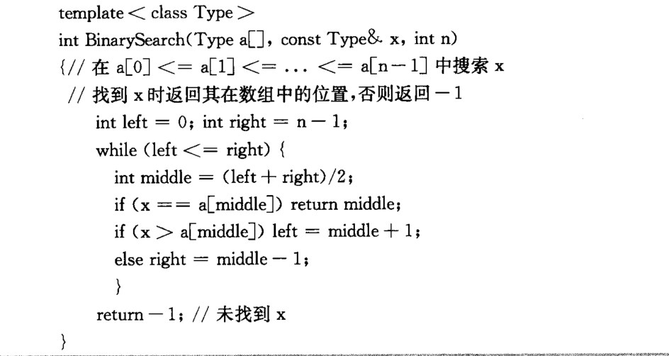
Chapter 2 Recursion and divide-and-conquer strategy - binary search algorithm
The While loop is executed logn times. Execution time in circulation is O(1).

Slide 12
Large integer multiplication

Slide 13
Chapter 2 Recursion and divide-and-conquer strategy - Large integer multiplication
When analyzing algorithm complexity, addition and multiplication are considered as basic operations or meta-operations.
When processing some large data multiplication on computer, due to the limitation of computer hardware, it is not possible to directly multiply to get the desired result. We can solve these problems by dividing and conquering a large integer multiplication, turning a large problem into a small problem—a simple small numbers multiplication and then merging.

Slide 14
Chapter 2 Recursion and divide-and-conquer strategy - Large integer multiplication
Large integer multiplication
X and Y are n-bit binary integers and Calculate the product XY. (Decimal also applies)
The primary school approach：O(n²) Inefficient
X=
Y=
a
b
c
d

Slide 15
Chapter 2 Recursion and divide-and-conquer strategy - Large integer multiplication
X = a 2^{n/2} + b Y = c 2^{n/2} + d
XY = ac 2^{n} + (ad+bc) 2^{n/2} + bd
The algorithm goes through 4 multiplications of n/2 bits of integers, 3 additions of 2n bits or less, and two shifts of 2^{n} and 2^{n/2}. All these additions and shifts require O(n), then
Complexity analysis

Slide 16
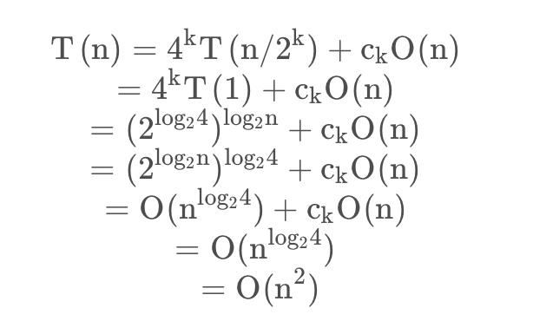
Chapter 2 Recursion and divide-and-conquer strategy - Large integer multiplication
Complexity analysis
T(n)=O(n²) ✗No improvement
n=2k
k=log2n

Slide 17
Chapter 2 Recursion and divide-and-conquer strategy - Large integer multiplication
T(n)=O(n²), It's not any faster than the traditional way of doing it. To reduce time complexity, the number of multiplications must be reduced
XY = ac 2^{n} + (ad+bc) 2^{n/2} + bd
E=ac F=bd G= (a+b)(c+d)
XY = E2^{n} + (G-E-F) 2^{n/2} + F
Three multiplications of n/2-bit integers, six additions and subtractions, and two shifts
Complexity analysis
T(n)=O(n^{log23}) =O(n^{1.59})✓A big improvement

Slide 18
Chapter 2 Recursion and divide-and-conquer strategy - Large integer multiplication
If large integers are divided into more segments and combined in more complex ways, it is possible to get better algorithms.
Eventually, this idea led to the Fast Fourier Transform. This method can also be regarded as a complex divide-and-conquer algorithm.
快速傅利叶变换

Slide 19
Merge sort

Slide 20
Chapter 2 Recursion and divide-and-conquer strategy - Merge sort
Basic idea: Divide the elements to be sorted into two subsets of roughly the same size, sort the two subsets separately, and finally merge the ordered subsets into the required ordered set.

Slide 21
Chapter 2 Recursion and divide-and-conquer strategy - Merge sort
The recursive process of MergeSort simply splits the set in half until there is only one element left, and then merges the two sorted array segments. According to this mechanism, you can first pair adjacent elements in array A and sort them by merging algorithm to form n/2 sorted subarray segments of length 2, and then sort them to sorted subarray segments of length 4, and so on until the whole array is sorted.
机制

Slide 22
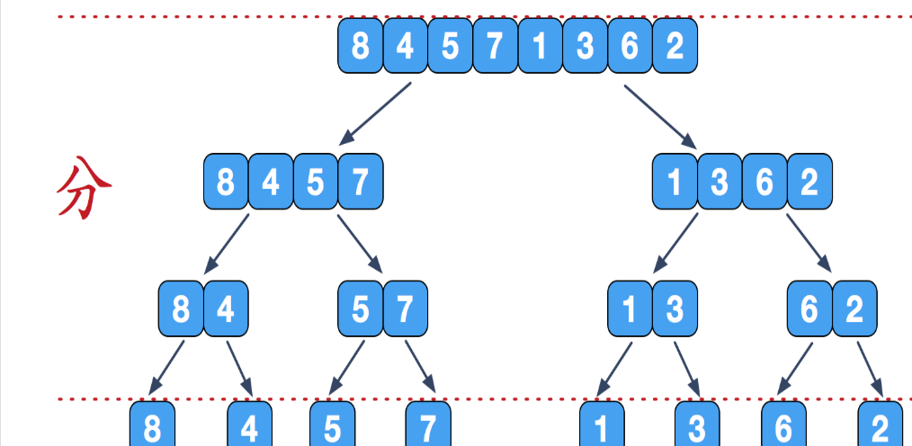
Chapter 2 Recursion and divide-and-conquer strategy - Merge sort

Slide 23
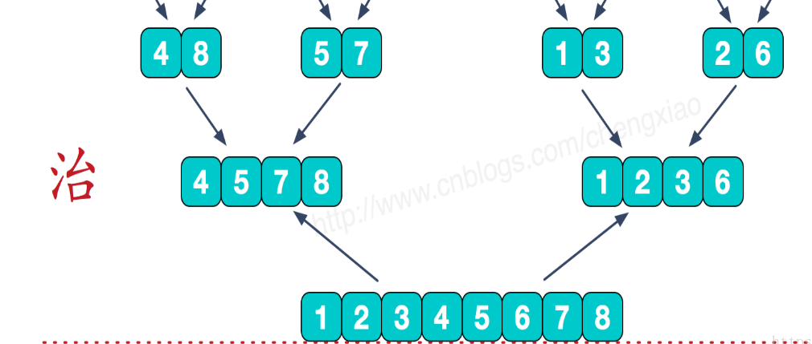
Chapter 2 Recursion and divide-and-conquer strategy - Merge sort

Slide 24
Chapter 2 Recursion and divide-and-conquer strategy - Merge sort
void MergeSort(Type a[], int left, int right)
{
if (left<right) {//There are at least two elements
int i=(left+right)/2; //Take the midpoint
mergeSort(a, left, i);
mergeSort(a, i+1, right);
merge(a, b, left, i, right); //Merge it into array b
copy(a, b, left, right); //Copy it back to array a
}
}
Merge and Copy can be done in O(n) time
Complexity analysis
T(n)=O(nlogn)
The optimal algorithm in the asymptotic sense

Slide 25
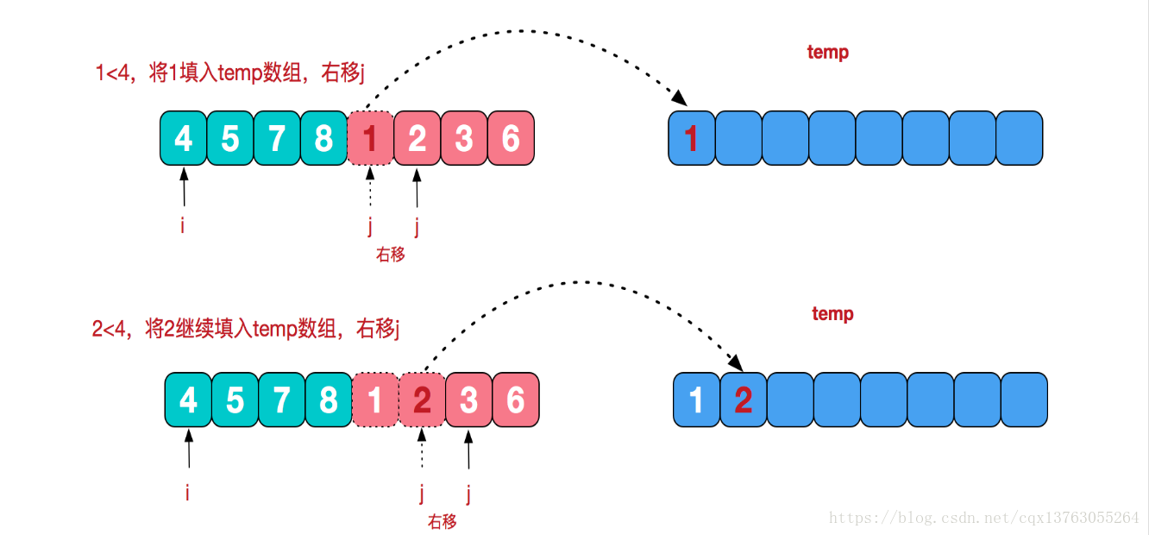
Chapter 2 Recursion and divide-and-conquer strategy - Merge sort

Slide 26
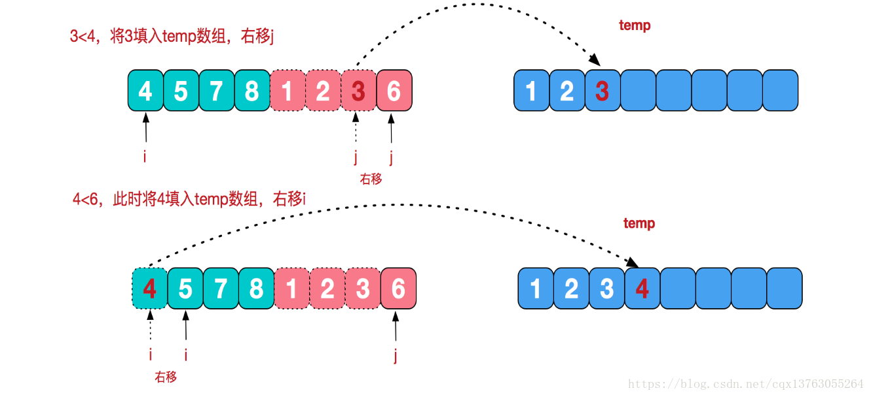
Chapter 2 Recursion and divide-and-conquer strategy - Merge sort

Slide 27
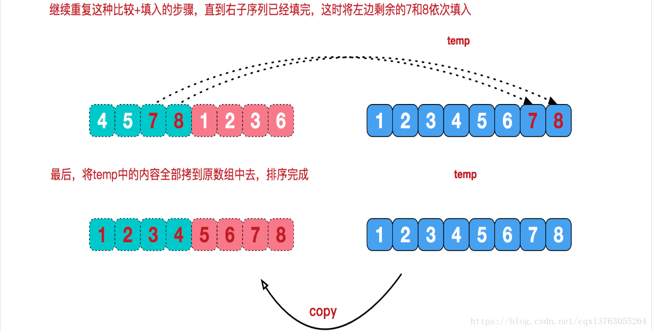
Chapter 2 Recursion and divide-and-conquer strategy - Merge sort
合并
拷贝

Slide 28
Chapter 2 Recursion and divide-and-conquer strategy - Merge sort
Natural MergeSort is a variant of MergeSort, which merges adjacent subarray segments of length 1 in the first step because the subarray segments of length 1 are already sorted. In fact, for an initially given array A, there are usually multiple naturally ordered subarray segments of length greater than 1. For example, if the elements in array A are {4,8,3,7,1,5,6,2}, then the naturally ordered subarray segments are
{4,8},{3,7},{1,5,6}和{2}

Slide 29
Chapter 2 Recursion and divide-and-conquer strategy - Merge sort
One linear scan of array A is enough to find all of these sorted subarray segments. The adjacent ordered subarray segments are then merged pairwise to form a larger ordered subarray segment. For the above example, two merged subarray segments {3,4,7,8} and {1,2,5,6} can be obtained after one merge until the whole array is sorted.
The combination of these two array segments gives {1,2,3,4,5,6,7,8}

Slide 30
Chapter 2 Recursion and divide-and-conquer strategy - Merge sort
Comparison of natural merge sort and merge sort:
In general, the number of merges required to perform natural merge sort is small. For example, in the extreme case where the given n-element array is already sorted, the natural merge sort algorithm does not need to perform the merge step. The MergeSort algorithm has to perform lgn merges so in this case, the natural MergeSort algorithm takes O(n) time, and MergeSort takes O(nlogn) time.

Slide 31
Quick sort

Slide 32
Chapter 2 Recursion and divide-and-conquer strategy - Quicksort
Suppose there is a set A, which has n elements:
Choose one element of A as pivot, which serves as the benchmark
Move elements smaller than the pivot to the left and elements larger than the pivot to the right (partition operation)
A is split into two pieces by pivot, A is divided into two parts by Pivot and continues to do the same for the remaining two parts
Until all subset elements are no longer required to perform the above steps
支点
基准

Slide 33
Chapter 2 Recursion and divide-and-conquer strategy - Quicksort
Advantages
In quicksort, the comparison and exchange of records are carried out from both ends to the middle. The records with larger keywords can be exchanged to the later unit once, and the records with smaller keywords can be exchanged to the front unit once. The distance of each movement of records is larger, so the total comparison and movement times are less.
template<class Type>
void QuickSort (Type a[], int p, int r)
{
if (p<r) {
int q=Partition(a,p,r); 确定分段位置
QuickSort (a,p,q-1); //对左半段排序
QuickSort (a,q+1,r); //对右半段排序
}
}

Slide 34
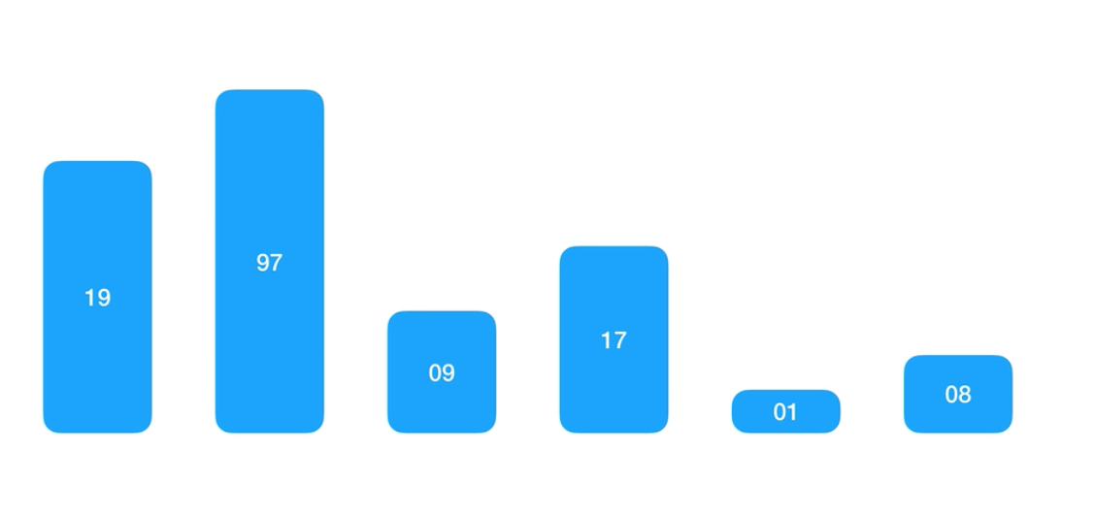
Chapter 2 Recursion and divide-and-conquer strategy - Quicksort
将< x的元素交换到左边区域
将> x的元素交换到右边区域
quicksort(A, lo, hi)
if lo < hi
p = partition(A, lo, hi)
quicksort(A, lo, p - 1)
quicksort(A, p + 1, hi)
partition(A, lo, hi)
pivot = A[hi]
i = lo //place for swapping
for j = lo to hi - 1
if A[j] <= pivot
swap A[i] with A[j]
i = i + 1
swap A[i] with A[hi]
return i
Swap elements less than x to the left region
Swap elements greater than x to the right regionquicksort(A, lo, hi)
if lo < hi
p = partition(A, lo, hi)
quicksort(A, lo, p - 1)
quicksort(A, p + 1, hi)
partition(A, lo, hi)
pivot = A[hi]
i = lo //place for swapping
for j = lo to hi - 1
if A[j] <= pivot
swap A[i] with A[j]
i = i + 1
swap A[i] with A[hi]
return i

Slide 35
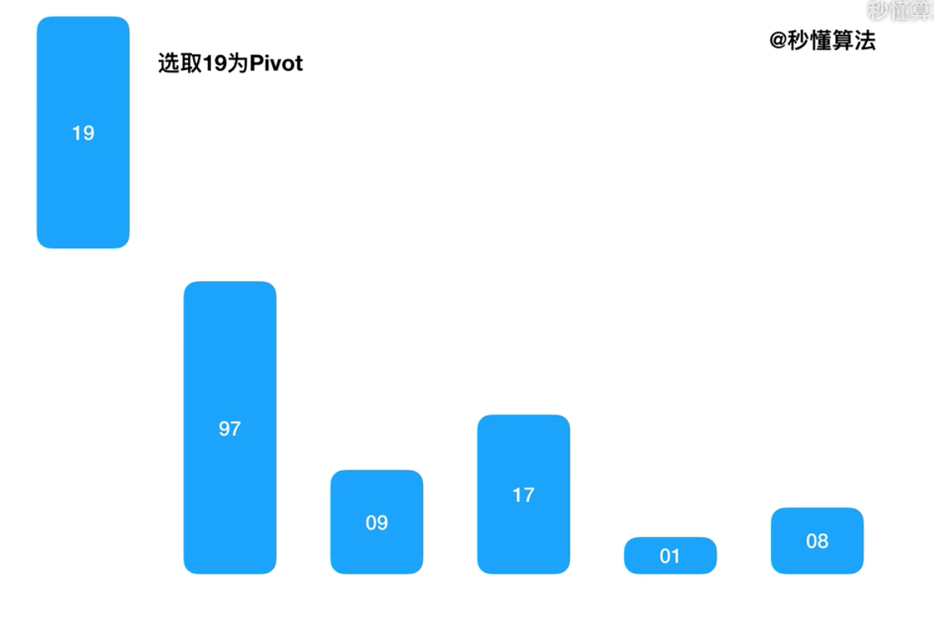
Chapter 2 Recursion and divide-and-conquer strategy - Quicksort
将< x的元素交换到左边区域
将> x的元素交换到右边区域
quicksort(A, lo, hi)
if lo < hi
p = partition(A, lo, hi)
quicksort(A, lo, p - 1)
quicksort(A, p + 1, hi)
partition(A, lo, hi)
pivot = A[hi]
i = lo //place for swapping
for j = lo to hi - 1
if A[j] <= pivot
swap A[i] with A[j]
i = i + 1
swap A[i] with A[hi]
return i
Swap elements less than x to the left region
Swap elements greater than x to the right regionquicksort(A, lo, hi)
if lo < hi
p = partition(A, lo, hi)
quicksort(A, lo, p - 1)
quicksort(A, p + 1, hi)
partition(A, lo, hi)
pivot = A[hi]
i = lo //place for swapping
for j = lo to hi - 1
if A[j] <= pivot
swap A[i] with A[j]
i = i + 1
swap A[i] with A[hi]
return i

Slide 36
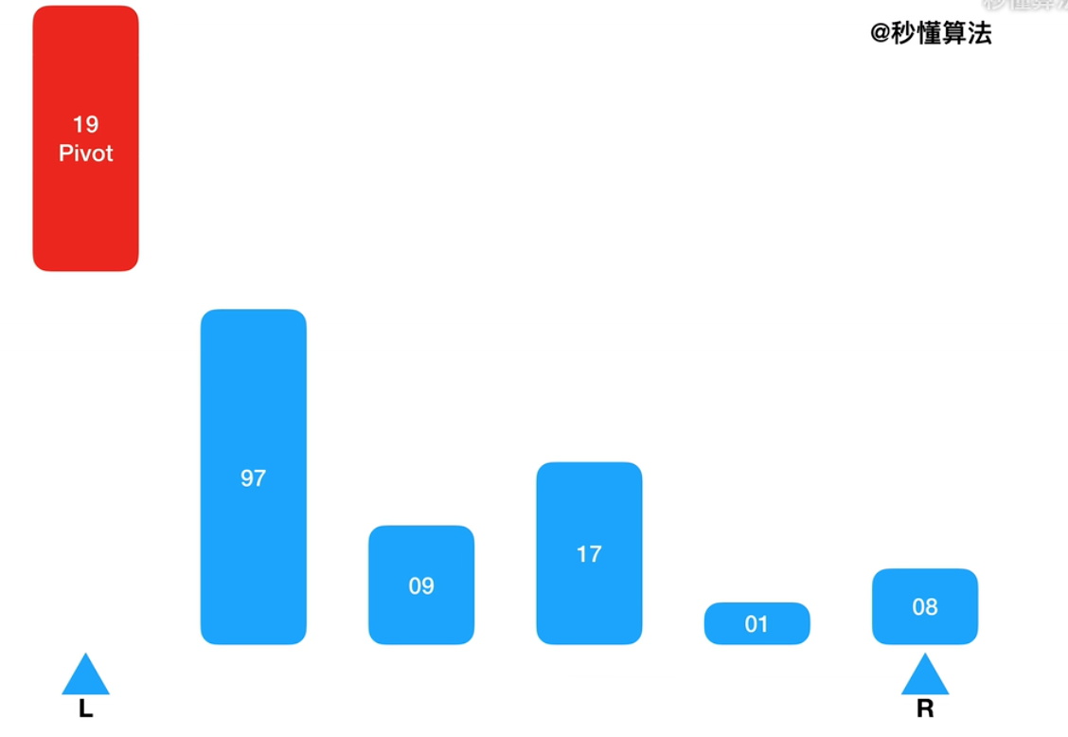
Chapter 2 Recursion and divide-and-conquer strategy - Quicksort
将< x的元素交换到左边区域
将> x的元素交换到右边区域
quicksort(A, lo, hi)
if lo < hi
p = partition(A, lo, hi)
quicksort(A, lo, p - 1)
quicksort(A, p + 1, hi)
partition(A, lo, hi)
pivot = A[hi]
i = lo //place for swapping
for j = lo to hi - 1
if A[j] <= pivot
swap A[i] with A[j]
i = i + 1
swap A[i] with A[hi]
return i
Swap elements less than x to the left region
Swap elements greater than x to the right regionquicksort(A, lo, hi)
if lo < hi
p = partition(A, lo, hi)
quicksort(A, lo, p - 1)
quicksort(A, p + 1, hi)
partition(A, lo, hi)
pivot = A[hi]
i = lo //place for swapping
for j = lo to hi - 1
if A[j] <= pivot
swap A[i] with A[j]
i = i + 1
swap A[i] with A[hi]
return i

Slide 37
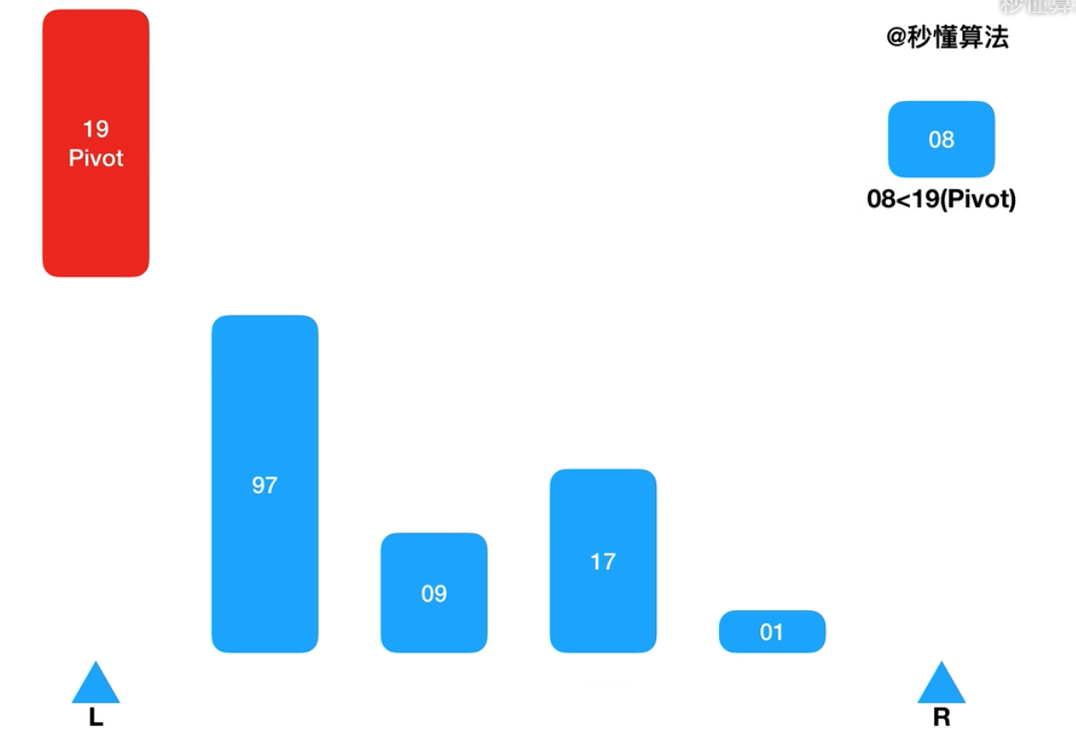
Chapter 2 Recursion and divide-and-conquer strategy - Quicksort
将< x的元素交换到左边区域
将> x的元素交换到右边区域
quicksort(A, lo, hi)
if lo < hi
p = partition(A, lo, hi)
quicksort(A, lo, p - 1)
quicksort(A, p + 1, hi)
partition(A, lo, hi)
pivot = A[hi]
i = lo //place for swapping
for j = lo to hi - 1
if A[j] <= pivot
swap A[i] with A[j]
i = i + 1
swap A[i] with A[hi]
return i
Swap elements less than x to the left region
Swap elements greater than x to the right regionquicksort(A, lo, hi)
if lo < hi
p = partition(A, lo, hi)
quicksort(A, lo, p - 1)
quicksort(A, p + 1, hi)
partition(A, lo, hi)
pivot = A[hi]
i = lo //place for swapping
for j = lo to hi - 1
if A[j] <= pivot
swap A[i] with A[j]
i = i + 1
swap A[i] with A[hi]
return i

Slide 38
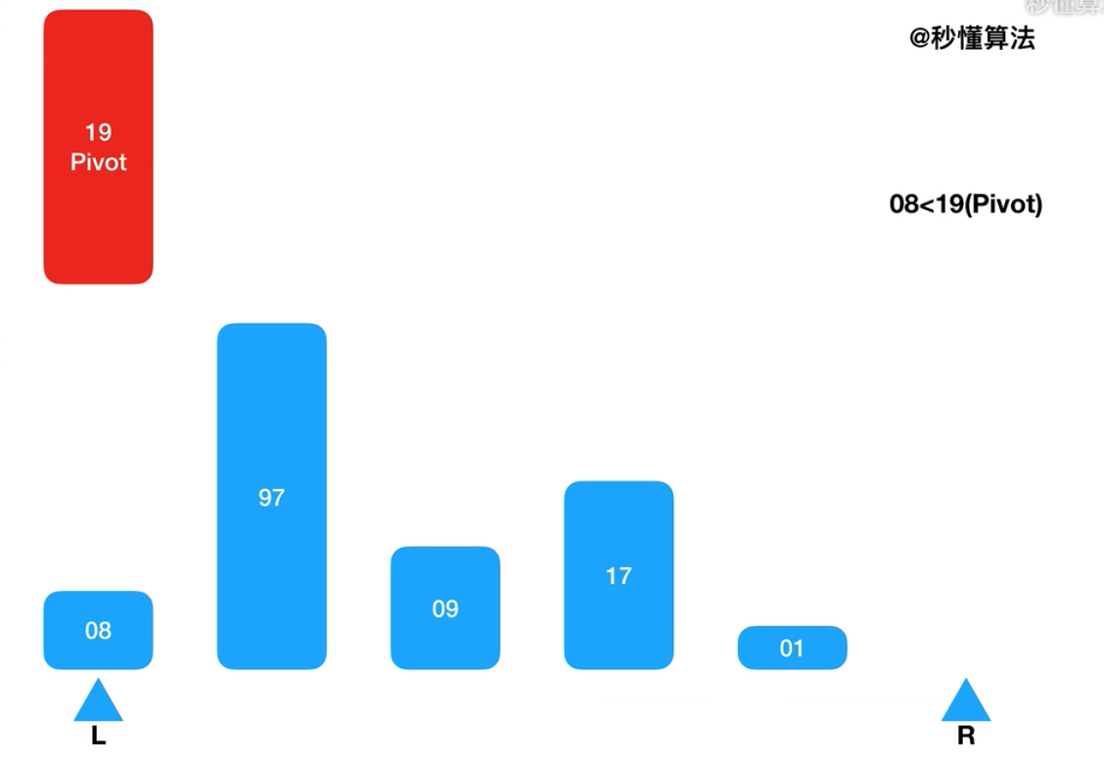
Chapter 2 Recursion and divide-and-conquer strategy - Quicksort
将< x的元素交换到左边区域
将> x的元素交换到右边区域
quicksort(A, lo, hi)
if lo < hi
p = partition(A, lo, hi)
quicksort(A, lo, p - 1)
quicksort(A, p + 1, hi)
partition(A, lo, hi)
pivot = A[hi]
i = lo //place for swapping
for j = lo to hi - 1
if A[j] <= pivot
swap A[i] with A[j]
i = i + 1
swap A[i] with A[hi]
return i
Swap elements less than x to the left region
Swap elements greater than x to the right regionquicksort(A, lo, hi)
if lo < hi
p = partition(A, lo, hi)
quicksort(A, lo, p - 1)
quicksort(A, p + 1, hi)
partition(A, lo, hi)
pivot = A[hi]
i = lo //place for swapping
for j = lo to hi - 1
if A[j] <= pivot
swap A[i] with A[j]
i = i + 1
swap A[i] with A[hi]
return i

Slide 39
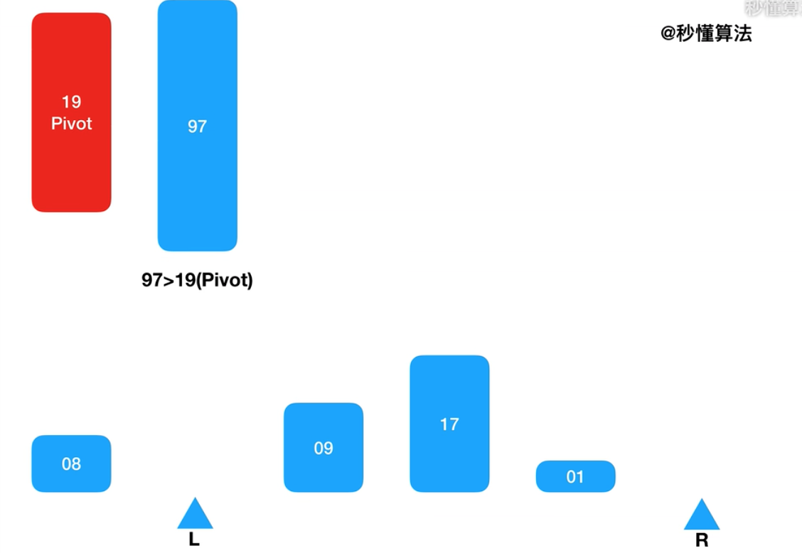
Chapter 2 Recursion and divide-and-conquer strategy - Quicksort
Swap elements less than x to the left region
Swap elements greater than x to the right regionquicksort(A, lo, hi)
if lo < hi
p = partition(A, lo, hi)
quicksort(A, lo, p - 1)
quicksort(A, p + 1, hi)
partition(A, lo, hi)
pivot = A[hi]
i = lo //place for swapping
for j = lo to hi - 1
if A[j] <= pivot
swap A[i] with A[j]
i = i + 1
swap A[i] with A[hi]
return i
template<class Type>
int Partition (Type a[], int p, int r)
{
int i = p, j = r + 1;
Type x=a[p];
// 将< x的元素交换到左边区域
// 将> x的元素交换到右边区域
while (true) {
while (a[- -j] >x);
if(i<j) Swap(a[i], a[j]);
while (a[++i] <x);
if(i<j) Swap(a[i], a[j]);
if (i >= j) break;
}
a[p] = a[j];
a[j] = x;
return j;
}

Slide 40
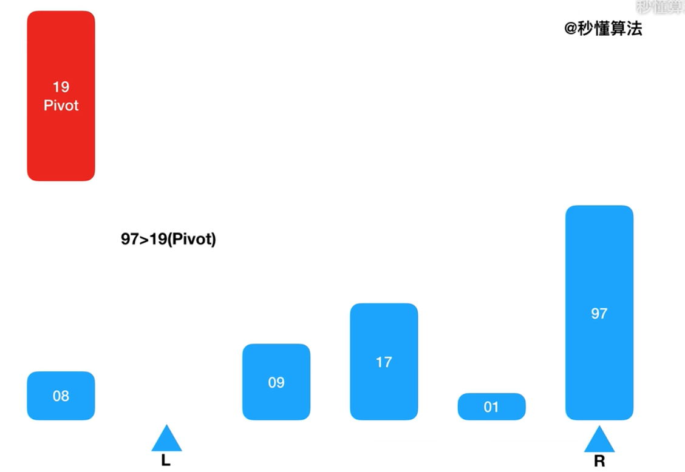
Chapter 2 Recursion and divide-and-conquer strategy - Quicksort
将< x的元素交换到左边区域
将> x的元素交换到右边区域
quicksort(A, lo, hi)
if lo < hi
p = partition(A, lo, hi)
quicksort(A, lo, p - 1)
quicksort(A, p + 1, hi)
partition(A, lo, hi)
pivot = A[hi]
i = lo //place for swapping
for j = lo to hi - 1
if A[j] <= pivot
swap A[i] with A[j]
i = i + 1
swap A[i] with A[hi]
return i
Swap elements less than x to the left region
Swap elements greater than x to the right regionquicksort(A, lo, hi)
if lo < hi
p = partition(A, lo, hi)
quicksort(A, lo, p - 1)
quicksort(A, p + 1, hi)
partition(A, lo, hi)
pivot = A[hi]
i = lo //place for swapping
for j = lo to hi - 1
if A[j] <= pivot
swap A[i] with A[j]
i = i + 1
swap A[i] with A[hi]
return i

Slide 41
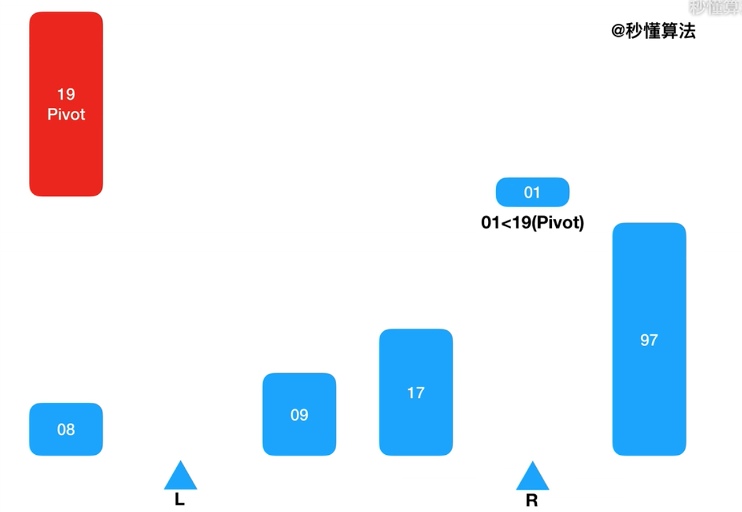
Chapter 2 Recursion and divide-and-conquer strategy - Quicksort
将< x的元素交换到左边区域
将> x的元素交换到右边区域
quicksort(A, lo, hi)
if lo < hi
p = partition(A, lo, hi)
quicksort(A, lo, p - 1)
quicksort(A, p + 1, hi)
partition(A, lo, hi)
pivot = A[hi]
i = lo //place for swapping
for j = lo to hi - 1
if A[j] <= pivot
swap A[i] with A[j]
i = i + 1
swap A[i] with A[hi]
return i
Swap elements less than x to the left region
Swap elements greater than x to the right regionquicksort(A, lo, hi)
if lo < hi
p = partition(A, lo, hi)
quicksort(A, lo, p - 1)
quicksort(A, p + 1, hi)
partition(A, lo, hi)
pivot = A[hi]
i = lo //place for swapping
for j = lo to hi - 1
if A[j] <= pivot
swap A[i] with A[j]
i = i + 1
swap A[i] with A[hi]
return i

Slide 42
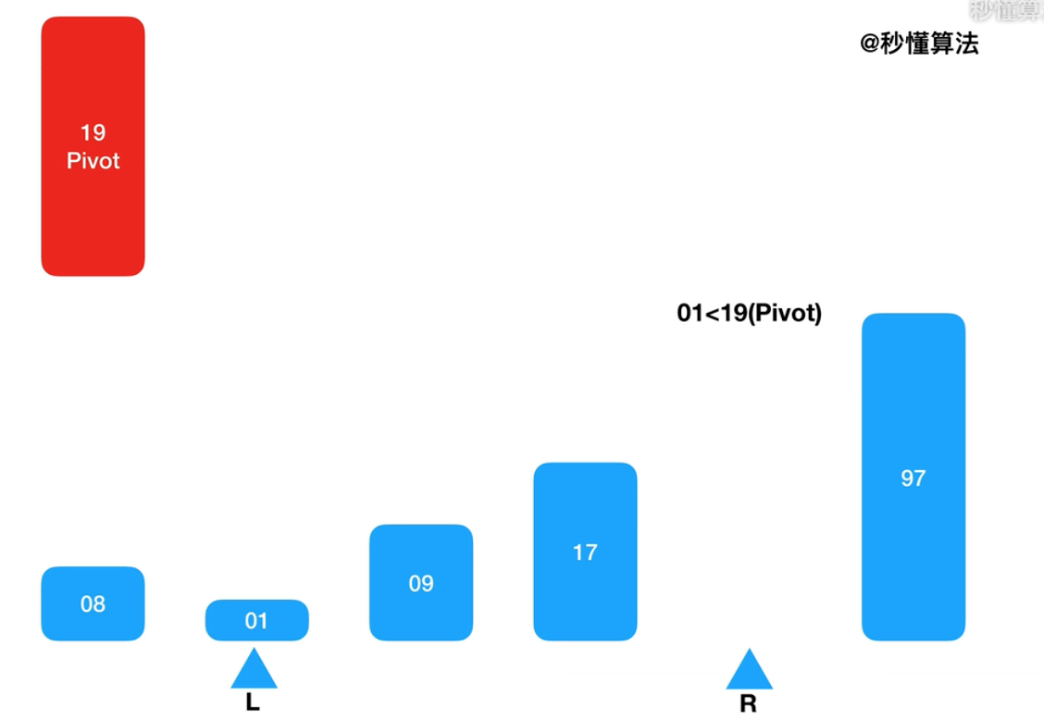
Chapter 2 Recursion and divide-and-conquer strategy - Quicksort
将< x的元素交换到左边区域
将> x的元素交换到右边区域
quicksort(A, lo, hi)
if lo < hi
p = partition(A, lo, hi)
quicksort(A, lo, p - 1)
quicksort(A, p + 1, hi)
partition(A, lo, hi)
pivot = A[hi]
i = lo //place for swapping
for j = lo to hi - 1
if A[j] <= pivot
swap A[i] with A[j]
i = i + 1
swap A[i] with A[hi]
return i
Swap elements less than x to the left region
Swap elements greater than x to the right regionquicksort(A, lo, hi)
if lo < hi
p = partition(A, lo, hi)
quicksort(A, lo, p - 1)
quicksort(A, p + 1, hi)
partition(A, lo, hi)
pivot = A[hi]
i = lo //place for swapping
for j = lo to hi - 1
if A[j] <= pivot
swap A[i] with A[j]
i = i + 1
swap A[i] with A[hi]
return i

Slide 43
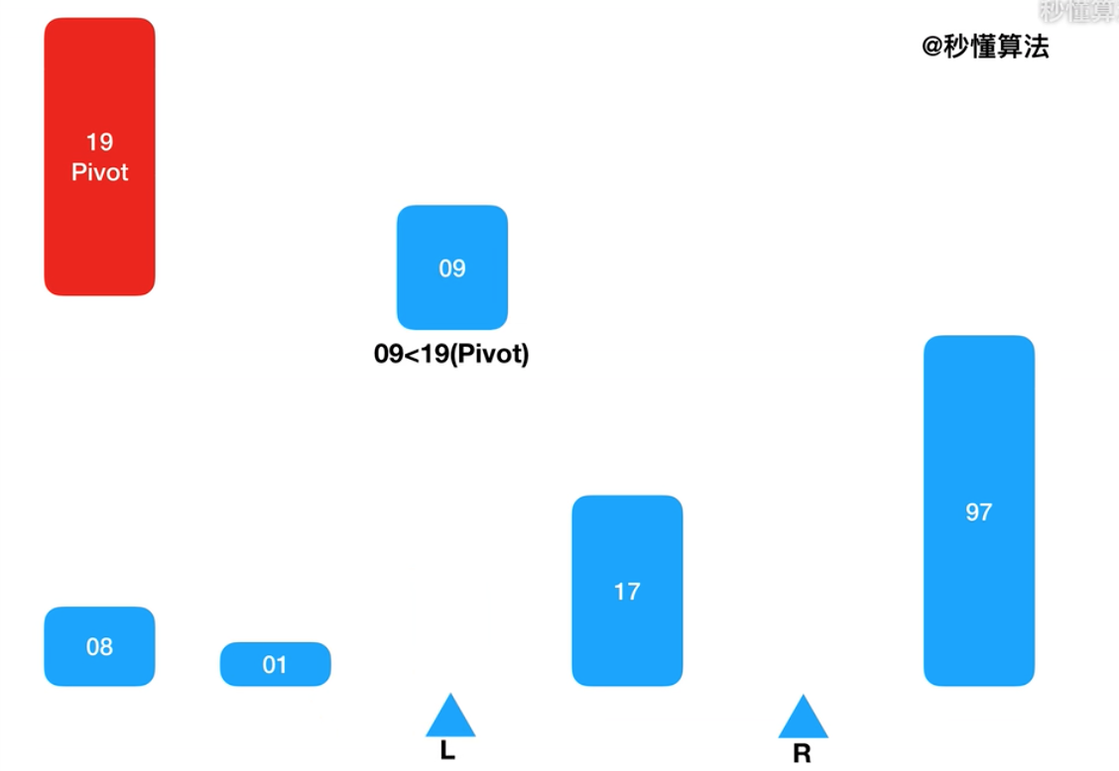
Chapter 2 Recursion and divide-and-conquer strategy - Quicksort
将< x的元素交换到左边区域
将> x的元素交换到右边区域
quicksort(A, lo, hi)
if lo < hi
p = partition(A, lo, hi)
quicksort(A, lo, p - 1)
quicksort(A, p + 1, hi)
partition(A, lo, hi)
pivot = A[hi]
i = lo //place for swapping
for j = lo to hi - 1
if A[j] <= pivot
swap A[i] with A[j]
i = i + 1
swap A[i] with A[hi]
return i
Swap elements less than x to the left region
Swap elements greater than x to the right regionquicksort(A, lo, hi)
if lo < hi
p = partition(A, lo, hi)
quicksort(A, lo, p - 1)
quicksort(A, p + 1, hi)
partition(A, lo, hi)
pivot = A[hi]
i = lo //place for swapping
for j = lo to hi - 1
if A[j] <= pivot
swap A[i] with A[j]
i = i + 1
swap A[i] with A[hi]
return i

Slide 44
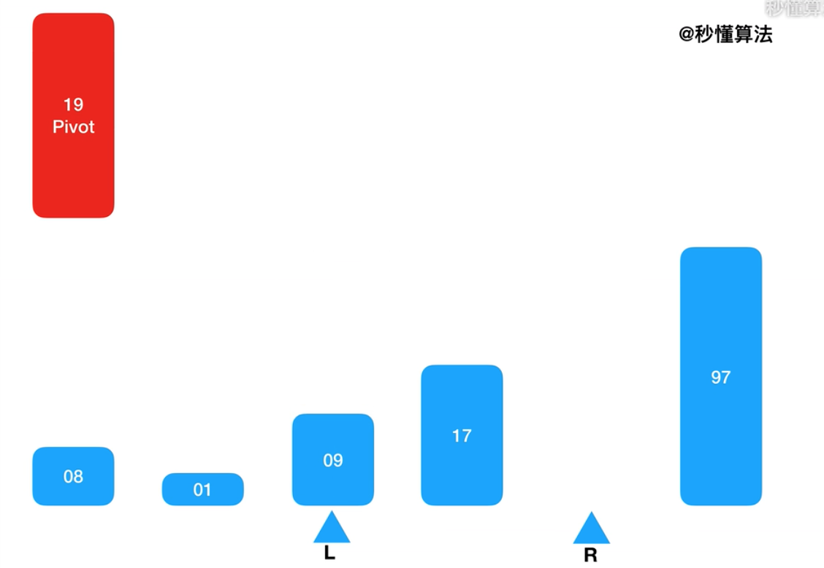
Chapter 2 Recursion and divide-and-conquer strategy - Quicksort
将< x的元素交换到左边区域
将> x的元素交换到右边区域
quicksort(A, lo, hi)
if lo < hi
p = partition(A, lo, hi)
quicksort(A, lo, p - 1)
quicksort(A, p + 1, hi)
partition(A, lo, hi)
pivot = A[hi]
i = lo //place for swapping
for j = lo to hi - 1
if A[j] <= pivot
swap A[i] with A[j]
i = i + 1
swap A[i] with A[hi]
return i
Swap elements less than x to the left region
Swap elements greater than x to the right regionquicksort(A, lo, hi)
if lo < hi
p = partition(A, lo, hi)
quicksort(A, lo, p - 1)
quicksort(A, p + 1, hi)
partition(A, lo, hi)
pivot = A[hi]
i = lo //place for swapping
for j = lo to hi - 1
if A[j] <= pivot
swap A[i] with A[j]
i = i + 1
swap A[i] with A[hi]
return i

Slide 45
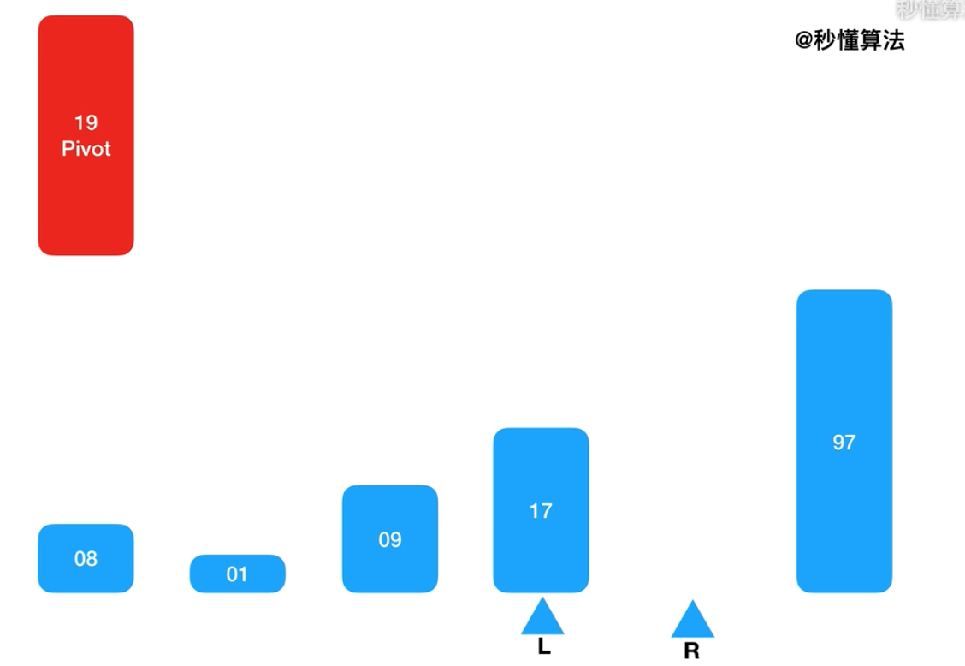
Chapter 2 Recursion and divide-and-conquer strategy - Quicksort
将< x的元素交换到左边区域
将> x的元素交换到右边区域
quicksort(A, lo, hi)
if lo < hi
p = partition(A, lo, hi)
quicksort(A, lo, p - 1)
quicksort(A, p + 1, hi)
partition(A, lo, hi)
pivot = A[hi]
i = lo //place for swapping
for j = lo to hi - 1
if A[j] <= pivot
swap A[i] with A[j]
i = i + 1
swap A[i] with A[hi]
return i
Swap elements less than x to the left region
Swap elements greater than x to the right regionquicksort(A, lo, hi)
if lo < hi
p = partition(A, lo, hi)
quicksort(A, lo, p - 1)
quicksort(A, p + 1, hi)
partition(A, lo, hi)
pivot = A[hi]
i = lo //place for swapping
for j = lo to hi - 1
if A[j] <= pivot
swap A[i] with A[j]
i = i + 1
swap A[i] with A[hi]
return i

Slide 46
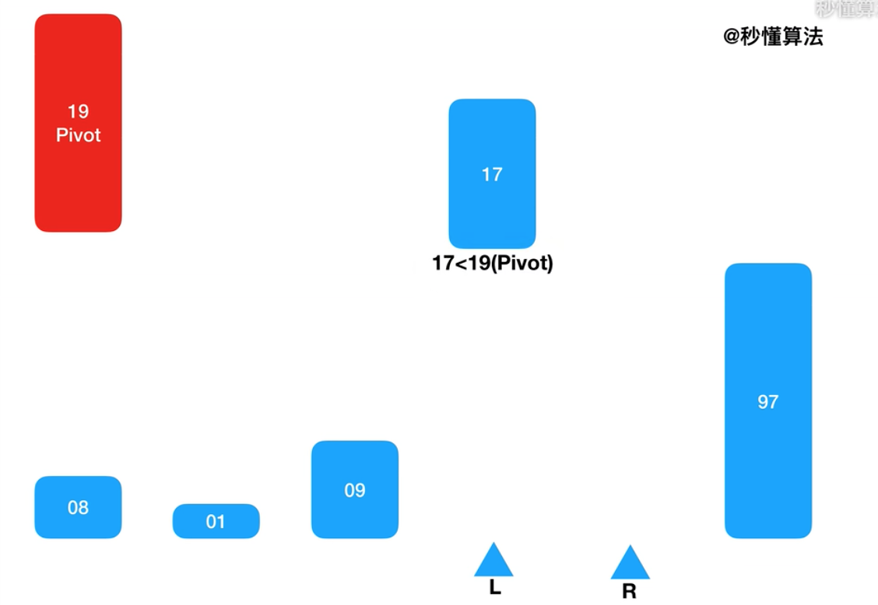
Chapter 2 Recursion and divide-and-conquer strategy - Quicksort
将< x的元素交换到左边区域
将> x的元素交换到右边区域
quicksort(A, lo, hi)
if lo < hi
p = partition(A, lo, hi)
quicksort(A, lo, p - 1)
quicksort(A, p + 1, hi)
partition(A, lo, hi)
pivot = A[hi]
i = lo //place for swapping
for j = lo to hi - 1
if A[j] <= pivot
swap A[i] with A[j]
i = i + 1
swap A[i] with A[hi]
return i
Swap elements less than x to the left region
Swap elements greater than x to the right regionquicksort(A, lo, hi)
if lo < hi
p = partition(A, lo, hi)
quicksort(A, lo, p - 1)
quicksort(A, p + 1, hi)
partition(A, lo, hi)
pivot = A[hi]
i = lo //place for swapping
for j = lo to hi - 1
if A[j] <= pivot
swap A[i] with A[j]
i = i + 1
swap A[i] with A[hi]
return i

Slide 47

Chapter 2 Recursion and divide-and-conquer strategy - Quicksort
将< x的元素交换到左边区域
将> x的元素交换到右边区域
quicksort(A, lo, hi)
if lo < hi
p = partition(A, lo, hi)
quicksort(A, lo, p - 1)
quicksort(A, p + 1, hi)
partition(A, lo, hi)
pivot = A[hi]
i = lo //place for swapping
for j = lo to hi - 1
if A[j] <= pivot
swap A[i] with A[j]
i = i + 1
swap A[i] with A[hi]
return i
Swap elements less than x to the left region
Swap elements greater than x to the right regionquicksort(A, lo, hi)
if lo < hi
p = partition(A, lo, hi)
quicksort(A, lo, p - 1)
quicksort(A, p + 1, hi)
partition(A, lo, hi)
pivot = A[hi]
i = lo //place for swapping
for j = lo to hi - 1
if A[j] <= pivot
swap A[i] with A[j]
i = i + 1
swap A[i] with A[hi]
return i

Slide 48
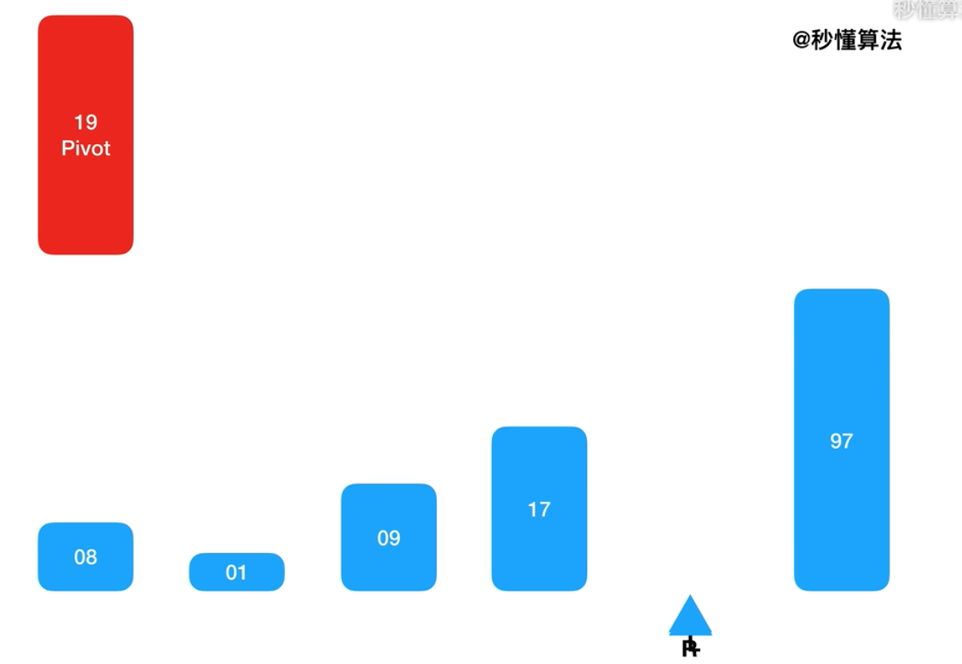
Chapter 2 Recursion and divide-and-conquer strategy - Quicksort
将< x的元素交换到左边区域
将> x的元素交换到右边区域
quicksort(A, lo, hi)
if lo < hi
p = partition(A, lo, hi)
quicksort(A, lo, p - 1)
quicksort(A, p + 1, hi)
partition(A, lo, hi)
pivot = A[hi]
i = lo //place for swapping
for j = lo to hi - 1
if A[j] <= pivot
swap A[i] with A[j]
i = i + 1
swap A[i] with A[hi]
return i
Swap elements less than x to the left region
Swap elements greater than x to the right regionquicksort(A, lo, hi)
if lo < hi
p = partition(A, lo, hi)
quicksort(A, lo, p - 1)
quicksort(A, p + 1, hi)
partition(A, lo, hi)
pivot = A[hi]
i = lo //place for swapping
for j = lo to hi - 1
if A[j] <= pivot
swap A[i] with A[j]
i = i + 1
swap A[i] with A[hi]
return i

Slide 49
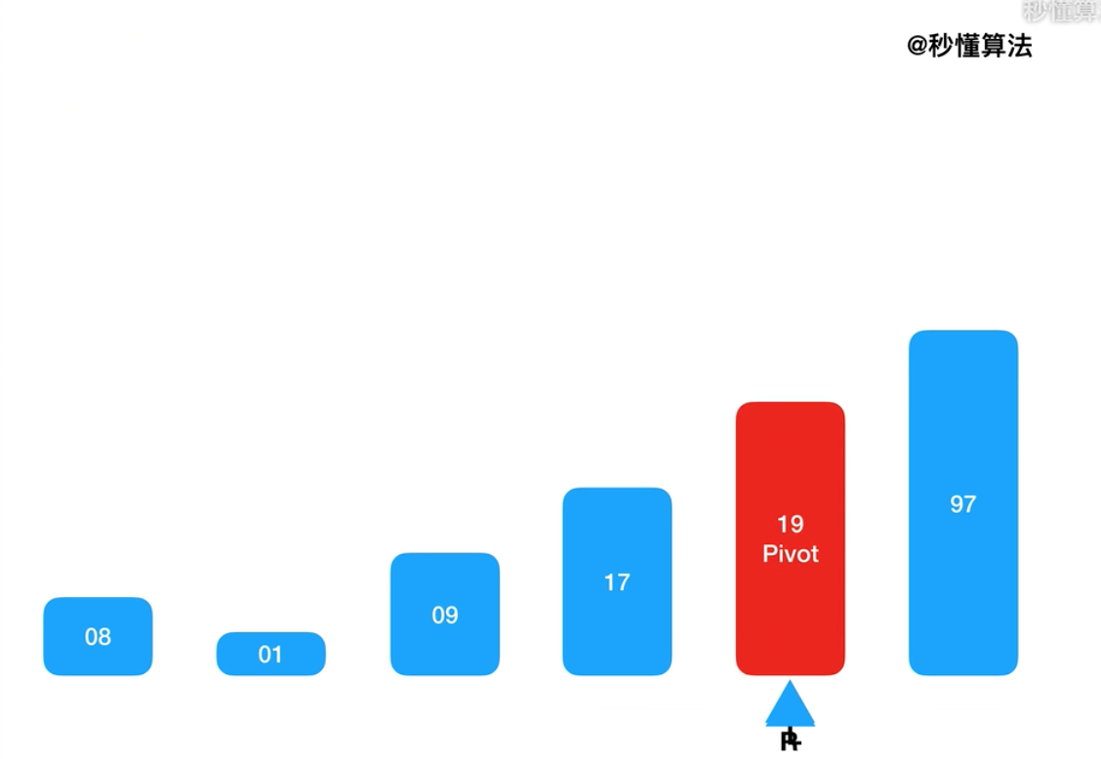
Chapter 2 Recursion and divide-and-conquer strategy - Quicksort
将< x的元素交换到左边区域
将> x的元素交换到右边区域
quicksort(A, lo, hi)
if lo < hi
p = partition(A, lo, hi)
quicksort(A, lo, p - 1)
quicksort(A, p + 1, hi)
partition(A, lo, hi)
pivot = A[hi]
i = lo //place for swapping
for j = lo to hi - 1
if A[j] <= pivot
swap A[i] with A[j]
i = i + 1
swap A[i] with A[hi]
return i
Swap elements less than x to the left region
Swap elements greater than x to the right regionquicksort(A, lo, hi)
if lo < hi
p = partition(A, lo, hi)
quicksort(A, lo, p - 1)
quicksort(A, p + 1, hi)
partition(A, lo, hi)
pivot = A[hi]
i = lo //place for swapping
for j = lo to hi - 1
if A[j] <= pivot
swap A[i] with A[j]
i = i + 1
swap A[i] with A[hi]
return i

Slide 50
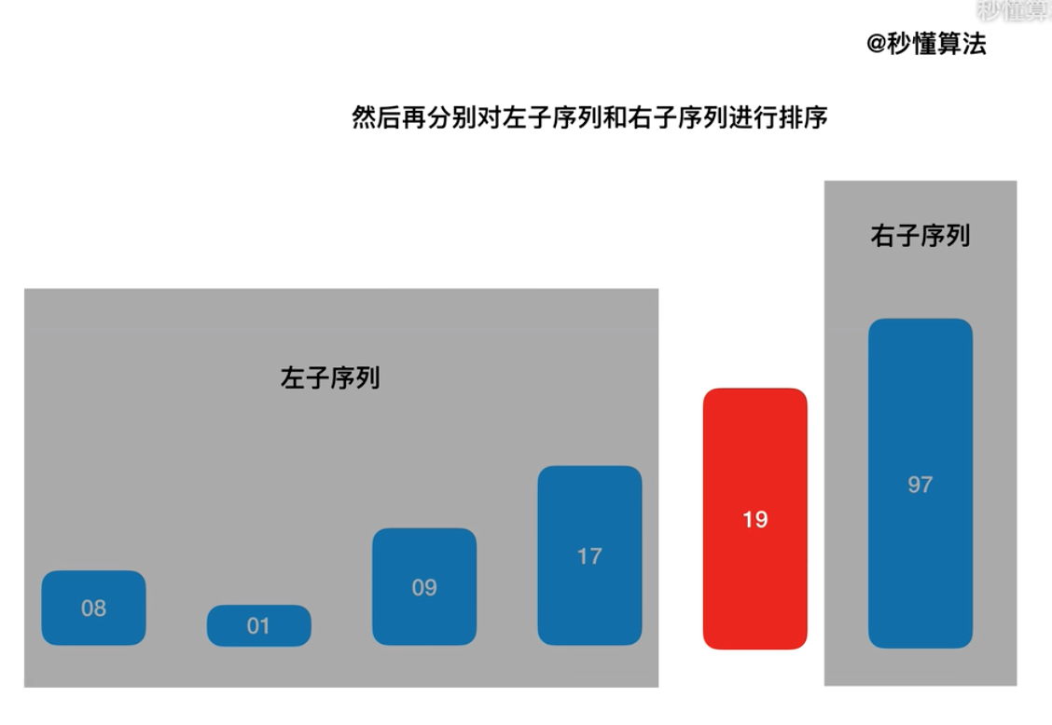
Chapter 2 Recursion and divide-and-conquer strategy - Quicksort
将< x的元素交换到左边区域
将> x的元素交换到右边区域
quicksort(A, lo, hi)
if lo < hi
p = partition(A, lo, hi)
quicksort(A, lo, p - 1)
quicksort(A, p + 1, hi)
partition(A, lo, hi)
pivot = A[hi]
i = lo //place for swapping
for j = lo to hi - 1
if A[j] <= pivot
swap A[i] with A[j]
i = i + 1
swap A[i] with A[hi]
return i
Swap elements less than x to the left region
Swap elements greater than x to the right regionquicksort(A, lo, hi)
if lo < hi
p = partition(A, lo, hi)
quicksort(A, lo, p - 1)
quicksort(A, p + 1, hi)
partition(A, lo, hi)
pivot = A[hi]
i = lo //place for swapping
for j = lo to hi - 1
if A[j] <= pivot
swap A[i] with A[j]
i = i + 1
swap A[i] with A[hi]
return i

Slide 51
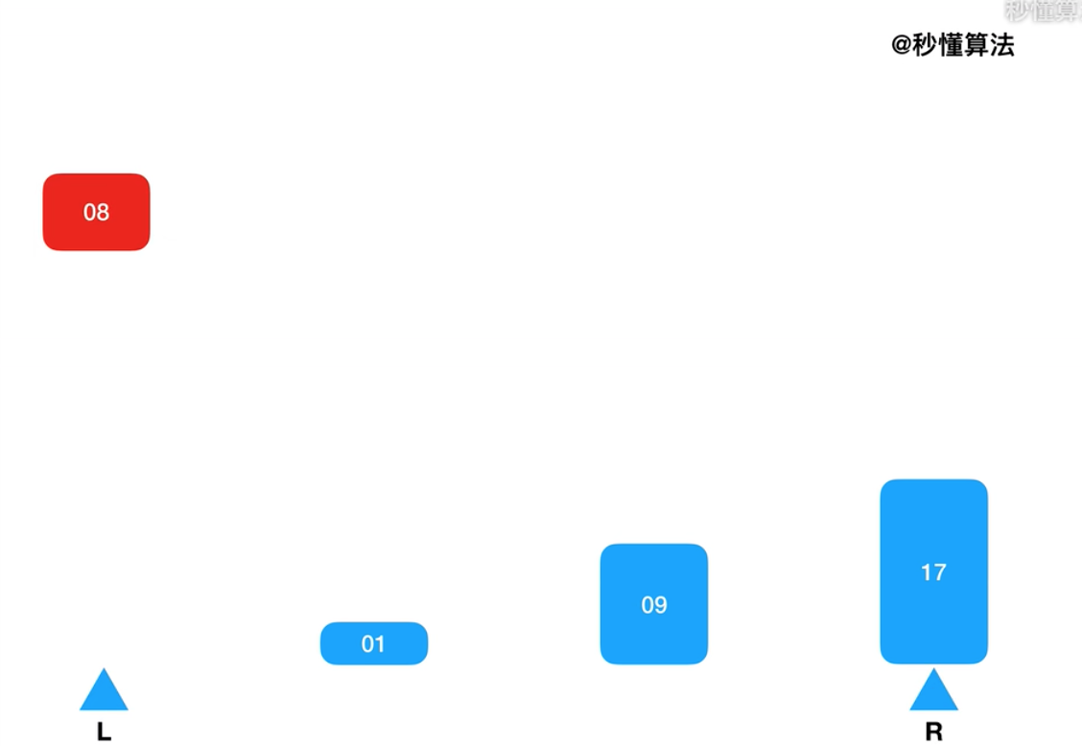
Chapter 2 Recursion and divide-and-conquer strategy - Quicksort
将< x的元素交换到左边区域
将> x的元素交换到右边区域
quicksort(A, lo, hi)
if lo < hi
p = partition(A, lo, hi)
quicksort(A, lo, p - 1)
quicksort(A, p + 1, hi)
partition(A, lo, hi)
pivot = A[hi]
i = lo //place for swapping
for j = lo to hi - 1
if A[j] <= pivot
swap A[i] with A[j]
i = i + 1
swap A[i] with A[hi]
return i
Swap elements less than x to the left region
Swap elements greater than x to the right regionquicksort(A, lo, hi)
if lo < hi
p = partition(A, lo, hi)
quicksort(A, lo, p - 1)
quicksort(A, p + 1, hi)
partition(A, lo, hi)
pivot = A[hi]
i = lo //place for swapping
for j = lo to hi - 1
if A[j] <= pivot
swap A[i] with A[j]
i = i + 1
swap A[i] with A[hi]
return i

Slide 52
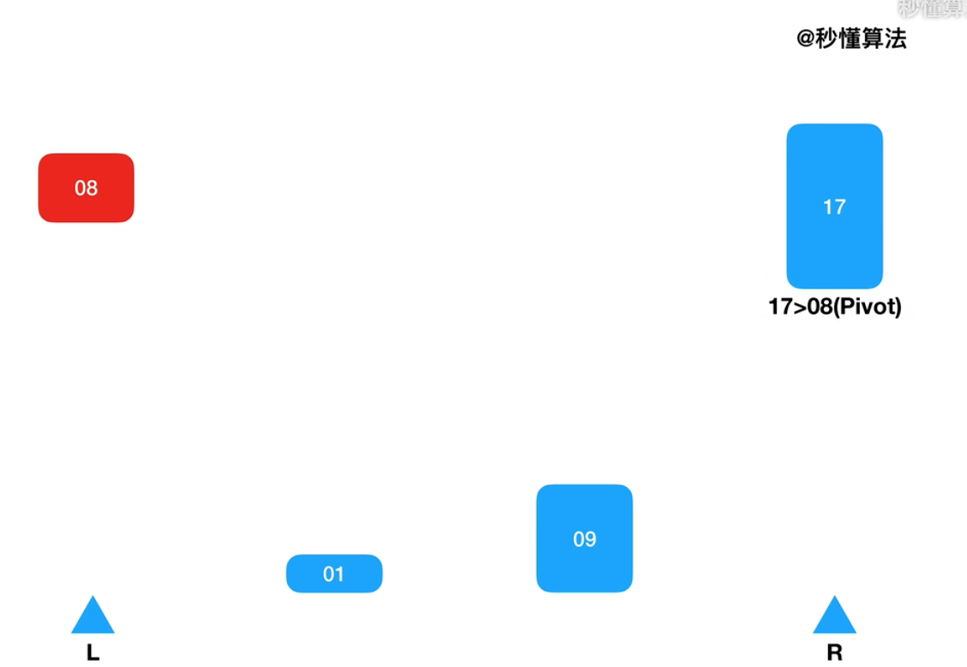
Chapter 2 Recursion and divide-and-conquer strategy - Quicksort
将< x的元素交换到左边区域
将> x的元素交换到右边区域
quicksort(A, lo, hi)
if lo < hi
p = partition(A, lo, hi)
quicksort(A, lo, p - 1)
quicksort(A, p + 1, hi)
partition(A, lo, hi)
pivot = A[hi]
i = lo //place for swapping
for j = lo to hi - 1
if A[j] <= pivot
swap A[i] with A[j]
i = i + 1
swap A[i] with A[hi]
return i
Swap elements less than x to the left region
Swap elements greater than x to the right regionquicksort(A, lo, hi)
if lo < hi
p = partition(A, lo, hi)
quicksort(A, lo, p - 1)
quicksort(A, p + 1, hi)
partition(A, lo, hi)
pivot = A[hi]
i = lo //place for swapping
for j = lo to hi - 1
if A[j] <= pivot
swap A[i] with A[j]
i = i + 1
swap A[i] with A[hi]
return i

Slide 53
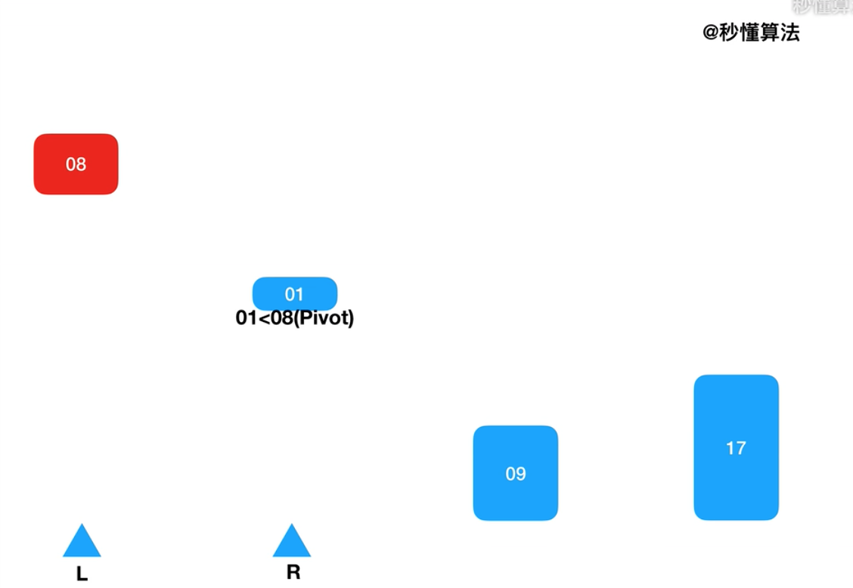
Chapter 2 Recursion and divide-and-conquer strategy - Quicksort
将< x的元素交换到左边区域
将> x的元素交换到右边区域
quicksort(A, lo, hi)
if lo < hi
p = partition(A, lo, hi)
quicksort(A, lo, p - 1)
quicksort(A, p + 1, hi)
partition(A, lo, hi)
pivot = A[hi]
i = lo //place for swapping
for j = lo to hi - 1
if A[j] <= pivot
swap A[i] with A[j]
i = i + 1
swap A[i] with A[hi]
return i
Swap elements less than x to the left region
Swap elements greater than x to the right regionquicksort(A, lo, hi)
if lo < hi
p = partition(A, lo, hi)
quicksort(A, lo, p - 1)
quicksort(A, p + 1, hi)
partition(A, lo, hi)
pivot = A[hi]
i = lo //place for swapping
for j = lo to hi - 1
if A[j] <= pivot
swap A[i] with A[j]
i = i + 1
swap A[i] with A[hi]
return i

Slide 54
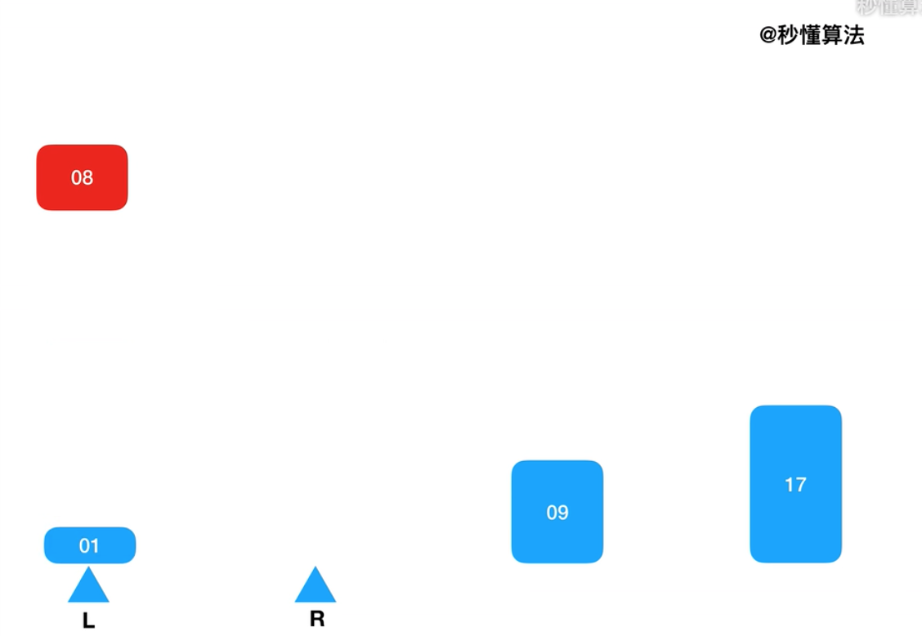
Chapter 2 Recursion and divide-and-conquer strategy - Quicksort
将< x的元素交换到左边区域
将> x的元素交换到右边区域
quicksort(A, lo, hi)
if lo < hi
p = partition(A, lo, hi)
quicksort(A, lo, p - 1)
quicksort(A, p + 1, hi)
partition(A, lo, hi)
pivot = A[hi]
i = lo //place for swapping
for j = lo to hi - 1
if A[j] <= pivot
swap A[i] with A[j]
i = i + 1
swap A[i] with A[hi]
return i
Swap elements less than x to the left region
Swap elements greater than x to the right regionquicksort(A, lo, hi)
if lo < hi
p = partition(A, lo, hi)
quicksort(A, lo, p - 1)
quicksort(A, p + 1, hi)
partition(A, lo, hi)
pivot = A[hi]
i = lo //place for swapping
for j = lo to hi - 1
if A[j] <= pivot
swap A[i] with A[j]
i = i + 1
swap A[i] with A[hi]
return i

Slide 55
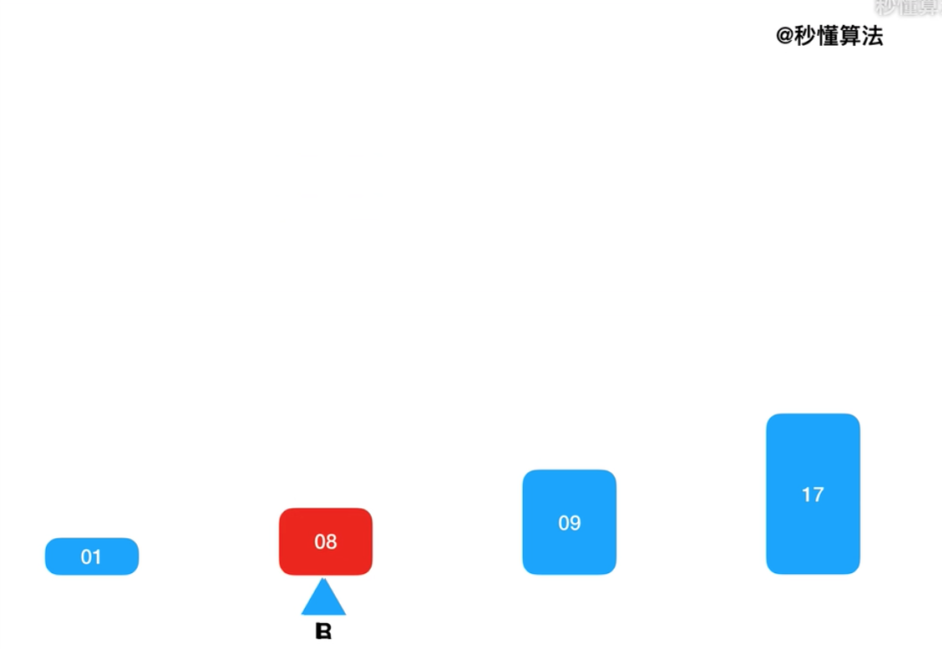
Chapter 2 Recursion and divide-and-conquer strategy - Quicksort
Swap elements less than x to the left region
Swap elements greater than x to the right regionquicksort(A, lo, hi)
if lo < hi
p = partition(A, lo, hi)
quicksort(A, lo, p - 1)
quicksort(A, p + 1, hi)
partition(A, lo, hi)
pivot = A[hi]
i = lo //place for swapping
for j = lo to hi - 1
if A[j] <= pivot
swap A[i] with A[j]
i = i + 1
swap A[i] with A[hi]
return i

Slide 56
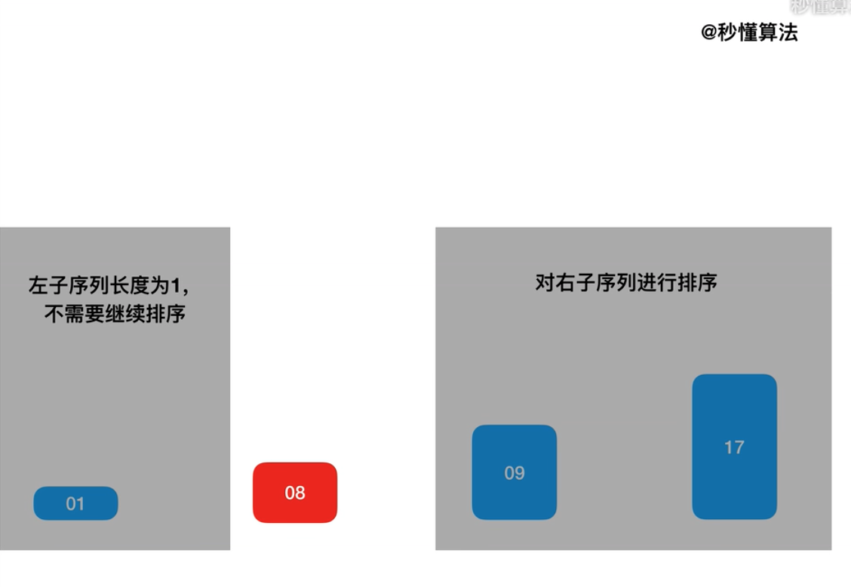
Chapter 2 Recursion and divide-and-conquer strategy - Quicksort
Swap elements less than x to the left region
Swap elements greater than x to the right regionquicksort(A, lo, hi)
if lo < hi
p = partition(A, lo, hi)
quicksort(A, lo, p - 1)
quicksort(A, p + 1, hi)
partition(A, lo, hi)
pivot = A[hi]
i = lo //place for swapping
for j = lo to hi - 1
if A[j] <= pivot
swap A[i] with A[j]
i = i + 1
swap A[i] with A[hi]
return i
template<class Type>
int Partition (Type a[], int p, int r)
{
int i = p, j = r + 1;
Type x=a[p];
// 将< x的元素交换到左边区域
// 将> x的元素交换到右边区域
while (true) {
while (a[- -j] >x);
if(i<j) Swap(a[i], a[j]);
while (a[++i] <x);
if(i<j) Swap(a[i], a[j]);
if (i >= j) break;
}
a[p] = a[j];
a[j] = x;
return j;
}

Slide 57
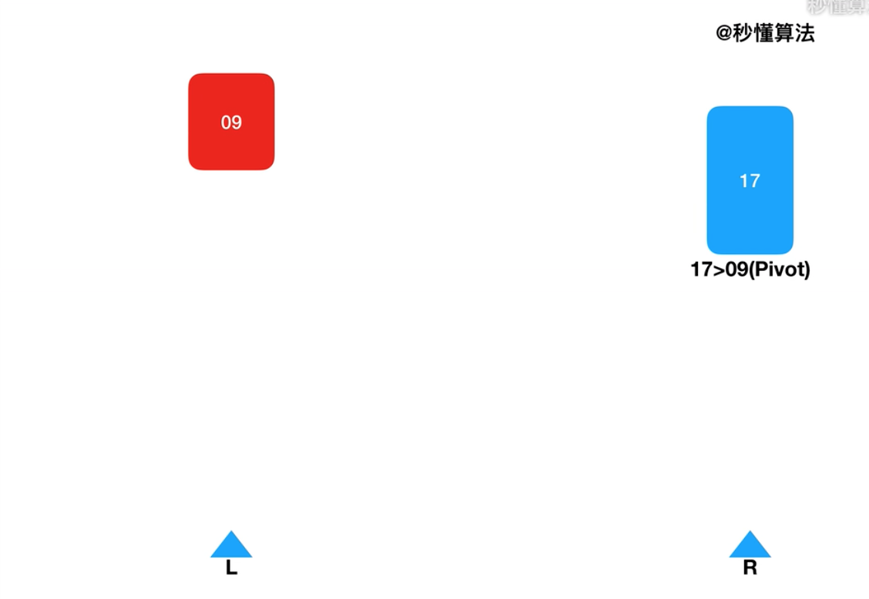
Chapter 2 Recursion and divide-and-conquer strategy - Quicksort
Swap elements less than x to the left region
Swap elements greater than x to the right regionquicksort(A, lo, hi)
if lo < hi
p = partition(A, lo, hi)
quicksort(A, lo, p - 1)
quicksort(A, p + 1, hi)
partition(A, lo, hi)
pivot = A[hi]
i = lo //place for swapping
for j = lo to hi - 1
if A[j] <= pivot
swap A[i] with A[j]
i = i + 1
swap A[i] with A[hi]
return i
template<class Type>
int Partition (Type a[], int p, int r)
{
int i = p, j = r + 1;
Type x=a[p];
// 将< x的元素交换到左边区域
// 将> x的元素交换到右边区域
while (true) {
while (a[- -j] >x);
if(i<j) Swap(a[i], a[j]);
while (a[++i] <x);
if(i<j) Swap(a[i], a[j]);
if (i >= j) break;
}
a[p] = a[j];
a[j] = x;
return j;
}

Slide 58
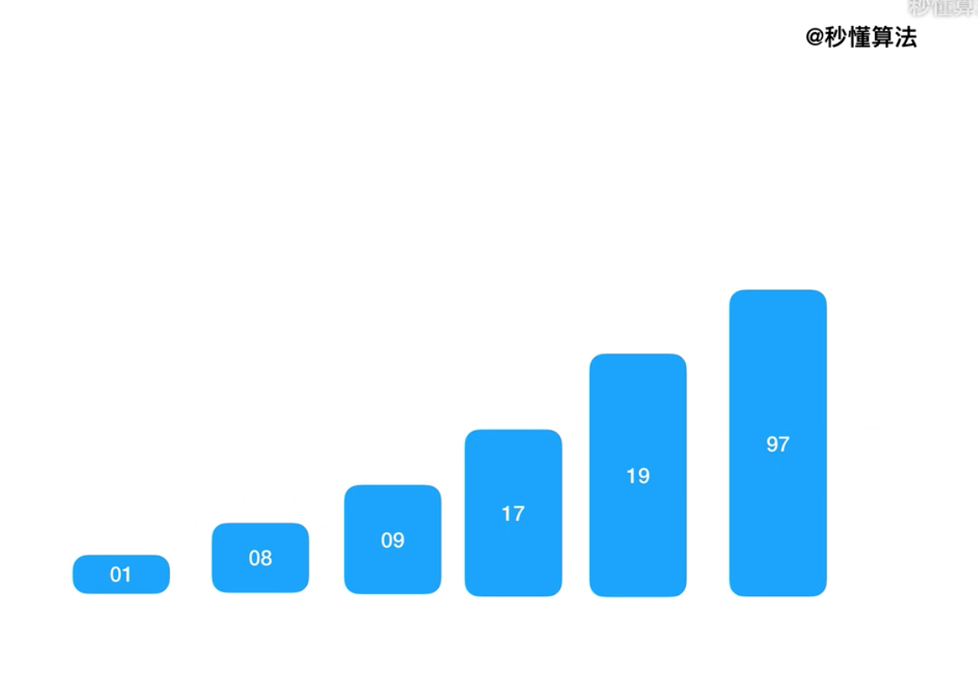
Chapter 2 Recursion and divide-and-conquer strategy - Quicksort
Swap elements less than x to the left region
Swap elements greater than x to the right regionquicksort(A, lo, hi)
if lo < hi
p = partition(A, lo, hi)
quicksort(A, lo, p - 1)
quicksort(A, p + 1, hi)
partition(A, lo, hi)
pivot = A[hi]
i = lo //place for swapping
for j = lo to hi - 1
if A[j] <= pivot
swap A[i] with A[j]
i = i + 1
swap A[i] with A[hi]
return i
template<class Type>
int Partition (Type a[], int p, int r)
{
int i = p, j = r + 1;
Type x=a[p];
// 将< x的元素交换到左边区域
// 将> x的元素交换到右边区域
while (true) {
while (a[- -j] >x);
if(i<j) Swap(a[i], a[j]);
while (a[++i] <x);
if(i<j) Swap(a[i], a[j]);
if (i >= j) break;
}
a[p] = a[j];
a[j] = x;
return j;
}

Slide 59
Chapter 2 Recursion and divide-and-conquer strategy - Quicksort
The performance of quicksort algorithm depends on the symmetry of partition and the selection of pivot
No matter how to choose the pivot will not affect the sorting result, but it may affect the choice of different overall sort time, because the pivot choice is different, which can lead to split the two sets of different sizes. After splitting, the two sets are almost equal in size. So the number of the overall segmentation can also be reduced obviously. Then the overall cost of time also corresponding reduced.

Slide 60
Chapter 2 Recursion and divide-and-conquer strategy - Quicksort
Pivot: first or last
If the number to be sorted is random, there is no problem with choosing the first or last one as the Pivot, which is the most common choice. But if the data to be sorted is already sorted, it will produce a bad split. Almost all the data is split into one set and the other set has no data. In this case, time is spent, but not much is done. And its time complexity is the worst case, O(n²). So this strategy is definitely not recommended.
Worst-case: When partitioning a region, the two partitions contain 1 and n-1 elements, respectively
T(n) = T(n-1)+O(n)

Slide 61
Chapter 2 Recursion and divide-and-conquer strategy - Quicksort
Pivot: randomly selected
It is safe to choose Pivot at random. Because it doesn't always produce bad splits.

Slide 62
Chapter 2 Recursion and divide-and-conquer strategy - Quicksort
The performance of the quicksort algorithm depends on the symmetry of the partition. By modifying algorithm Partition, a quicksort algorithm with random selection strategy can be designed. In each step of the quicksort algorithm, when the array has not been partitioned, a random element in a[p: r] can be selected as the partition pivot, so that the selection of partition pivot is random, so that the partition can be expected to be more symmetric.
template<class Type>
int RandomizedPartition (Type a[], int p, int r)
{
int i = Random(p,r);
Swap(a[i], a[p]); Pick a random number and switch it with the first element
return Partition (a, p, r);
}

Slide 63
Chapter 2 Recursion and divide-and-conquer strategy - Quicksort
Pivot: Select the median of three numbers
If you can pick the median of the data, that's the best, because it divides the set almost equally. But many times it's hard to figure out the median and it's computationally expensive. You can pick three elements at random and use their median value as an estimate of the median value of the entire data

Slide 64
Chapter 2 Recursion and divide-and-conquer strategy - Quicksort
The worst time complexity：O(n²)
Average time complexity：O(nlogn)
The first number is traversed through n numbers
The second number is traversed through n-1 numbers
And so on
The sum of these equals n*(1+n)/2, and the time is O(n²).

Slide 65
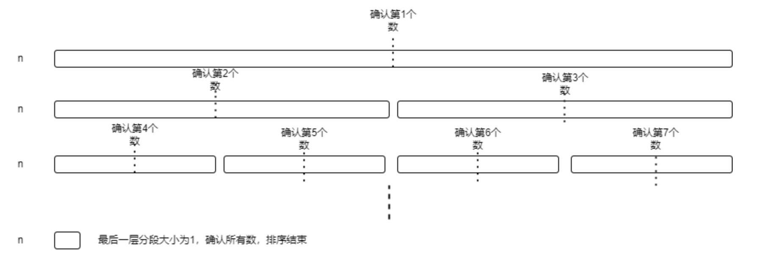
Chapter 2 Recursion and divide-and-conquer strategy - Quicksort
The worst time complexity：O(n²)
Average time complexity：O(nlogn)
2T(n/2)+O(n)

Slide 66
Chapter 2 Recursion and divide-and-conquer strategy - Quicksort
Quick sort and Merge sort
Quick sort：Commonly used, the efficiency of the algorithm is not stable
Merge sort：Stable, but takes up a lot of extra memory

