Slide 1
0-1 knapsack problem
0-1背包问题

Slide 2
0-1背包问题
假设你是一名经验丰富的探险家，背着背包来到野外进行日常探险。天气晴朗而不燥热，山间的风夹杂着花香，正当你欣赏这世外桃源般的美景时，突然，你发现了一个洞穴，这个洞穴外表看起来其貌不扬，但凭借着惊为天人的直觉，这个洞穴不简单。
于是，你开始往洞穴内探索，希望能发现一些有意思的东西。终于，皇天不负有心人，你在洞穴的尽头，发现了一堆不世出的珠宝，凭借你惊人的阅历，一眼便看出了它们各自的价值，心想着下下下下下下下下半辈子都有着落了。
然而，天有不测风云，正准备将它们收入囊中，却不小心触碰到一个防御机关，洞穴马上就要崩塌了。在此危机时刻，你只有一个背包，你必须尽快做出抉择，从中选择最值钱的珠宝塞到你的背包，让背包中珠宝的总价值最大。

Slide 3
Story background
In short, you have a limited backpack with a total capacity of c. You have n items to choose from, one for each item, each with their own weight and value, and you need to choose the right combination to maximize the total value of the items in your backpack.
There is only one for each item, and for each item, there are only two choices, choose it or not, choose it as 1, do not choose as 0, we can not divide the item, for example, only take half is not allowed. That's why this problem is called the 0/1 knapsack problem.
容量

Slide 4
0-1 knapsack problem
There is a backpack with capacity c, and some items. These items have two attributes, volume w and value v, one for each item. Ask to use this knapsack to pack as many items as possible under the value of the maximum value, the backpack can be left unfilled.
0-1 knapsack problem: In the optimal solution, each item has only two possible situations, in the knapsack or not in the knapsack (the number of items in the knapsack is 0 or 1), so it is called the 0-1 knapsack problem.
容量
体积

Slide 5
Solution analysis
For each item, there are two result: can fit or can't fit.
First, the capacity of the bag is smaller than the volume of the item, so the maximum value of the bag is the same as the maximum value of the previous i-1 items.
Second, there is still enough capacity to hold the item, but it is not necessarily greater than the current optimal value for the same volume, so comparisions are made.
According to the above analysis, the number of items and backpack capacity in the subproblem should be used as variables. Therefore, the subproblem is determined to find the maximum value of the first i items when the backpack capacity is j.

Slide 6
Let the optimal value of the subproblem of the given 0-1 knapsack problem be m(i, j), that is, m(i, j) is the optimal value of the 0-1 knapsack problem when knapsack capacity is j and optional items are i, i +1... n. From the optimal substructure properties of the 0-1 knapsack problem, the recurrence for computing m(i, j) can be established as follows.

Slide 7
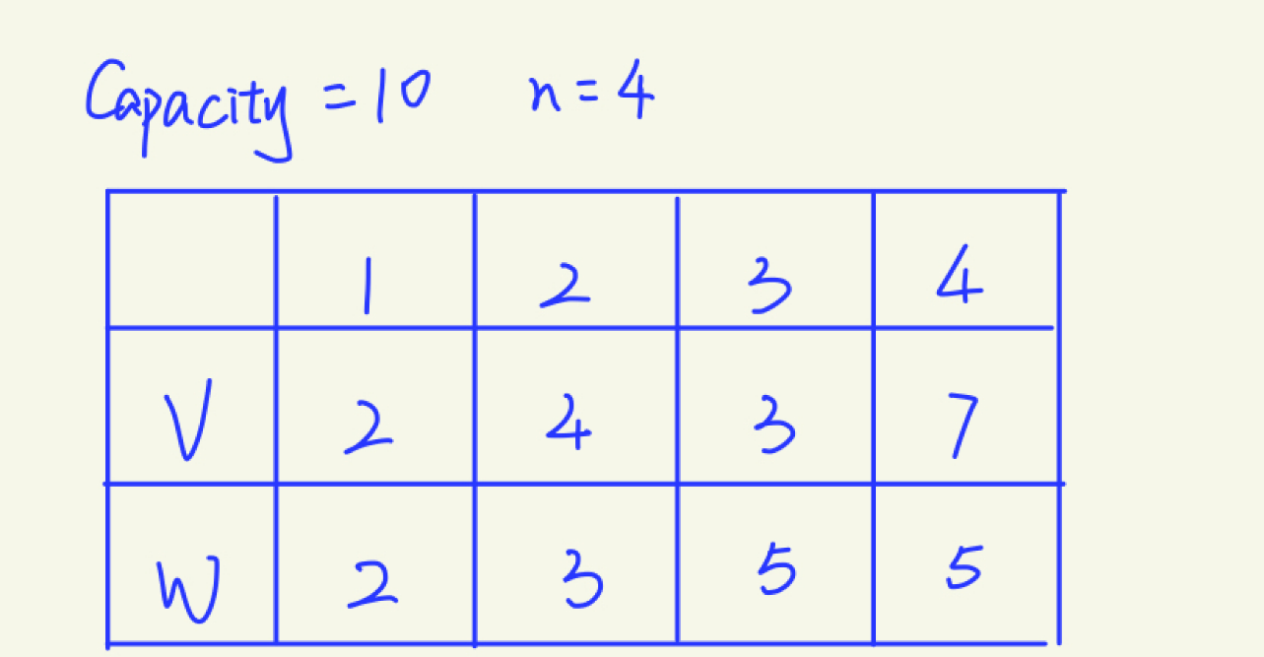
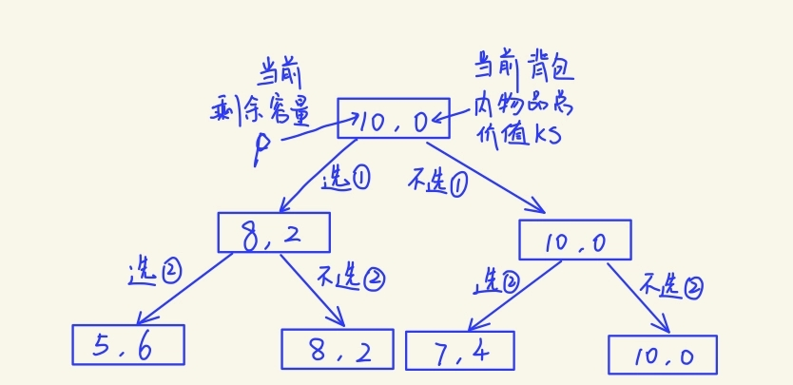
The initial state is that the backpack capacity is 10 and the total value of the items in the backpack is 0. For jewelry number 1, the current capacity is 10, which is more than enough to hold its weight of 2, so there are two choices: choose it or not. When we choose a piece of jewelry, the backpack's capacity decreases, but the total value of the contents increases

Slide 8
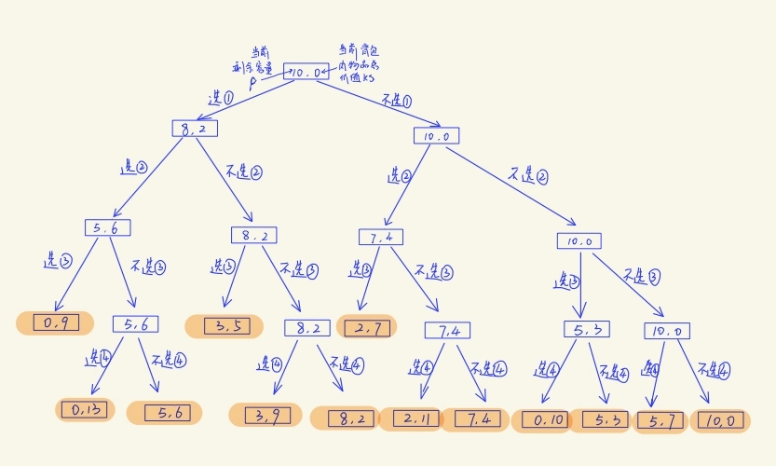
There should have been 16 results to choose from, but three results did not proceed to fission because the capacity was not enough to accommodate the last jewel, with a maximum value of 13, and the final results were: jewel 4, jewel 2, jewel 1.

Slide 9
动态规划就是一个填表的过程。该表记录了已解决的子问题的答案。求解下一个子问题时会用到上一个子问题的答案。{比如01背包问题：假如有1个背包，背包容量是10，有5个物品，编号为1，2，3，4，5，他们都有各自的重量和价格。要求在不超过背包容量的情况下，使背包装载物品的价值最大。现将问题拆分为五个子问题。
1.背容=10，从1号物品中找出该问题的解
2.背容=10，从1号，2号物品中找出该问题的解
3.背容=10，从1号，2号，3号物品中找出该问题的解
4.背容=10，从1号，2号，3号，4号物品中找出该问题的解
5.背容=10，从1号，2号，3号，4号，5号物品中找出该问题的解

Slide 10
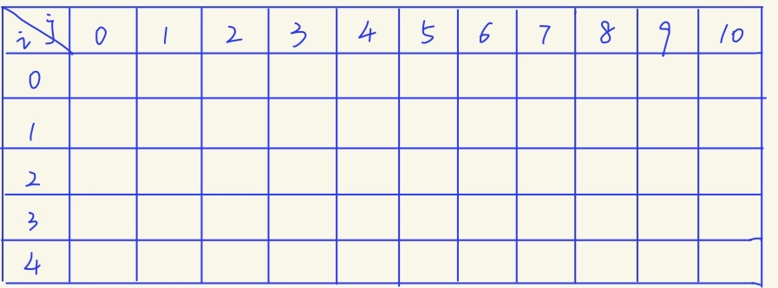
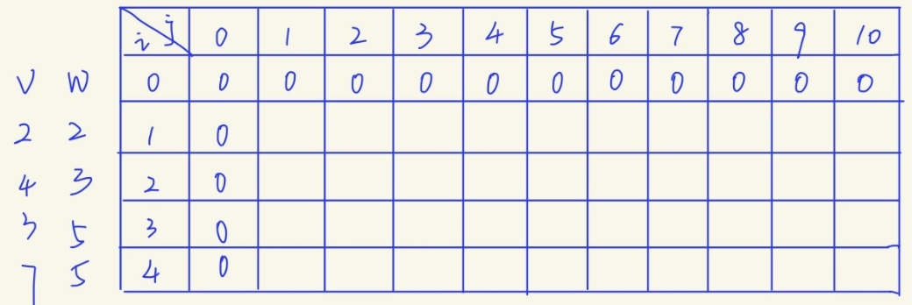
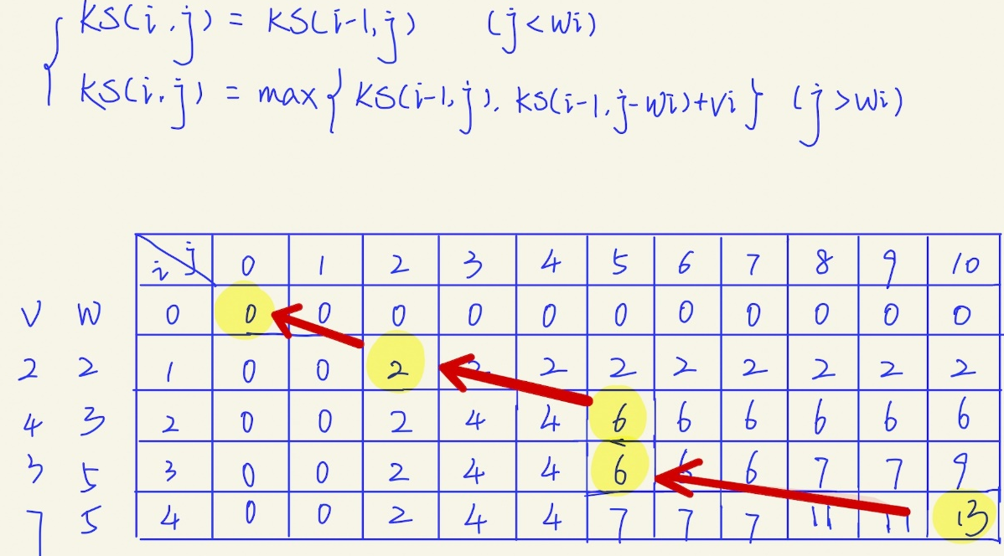
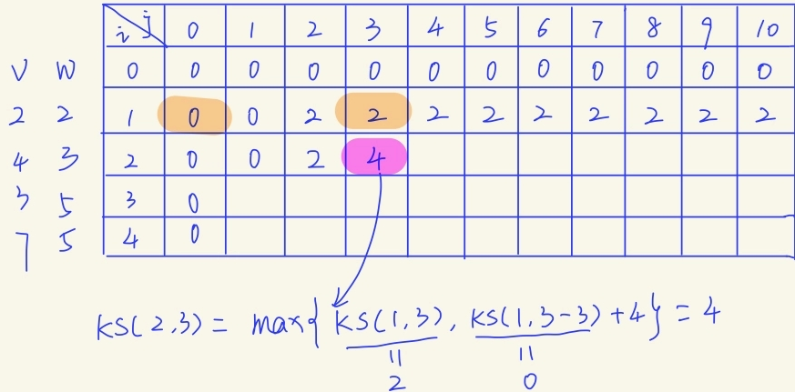
当i=1时，即只有珠宝1可供选择，那么如果容量足够的话，最大价值自然就是珠宝1的价值了。
当i=2时，有两个物品可供选择，此时应用上面的递推关系式进行判断即可。这里以i=2,j=3为例进行分析：
9
反向找出各个物品的选择，寻找的方法很简单，就是从i=4,j=10开始寻找，如果ks(i-1,j)=ks(i,j)，说明第i个物品没有被选中，从ks(i-1,j)继续寻找。否则，表示第i个物品已被选中，则从ks(i-1,j-wi)开始寻找。

Slide 11
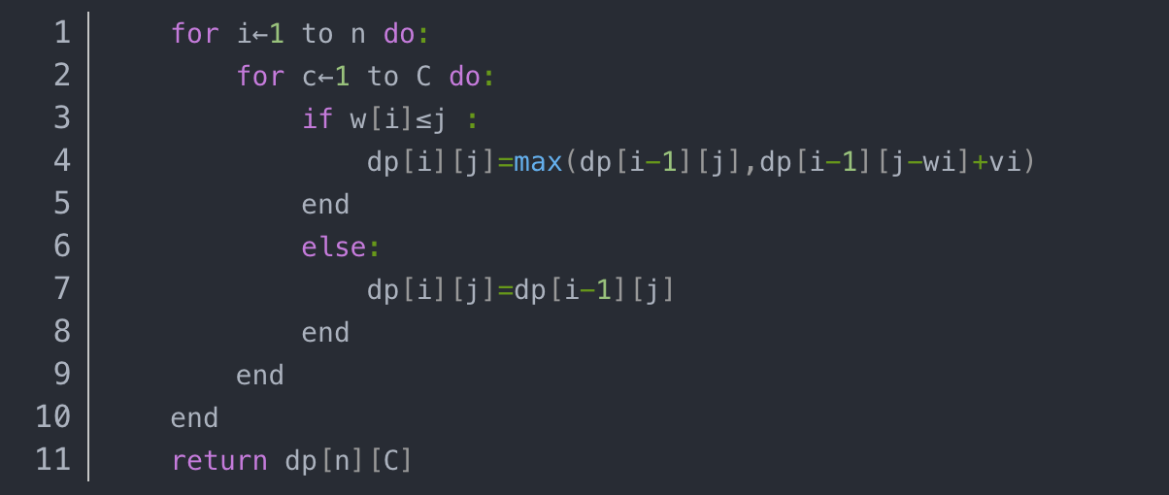
Pseudo code

Slide 12
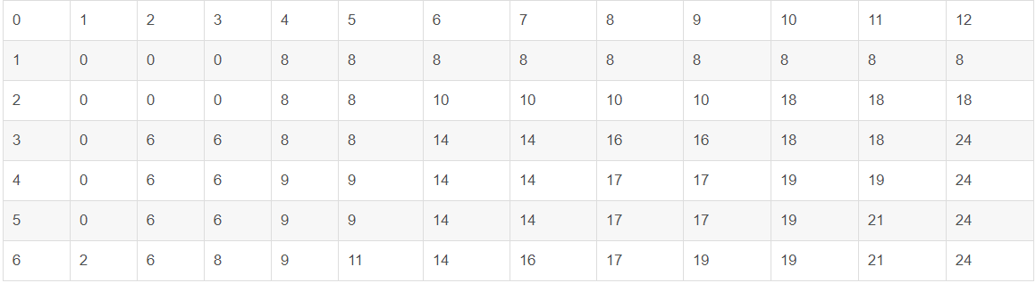
Value array v = {8, 10, 6, 3, 7, 2}，weight array w = {4, 6, 2, 2, 5, 1}， knapsack capacity c = 12 corresponding m[i][j].

Slide 13
Optimal Binary Search Trees

Slide 14
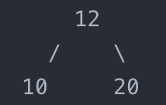
Instance
If the search probability of each element in an ordered array or an ordered table is equal, then binary search tree (BST) is used to search in half, and the performance is optimal. (recall binary search method)

Slide 15
Instance
The ordered table keys is known, and the query frequency of each element is given. Note that the query frequency of each element is not the same. Under this condition, an optimal search binary search tree is required to be constructed.
keys[] = {10, 12, 20}
freq[] = {34, 8, 50}

Slide 16
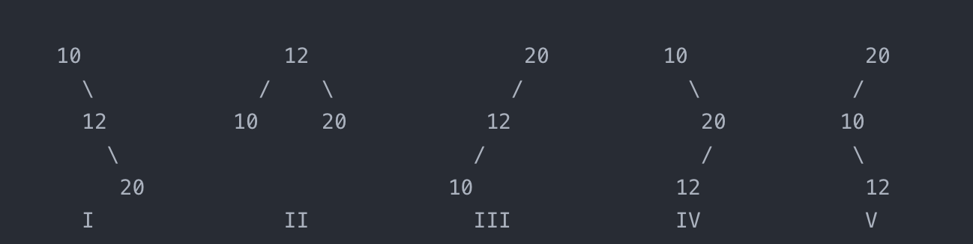
Instance
Five different binary search trees can be constructed, and the optimal binary search tree is the sum of the least weighted path:
Path Weight=Σ（weight[i]∗height[i])(0<=i<n)

Slide 17
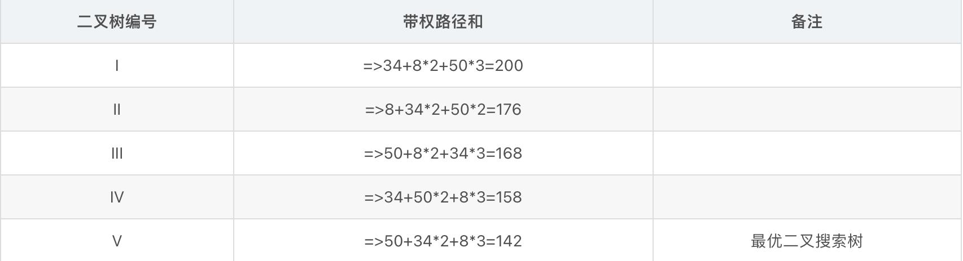
Instance

Slide 18
Given a sorted sequence of n different keywords S，construct a binary search tree by using these keywords.
For each keyword x_{i}, there is a probability pi that represents its search frequency.
Some of the values to be searched for may not be in S, so we also have n+1 "pseudo keywords" d₀, d₁, d₂ ... d_{n} stands for a value that is not in S. d₀ denotes all values less than x₁, d_{n} denotes all values greater than x_{n}, for i=1,2,...,n−1, the pseudo-keyword d_{i} represents all values between x_{i} and x_{i+1}. For each pseudo-keyword d_{i}, there is also a probability pi representing the corresponding search frequency.
Notes:
画一个示意图

Slide 19
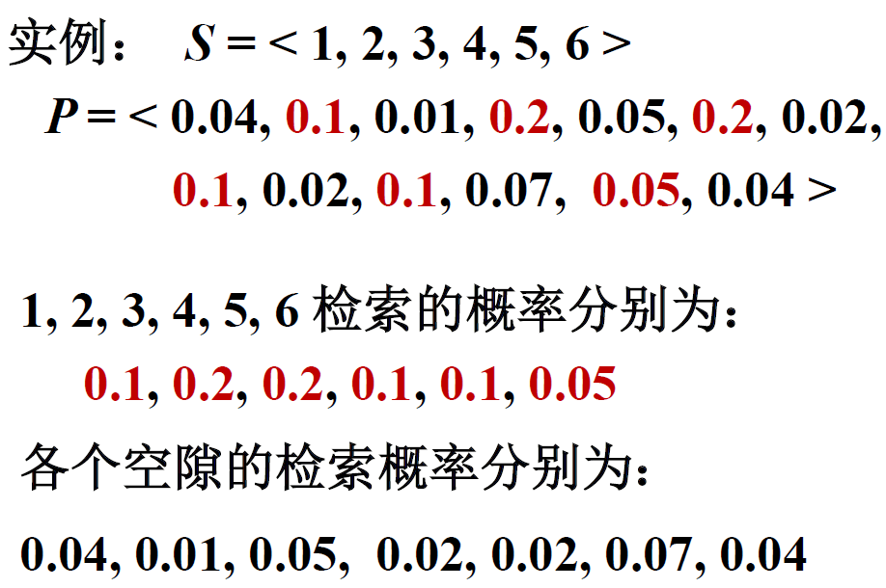

Slide 20
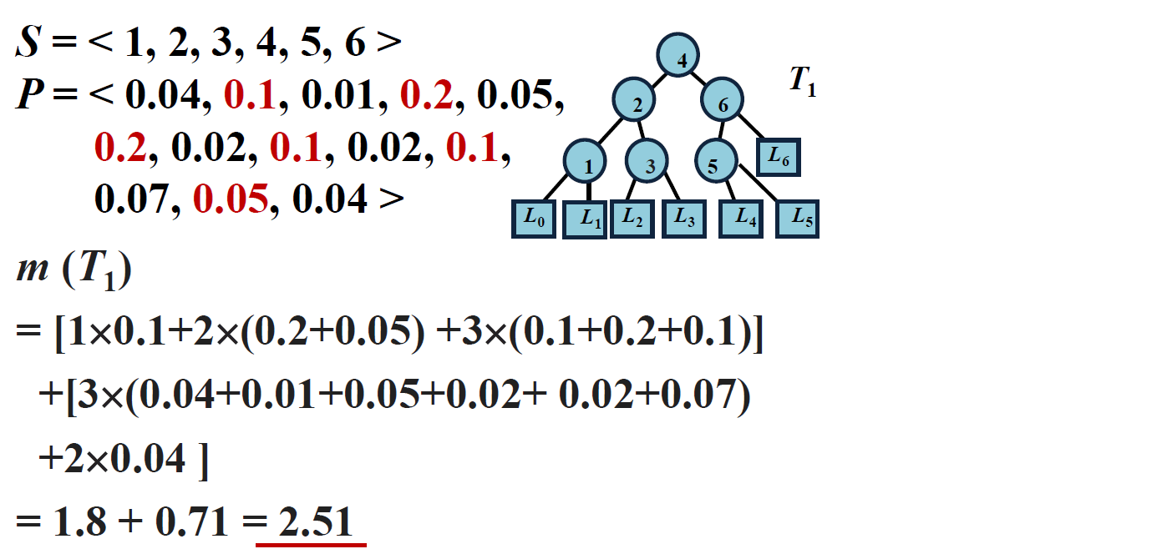

Slide 21
Let the actual cost of a search be the number of nodes checked, that is, the depth of nodes found by searching in T plus 1. So the expected cost of a search in T is:
It is important to note that an optimal binary search tree is not necessarily a tree with minimum overall height, nor does it always place the keyword with maximum probability at the root.

Slide 22
Key Issues
The boundary of subproblem is defined
How can the problem be reduced to smaller subproblems
Recursion equation and initial value of optimization function
Calculate the order
Time complexity analysis

Slide 23
The subproblem boundary is (i,j):
Data set：S [i, j] = < xi , xi+1, … , xj >
Access probability distribution：
P[i, j]=<ai－1, bi , ai , bi+1 , … , bj , aj>
Input the instance: S = < A,B,C,D,E >
P = < 0.04, 0.1, 0.02, 0.3, 0.02, 0.1,
0.05, 0.2, 0.06, 0.1, 0.01>
Subproblem：S[2,4] = < B, C, D >
P[2,4]=<0.02, 0.3, 0.02, 0.1, 0.05, 0.2, 0.06>

Slide 24
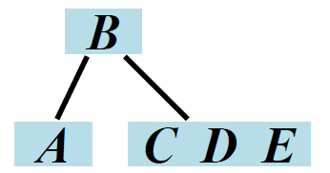
Taking x_{k} as a root reduces to a subproblem：
S[ i, k−1 ], P[ i, k−1]
S[ k+1, j ], P[ k+1, j ]
S[1,5] = < A, B, C, D, E >
P[1,5]= < 0.04, 0.1, 0.02, 0.3, 0.02, 0.1,
0.05, 0.2, 0.06, 0.1, 0.01>
S[1,1] = < A >，
P[1,1] = < 0.04, 0.1, 0.02 >
S[3,5] = < C,D,E >,
P[3,5] = < 0.02, 0.1, 0.05, 0.2, 0.06, 0.1, 0.01>

Slide 25
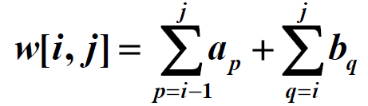
Subproblem definition S[i,j] 和P[i,j], set
Is the sum of all probabilities (data and gaps) in P[i,j]
Instance：S[2,4]=<B,C,D>
P[2,4]=<0.02,0.3,0.02,0.1,0.05,0.2,0.06>
w[2,4]=(0.3+0.1+0.2)+(0.02+0.02+0.05+0.06) = 0.75

Slide 26
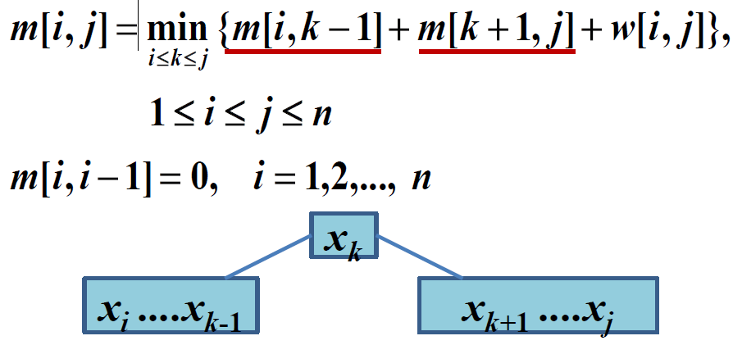
The recursive equation of the optimization function: Let m[i,j] be the average number of comparisons of the optimal binary search tree with respect to the inputs S[i,j] and P[i,j] :

Slide 27
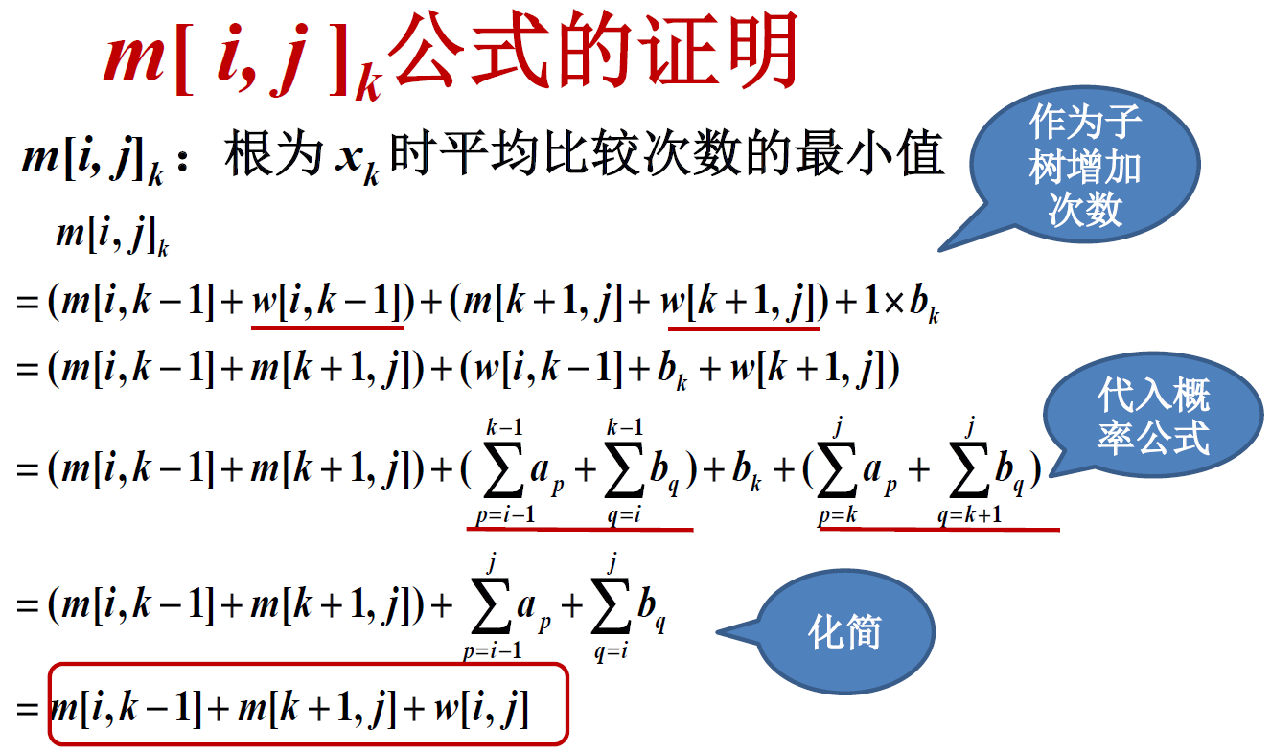

Slide 28
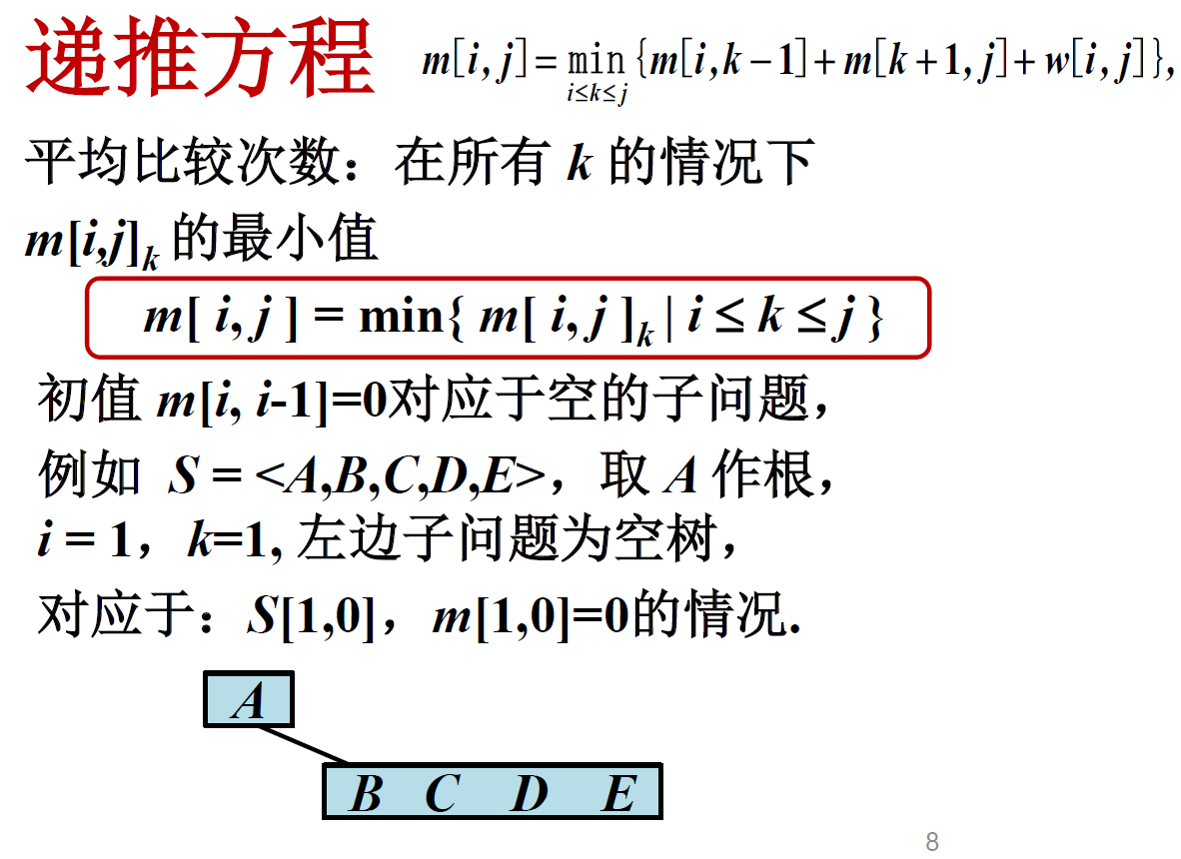
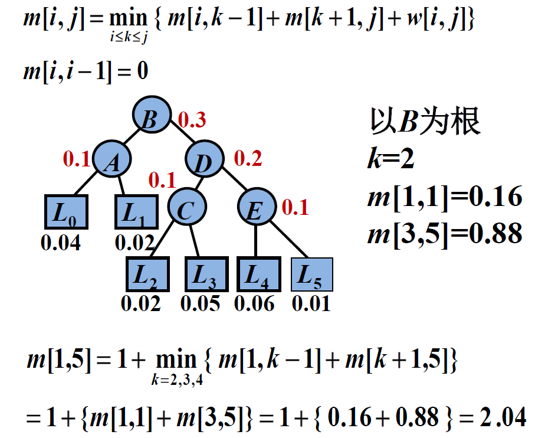

Slide 29
Pseudo-code
void optimalBST(int keys[], int freq[], int n) {
int cost[n][n]; // 存储最优二叉搜索树的期望搜索代价
int root[n][n]; // 存储最优二叉搜索树的根节点
for (int i = 0; i < n; i++) // 初始化只包含一个关键字的情况
{ cost[i][i] = freq[i]; // 当只有一个关键字时，期望搜索代价为频率
}
for (int length = 2; length <= n; length++) // 计算包含不同关键字数量的最优二叉搜索树
{ for (int i = 0; i < n - length + 1; i++) {
int j = i + length - 1;
cost[i][j] = INT_MAX;//初始化为整型变量类型的最大值 INT_MAX，通过比较找到更小的代价值并更新
for (int r = i; r <= j; r++) {
int c = (r == i) ? 0 : cost[i][r - 1]; // 左子树的期望搜索代价
c += freq[r]; // 当前关键字的频率
c += (r == j) ? 0 : cost[r + 1][j]; // 右子树的期望搜索代价
if (c < cost[i][j]) {
cost[i][j] = c;
root[i][j] = r; // 更新根节点位置
}
}
}
}

Slide 30
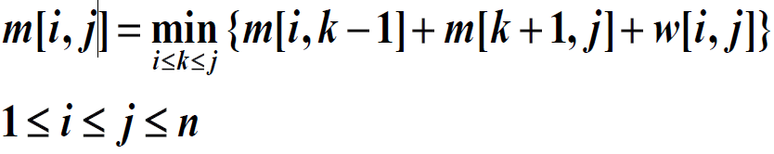
m[i,i-1] = 0, i =1,2,…,n
i, j all combination is O(n²)
Each of these is going to be computed for a different k, k=O(n)
Each calculation is a constant time
Time complexity：T (n) = O (n³)
Space complexity：S (n) = O (n²）

Slide 31
Divided into sub-problems, take the data node as the root
Define optimization function, list recursive equation and boundary condition
A marker function is set to record the location of the root when forming an optimal binary search tree or subtree.
Bottom-up calculations, design memos (tables)
Time complexity estimation

