Slide 1
Image Compression

Slide 2
Problem description
Problem description: In the computer, the gray value sequence {p₁,p₂,……p_{n}} represents the image. The integer p_{i},1<=i<=n, represents the gray value of pixel i.
Usually, the gray value ranges from 0 to 255. So at most 8 bits (2⁸) are needed to represent a pixel. If there are n gray sequences, the occupied space is 8*n.
像素

Slide 3
Problem analysis
Analysis: Not all pixels need to be stored with binary 8 bits, because some gray values are not as large as 255, so can the algorithm be improved?
23，17，28，23，27，29，30，18，28，27，39，48，129 ，139，178，220，23，9，183，133，19，255.... We can think of 23,17,28,23,27,29,30,18,28,27 as a group (10 numbers), each of which can be stored with 5 bits (2⁵ );
{6,5,7,5,245,180,28,28,19, 22, 25,20} This is a set of gray value sequence, a total of 12 numbers, the traditional storage method: 12*8=96 bits to represent.

Slide 4
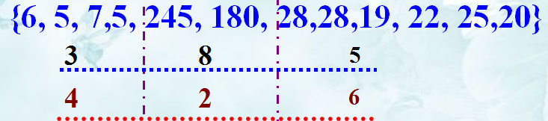
Problem analysis
If divided into three groups:
The first set has 4 numbers, the maximum is 7, so it's represented by 3 bits;
The second set has 2 numbers, the maximum is 245, so it's represented by 8 bits;
The third set has 6 numbers, the maximum is 28, so it's represented by 5 bits;
The final number of bits is 4*3+2*8+6*5+11*3=91.

Slide 5
Problem analysis
Gray value sequence P={10,12,15,255,1,2,1,1,2,2,1,1}. (12 numbers)
Method1：S1= {10, 12, 15}，S2={255}, S3={1, 2, 1, 1, 2, 2, 1, 1}。
Method2：S1={10,12,15,255,1,2,1,1,2,2,1,1}。
Method3：Divide into 12 groups, one number for each group.
Storage space
Method1：11×3+4×3+ 8×1+2×8 = 69
Method2：11×1+8×12 =107
Method3：11×12+4×3+8×1+1×5+2×3=163

Slide 6
Problem analysis
The principle of compression is to set a break point for the sequence {p₁,p₂,……p_{n}} and divide it into segments, and the pixels in the same segment occupy the same number of bits.
The process of segmentation is to find a break point so that the maximum gray value of the pixels in a segment is small, so that the segment of pixels (which would otherwise need 8 bits) can be represented by fewer bits (such as 5 bits), thus reducing storage space.

Slide 7
Problem analysis
Each pixel stores the required information:
1. The number of pixels contained in each segment of pixel; (To give a constraint, generally set no more than 256)
2. The number of bits occupied by the largest pixel in this segment of pixels;

Slide 8
Problem analysis
The problem of image compression is to determine the optimal segmentation of the pixel sequence {p₁,p₂,……p_{n}}, which minimizes the storage space required for the segmentation.
Modeling: A sequence of n pixels {p1,p2,……,pn}, divided into m segments s1,s2,……,sm, the number of pixels in the same segment occupy same bits.
确定
最优分段
S1
S2
S3
S4
Sm

Slide 9
Problem analysis
For segment t, there are l[t] pixels, each occupying b[t] bits.
Segment header: recording l[t] (8 bits) and b[t] (3 bits) requires 11 bits.
In fact, storage space is allocated to record the number of pixels（2⁸） and the maximum number of bits per pixel（2³） in each segment.
Specific pixel information: number of pixels * maximum number of bits per pixel;

Slide 10
Problem analysis
段头
具体像素信息
段头：像素个数，约束不超过256个，采用最多8位就可存储；每个像素最多8位存储，段头用3位表示。
Total bits
Each segment

Slide 11
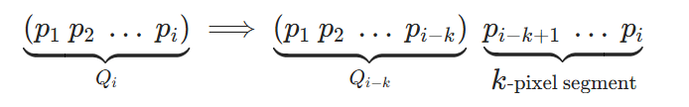
Dynamic programming
Ⅰ. Optimal substructure properties
Problem Definition: Let Q_{i}​ denote the optimal segmentation of the first i pixels (p₁​,p₂​,…,p_{i}​).
Assume the last segment of this optimal segmentation contains k pixels, then the following relationship holds:
It can be seen that the optimal substructure property is satisfied: Q_{i}​ contains Q_{i−k}​.
表示
假设
成立

Slide 12
Ⅱ. Compute the optimal value recursively
Let s[i],1<=i<=n be the number of memory bits required for optimal segmentation of pixel sequence {p1,p2,……pi}, then s[i] is the first i-k bits plus the last k bits of storage space.

Slide 13
Ⅱ. Compute the optimal value recursively
From the optimal substructure properties:
K indicates the disconnection position
P1, P2, …. P_{i-k} P_{i-k+1}, P_{i-k+2}, ….. P_{i}

Slide 14
// 函数：Compress —— 使用动态规划实现图像压缩
// 参数：
// n: 像素总数
// p[]: 存储像素值的数组（p[i] 表示第 i 个像素）
// s[]: 动态规划状态数组，s[i] 表示前 i 个像素所需的最小存储空间
// l[]: 记录最优划分方式，l[i] 表示第 i 个像素所在块包含的像素数量
// b[]: 辅助数组，b[i] 表示第 i 个像素所需存储位数
void Compress(int n, int p[], int s[], int l[], int b[])
{
// Lmax: 最大允许的连续像素块长度（即最多连续合并多少个像素）
// header: 每个块需要的头部信息开销（单位：比特）
int Lmax = 256, header = 11;
// 初始化：前0个像素不需要任何存储空间
s[0] = 0;

Slide 15
// 遍历每一个像素点 i (从 1 到 n)
for (int i = 1; i <= n; i++)
{
// 第一步：计算当前像素 p[i] 所需的存储位数
// 调用 length() 函数返回表示该像素值所需的二进制位数
b[i] = length(p[i]);
// 初始化当前最大位数为当前像素本身的位数
int bmax = b[i];
// 初始化：假设前 i 个像素中最后一个块只包含当前像素
s[i] = s[i - 1] + bmax; // 即：前面 i-1 个像素已最优压缩 + 当前像素单独存
l[i] = 1; // 当前块长度设为 1（即仅含当前像素）

Slide 16
// 尝试将当前像素与前面 j 个像素合并成一个块（j 从 2 到 min(i, Lmax)）
// 这样做的目的是寻找是否能通过合并减少总体存储空间
for (int j = 2; j <= i && j <= Lmax; j++)
{
// 更新 bmax：找出从 i-j+1 到 i 这 j 个像素中，所需位数最多的那个
// 因为整个块要用统一的位数来编码所有像素（按最长的对齐）
if (bmax < b[i - j + 1])
{
bmax = b[i - j + 1];
}
// 如果将最后 j 个像素（从 i-j+1 到 i）合并成一个块，
// 总存储空间为：前 i-j 个像素的最优存储 + 一个头 + j * bmax（固定长度编码）
// 若这种方案比之前更优，则更新 s[i] 和 l[i]
if (s[i] > s[i - j] + j * bmax)
{
s[i] = s[i - j] + j * bmax;
l[i] = j; // 记录最优决策：当前块包含 j 个像素
}
}

Slide 17
// 最后加上一个块头（header）的开销，因为每个块都需要一个头
s[i] += header;
}
}
// 函数：length —— 返回整数 i 的二进制表示所需的最少位数
// 示例：i=8 → 二进制是 1000 → 需要 4 位；i=1 → 1 → 需要 1 位
int length(int i)
{
int k = 1; // 初始化为 1，因为至少需要 1 位表示非零数
i = i / 2; // 先除以 2，因为下面循环会再处理一次
// 不断除以 2，直到 i 变为 0，每次增加一位
while (i > 0)
{
k++;
i = i / 2;
}
return k;
}

Slide 18
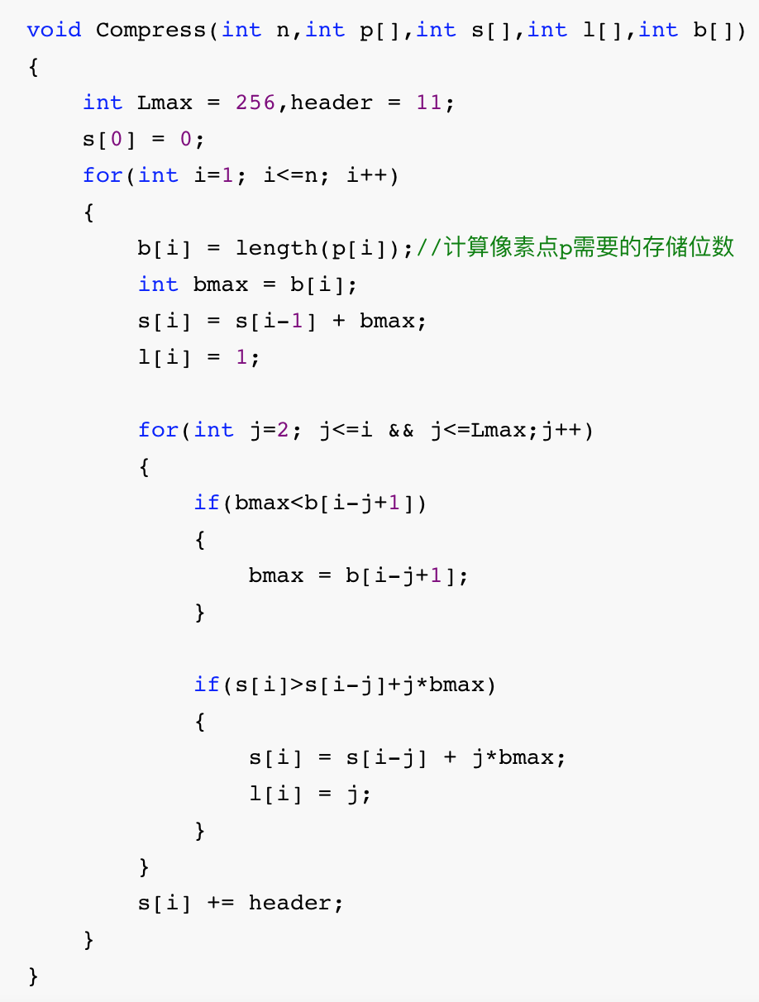
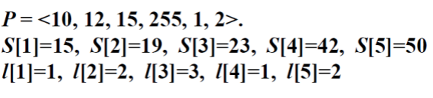
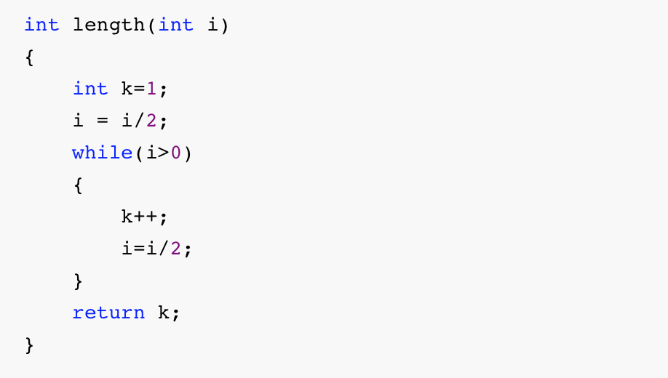

Slide 19
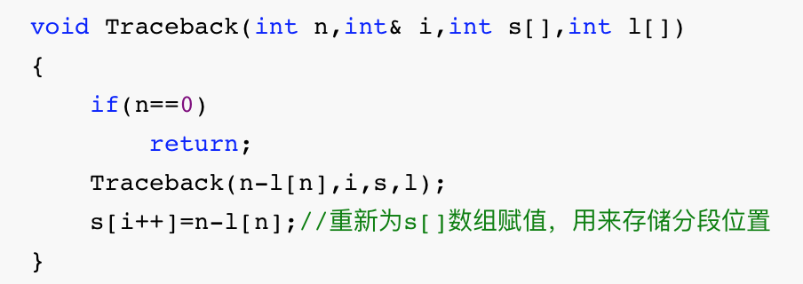
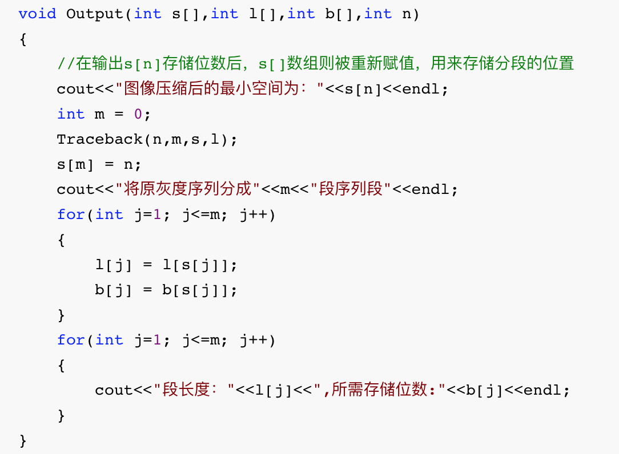
 | l[n] | b[n] | s[n]
1 | 1 | 4 | 15
2 | 2 | 4 | 19
3 | 3 | 4 | 23
4 | 1 | 8 | 42
5 | 2 | 2 | 50
6 | 2 | 2 | 57
 | s[n]
0 | 0
1 | 3
2 | 4
3 | 6
l[1]=l[s[1]]=l[3]=3 | l[2]=l[s[2]]=l[4]=1 | l[3]=l[s[3]]=l[6]=2
b[1]=b[s[1]]=b[3]=4 | b[2]=b[s[2]]=b[4]=8 | b[3]=b[s[3]]=b[6]=2

Slide 20
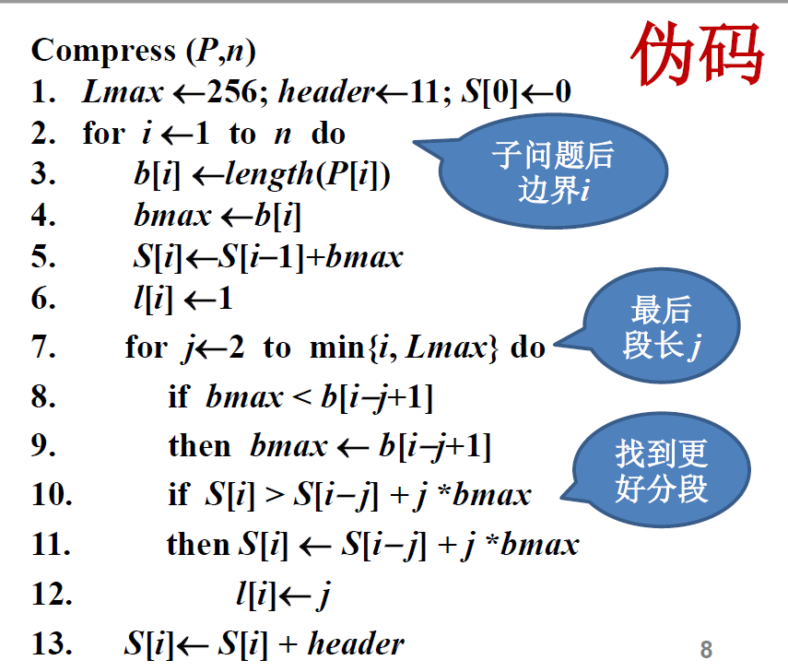
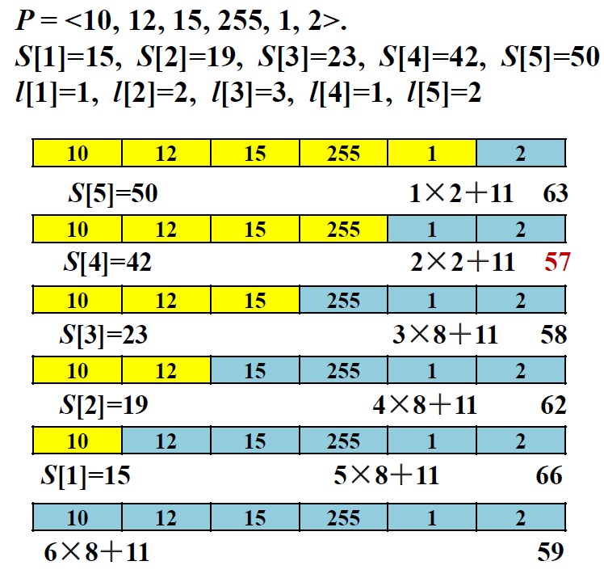

Slide 21
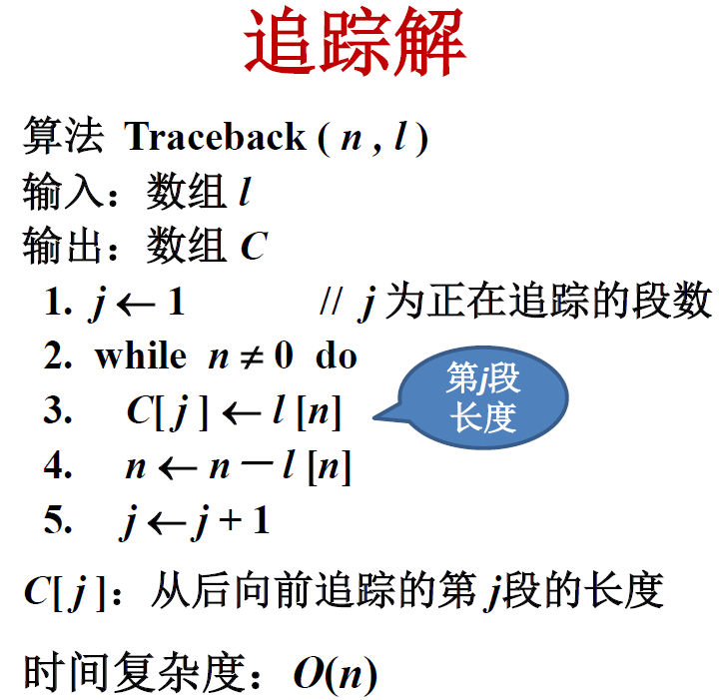
Ⅲ. construct the optimal solution

