Slide 1
Maximum Subarray Sum

Slide 2
Problem description
Problem description: Given a sequence of n integers (possibly negative) a1, a2,... , an, find the maximal subarray sum of the sequence. If all integers are negative, then define their maximum subarray sum to be 0.
(that is, the sum of maximal continuous subsequences)
Definition of optimal value:
序列
负数

Slide 3
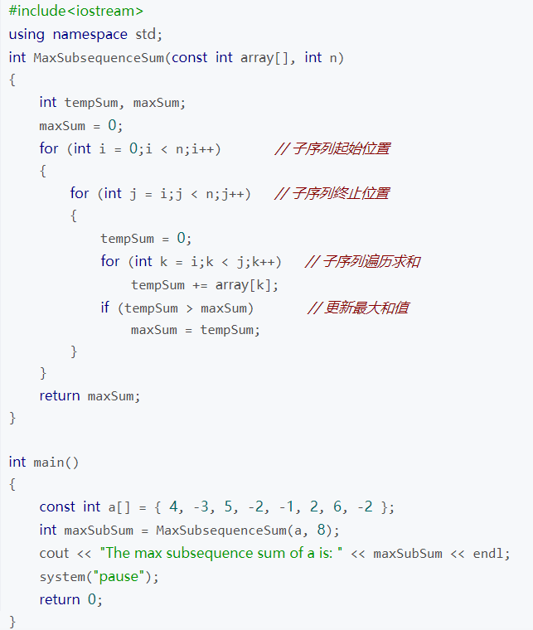
Solution 1: Brute force algorithm or exhaustive algorithm
Exhaustive of all possible subsequences starting with the first element of the sequence: it is obvious that this problem can be done in O(n²) time complexity.
穷举
O（n³）
a1 | a2 | a3 |  |  |  |  |  |  | an
i
j
<=

Slide 4
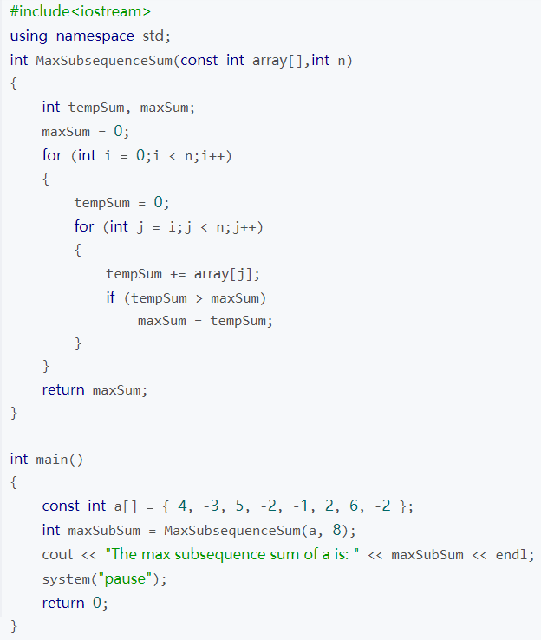
Solution 1: Brute force algorithm or exhaustive algorithm
Exhaustive of all possible subsequences starting with the first element of the sequence: it is obvious that this problem can be done in O(n²) time complexity.
穷举
O（n²）
a1 | a2 | a3 |  |  |  |  |  |  | an
i
j
a1 | a2 | a3 |  |  |  |  |  |  | an
i
j+1

Slide 5
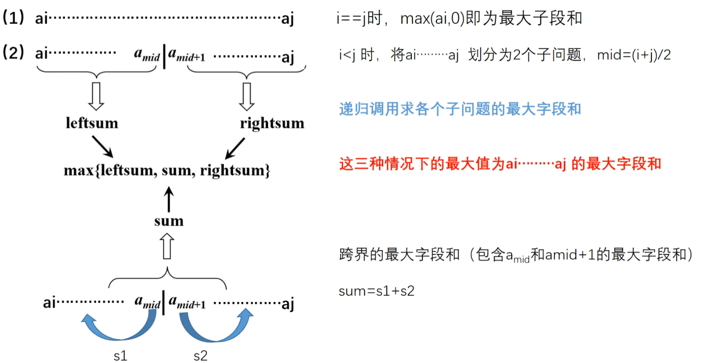
Solution 2: Divide and conquer recursive algorithm
By dividing the sequence into left and right parts, the largest subsum can occur in three places: the left half, the right half, and the part that crosses the left and right boundaries. The termination condition for recursion is left == right.

Slide 6
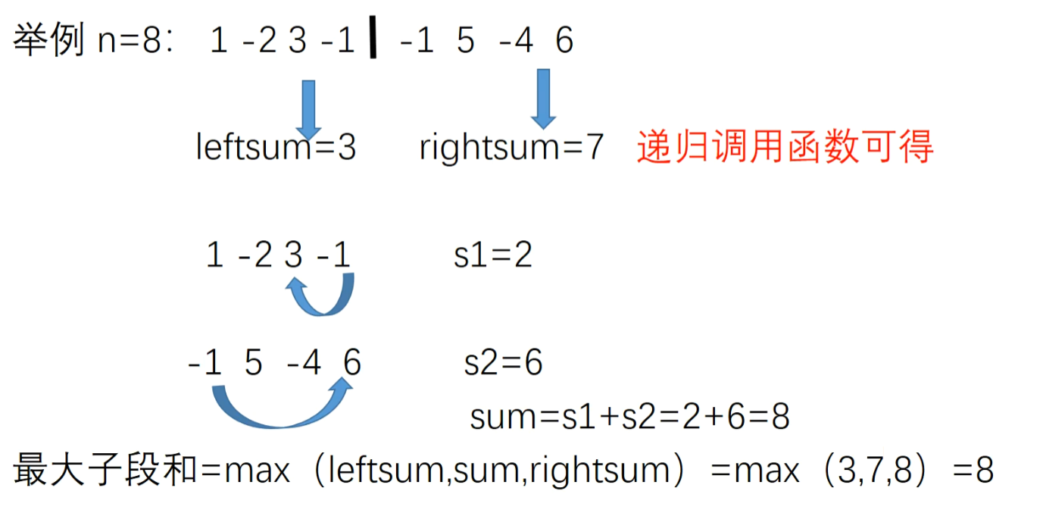
Solution 2: Divide and conquer recursive algorithm
By dividing the sequence into left and right parts, the largest subsum can occur in three places: the left half, the right half, and the part that crosses the left and right boundaries. The termination condition for recursion is left == right.

Slide 7
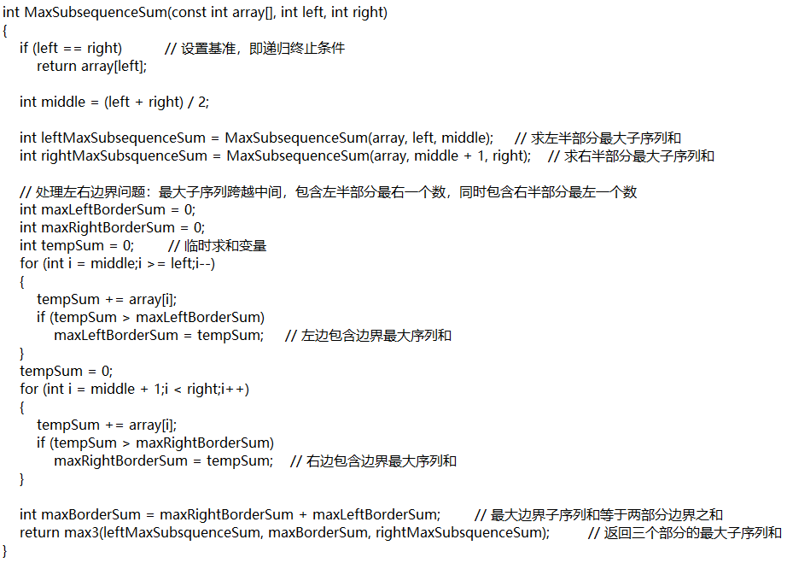
Solution 2: Divide and conquer recursive algorithm
By dividing the sequence into left and right parts, the largest subsum can occur in three places: the left half, the right half, and the part that crosses the left and right boundaries. The termination condition for recursion is left == right.
T（n） = 2T（n/2）+O（n）
主定理解方程得：
T（n） = O（nlogn）

Slide 8
Solution 3: Dynamic programming
It is difficult to optimize problems with both ends changing. It is better to fix one end, which will greatly simplify the analysis. Therefore, j is temporarily extracted from the original formula, and the rest is named b [j].
The maximum field sum required becomes:

Slide 9
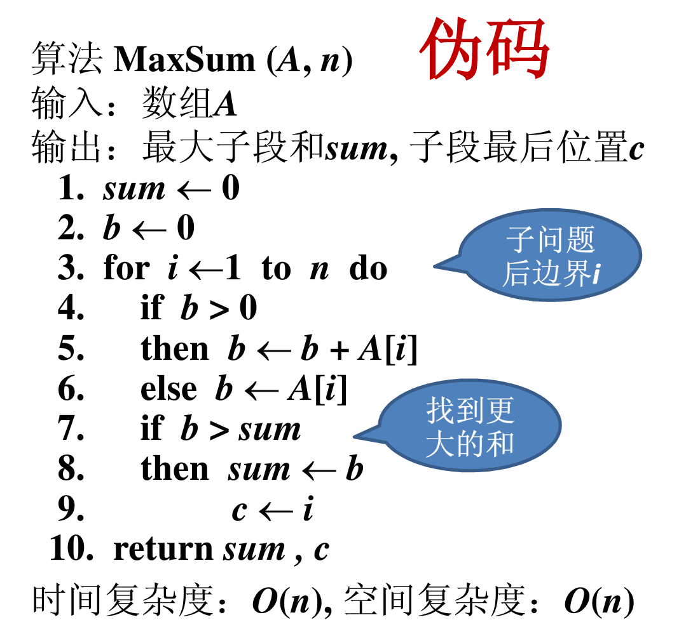
Solution 3: Dynamic programming
According to the definition of b[j], b[j] is the largest sum of subsegments ending in a[j].
If b[j-1]>0, b[j] = b[j-1] + a[j];
else b[j] = a[j].
Therefore：
b[j] = max{b[j-1] + a[j] , a[j]} 1≤j≤n

Slide 10
Solution 3: Dynamic programming
Example: {-2, 11, -4, 13, -5, -2}
sum=0
b=0
i=1~6
i = 1, b = -2
i = 2, b = 11, sum = 11, c = 2
i = 3, b = 11+(-4) = 7
i = 4, b = 7+13 = 20, sum = 20, c = 4
i = 5, b = 20+(-5) = 15
i = 6, b = 15

Slide 11
Solution 3: Dynamic programming
Key points of dynamic programming algorithm design:
(1)(division) Multi-stage decision-making process, each step deals with a sub-problem, and defines the boundary of the sub-problem (initial value problem).
(2)List the recursive equation and initial value of the optimization function (extremely critical).
(3)The problem should satisfy the optimization principle or the optimal substructure property. That is, any subsequence of an optimal decision sequence must itself be an optimal decision sequence with respect to the initial and end states of the subsequence
划分
多阶段
决策

