Slide 1
Dynamic programming

Slide 2
Basic Elements
Longest common subsequence

Slide 3
Basic elements
I. Optimal substructure
The optimal solution of a problem contains the optimal solution of its subproblems. This property is called the optimal substructure property.
When analyzing the properties of the optimal substructure of the problem, the method used is universal: first assume that the solution of the subproblem derived from the optimal solution of the problem is not optimal, and then try to show that under this assumption a better solution can be constructed than the optimal solution of the original problem, which leads to contradictions.
最优子结构
假设
矛盾

Slide 4
Basic elements
I. Optimal substructure
The optimal substructure property of the problem is used to recursively construct the optimal solution of the whole problem step by step from the optimal solution of the subproblem in a bottom-up manner. The optimal substructure is the precondition for the problem to be solved by dynamic programming algorithm.
最优子结构
前提条件

Slide 5
Basic elements
II. Properties of overlapping subproblems
When a recursive algorithm solves a problem, the subproblems generated each time are not always new problems, and some subproblems are computed repeatedly. This property is called the overlap property of subproblems.
The dynamic programming algorithm solves each subproblem only once, then saves the solution in a table, and when it needs to solve the subproblem again, it simply looks at the result in constant time.
重叠

Slide 6
基本要素
II. Properties of overlapping subproblems
Usually the number of different subproblems grows polynomially with the size of the problem. Therefore, the dynamic programming algorithm only needs polynomial time to solve the problem, so as to obtain high efficiency.
重叠
多项式的

Slide 7
Longest common subsequence

Slide 8
Problem description
Given a sequenceX={x₁,x₂,…,x_{m}}, then another sequence Z={z₁,z₂,…,z_{k}}, is a subsequence of X, which means that there exists a strictly increasing subscript sequence {i₁,i₂,…,i_{k}} such that for all j=1,2,…,k has: z_{j}=x_{ij.} For example, the sequence Z={B，C，D，B} is a subsequence of the sequence X={A，B，C，B，D，A，B}, and the subscript sequence is {2，3，5，7}.
Given two sequences X and Y, Z is said to be a common subsequence of sequences X and Y when another sequence Z is both a subsequence of X and a subsequence of Y.
严格递增
下标序列
公共子序列

Slide 9
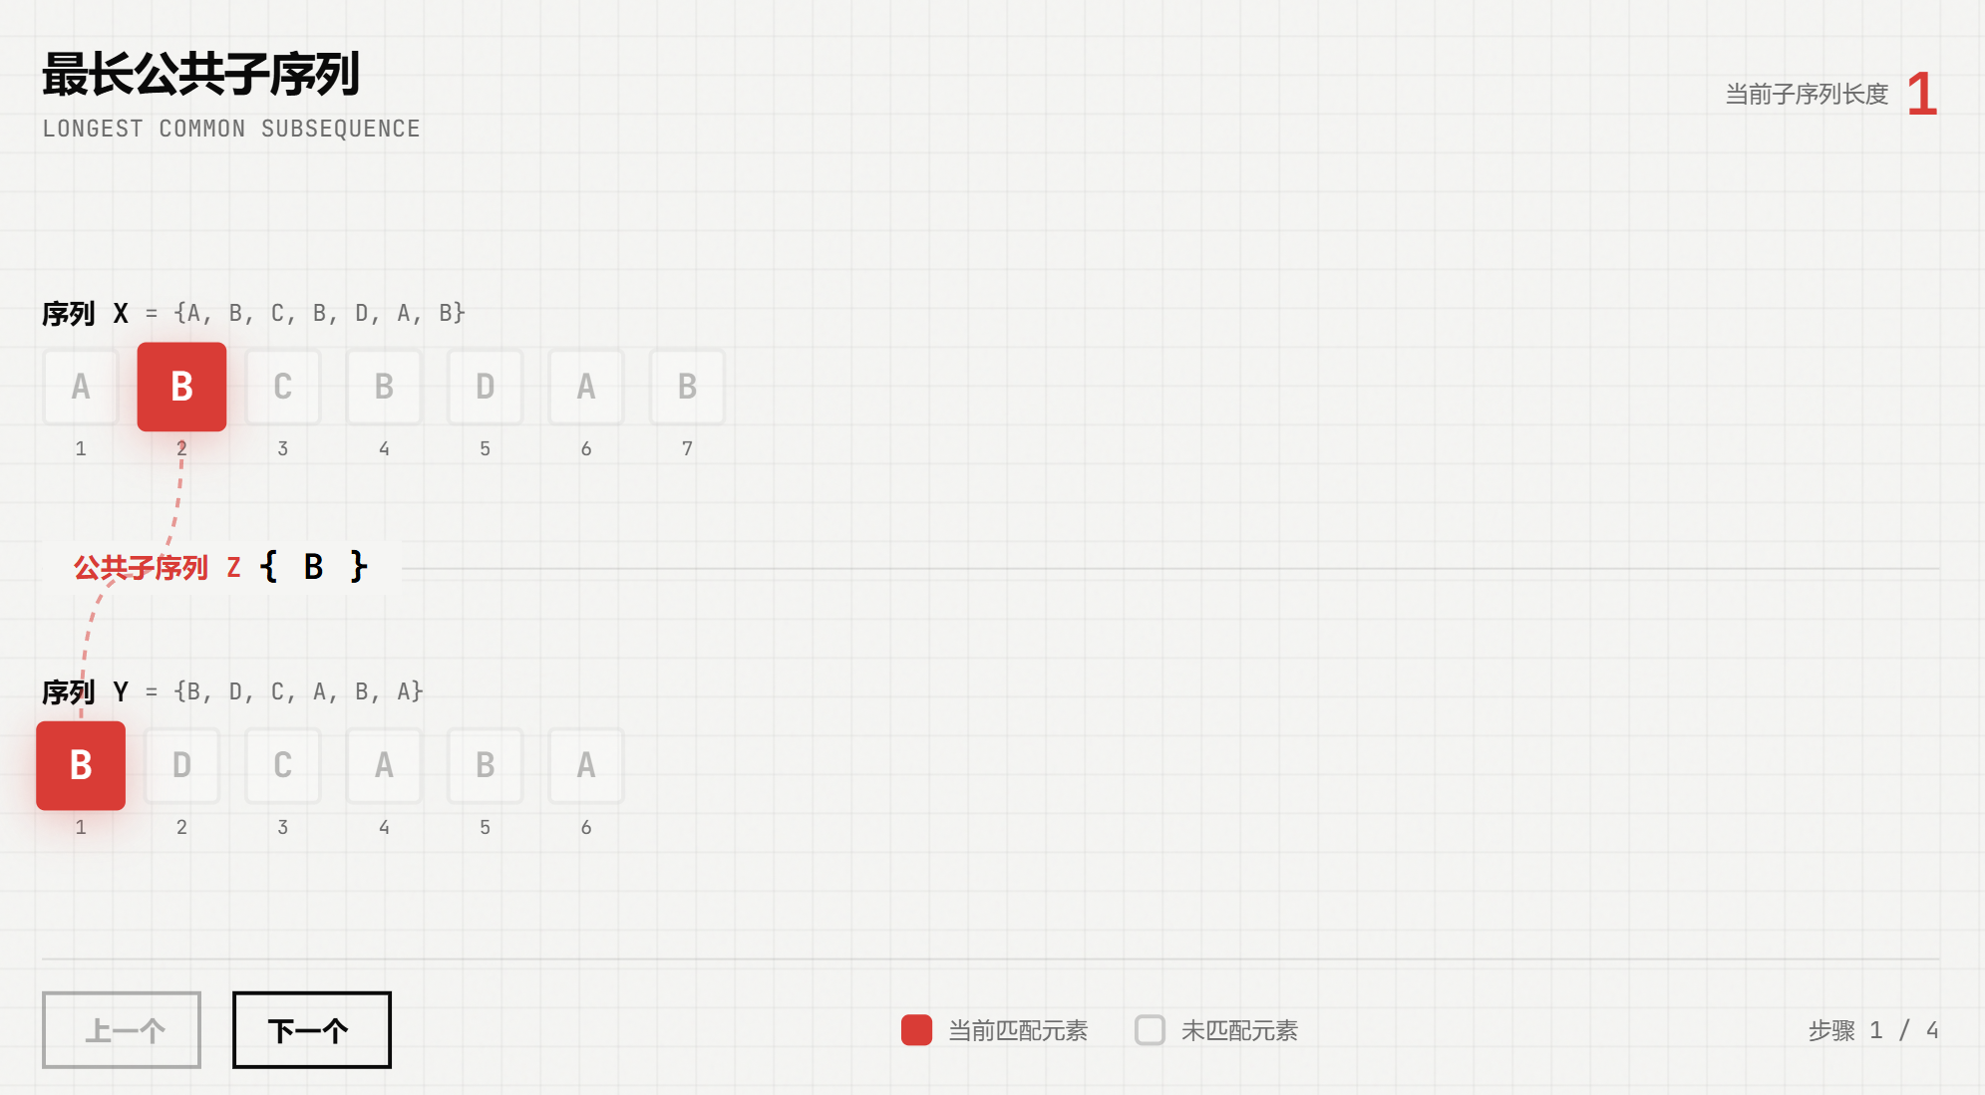
Problem description

Slide 10
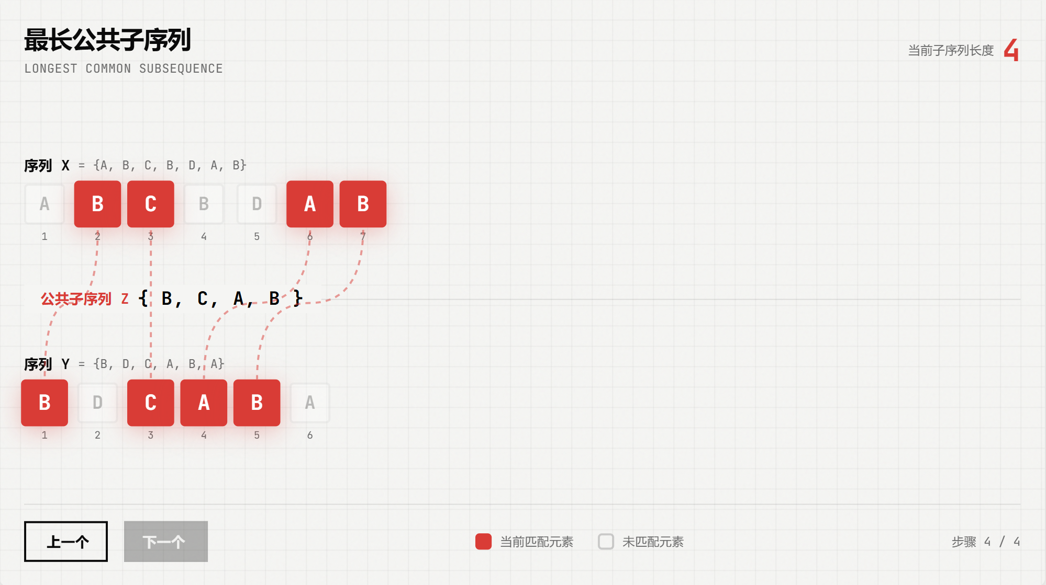
Problem description

Slide 11
Structure of the longest common subsequence
Given two sequences X={x₁,x₂,…,x_{m}} and Y={y₁,y₂,…,y_{n}}, find the longest common subsequence of X and Y.
I. Structure of the longest common subsequence
Set the longest common subsequence of sequence X={x₁,x₂,…,x_{m}} and Y={y₁,y₂,…,y_{n}} be Z={z₁,z₂,…,z_{k}}, then
(1) If x_{m}=y_{n}, then z_{k}=x_{m}=y_{n}, and Z_{k-1} is the longest common subsequence of X_{m-1} and Y_{n-1}.
(2) If x_{m}≠y_{n} and z_{k}≠x_{m}, then Z is the longest common subsequence of X_{m-1} and Y.
(3) If x_{m}≠y_{n} and z_{k}≠y_{n}, then Z is the longest common subsequence of X and Y_{n-1}.

Slide 12
Structure of the longest common subsequence
Conclusion:
the longest common subsequence of two sequences
contains
the longest common subsequence of the prefix of the two sequences.
Therefore, the longest common subsequence problem has the optimal substructure property.

Slide 13
Structure of the longest common subsequence
Ⅱ.Recursive structure of the subproblem
The recursive relation of the optimal value is established by the properties of the optimal substructure. C[i][j] is used to record the length of the longest common subsequence of the sequence. X_{i}={x₁,x₂,…,x_{i}}；Y_{j}={y₁,y₂,…,y_{j}}. When i=0 or j=0, an empty sequence is the longest common subsequence of X_{i} and Y_{j}. Therefore, C[i][j]=0. In other cases, the recursive relation can be established from the optimal substructure property as follows:

Slide 14
Structure of the longest common subsequence
Ⅱ.Recursive structure of the subproblem

Slide 15
Structure of the longest common subsequence
Ⅲ.Calculate the optimal value: There are O(mn) different subproblems in the considered subproblem space. The efficiency of the algorithm can be improved by using the dynamic programming algorithm to calculate the optimal value from the bottom-up
void LCSLength(int m，int n，char *x，char *y，int **c，int **b)
{
int i，j;
for (i = 1; i <= m; i++) c[i][0] = 0;
for (i = 1; i <= n; i++) c[0][i] = 0;
for (i = 1; i <= m; i++)
for (j = 1; j <= n; j++) {
if (x[i]==y[j]) {
c[i][j]=c[i-1][j-1]+1; b[i][j]=1;}
else if (c[i-1][j]>=c[i][j-1]) {
c[i][j]=c[i-1][j]; b[i][j]=2;}
else { c[i][j]=c[i][j-1]; b[i][j]=3; }
}
}
c[i][j]数组存储X和Y的最长公共子序列的长度;
b[i][j]记录c[i][j]的值，是从哪个子问题的解得到的

Slide 16
Structure of the longest common subsequence
X={1, 5, 2, 8, 9, 3, 6} (7)
Y={5, 6, 8, 9, 3, 7} (6)
c[i][j]
b[i][j]
void LCSLength(int m，int n，char *x，char *y，int **c，int **b)
{
int i，j;
for (i = 1; i <= m; i++) c[i][0] = 0;
for (i = 1; i <= n; i++) c[0][i] = 0;
for (i = 1; i <= m; i++)
for (j = 1; j <= n; j++) {
if (x[i]==y[j]) {
c[i][j]=c[i-1][j-1]+1; b[i][j]=1;}
else if (c[i-1][j]>=c[i][j-1]) {
c[i][j]=c[i-1][j]; b[i][j]=2;}
else { c[i][j]=c[i][j-1]; b[i][j]=3; }
}
}
 | 0 | 1 | 2 | 3 | 4 | 5 | 6
0 | 0 | 0 | 0 | 0 | 0 | 0 | 0
1 | 0 | 0 | 0 | 0 | 0 | 0 | 0
2 | 0 | 1 | 1 | 1 | 1 | 1 | 1
3 | 0 | 1 | 1 | 1 | 1 | 1 | 1
4 | 0 | 1 | 1 | 2 | 2 | 2 | 2
5 | 0 | 1 | 1 | 2 | 3 | 3 | 3
6 | 0 | 1 | 1 | 2 | 3 | 4 | 4
7 | 0 | 1 | 2 | 2 | 3 | 4 | 4
 | 0 | 1 | 2 | 3 | 4 | 5 | 6
0
1 |  | 2 | 2 | 2 | 2 | 2 | 2
2 |  | 1 | 3 | 3 | 3 | 3 | 3
3 |  | 2 | 2 | 2 | 2 | 2 | 2
4 |  | 2 | 2 | 1 | 3 | 3 | 3
5 |  | 2 | 2 | 2 | 1 | 3 | 3
6 |  | 2 | 2 | 2 | 2 | 1 | 3
7 |  | 2 | 1 | 2 | 2 | 2 | 2

Slide 17
Structure of the longest common subsequence
Ⅳ.Construct the longest common subsequence
b[i][j]
void LCS(int i，int j，char *x，int **b)
{
if (i ==0 || j==0) return;
if (b[i][j]== 1){ LCS(i-1，j-1，x，b); cout<<x[i]; }
else if (b[i][j]== 2) LCS(i-1，j，x，b);
else LCS(i，j-1，x，b);
}
 | 0 | 1 | 2 | 3 | 4 | 5 | 6
0
1 |  | 2 | 2 | 2 | 2 | 2 | 2
2 |  | 1 | 3 | 3 | 3 | 3 | 3
3 |  | 2 | 2 | 2 | 2 | 2 | 2
4 |  | 2 | 2 | 1 | 3 | 3 | 3
5 |  | 2 | 2 | 2 | 1 | 3 | 3
6 |  | 2 | 2 | 2 | 2 | 1 | 3
7 |  | 2 | 1 | 2 | 2 | 2 | 2

Slide 18
Structure of the longest common subsequence
In the algorithm lcsLength and lcs, the Array B can be further omitted. In fact, the value of the array element c[i][j] is determined only by the values of the three array elements c[i-1][j-1]，c[i-1][j] and c[i][j-1]. For a given array element c[i][j], it is possible to determine in time which value of c[i][j] is determined by c[i-1][j-1]，c[i-1][j] and c[i][j-1] without the aid of Array B, but only by the aid of C itself.

Slide 19
Structure of the longest common subsequence
If only the length of the longest common subsequence needs to be calculated, the space requirement of the algorithm can be greatly reduced. In fact, when we compute c[i][j], we only use row i and row i-1 of Array C.
Therefore, the length of the longest common subsequence can be calculated using an array space of two rows. Further analysis can also reduce the space requirement to O(min(m,n)).

Slide 20
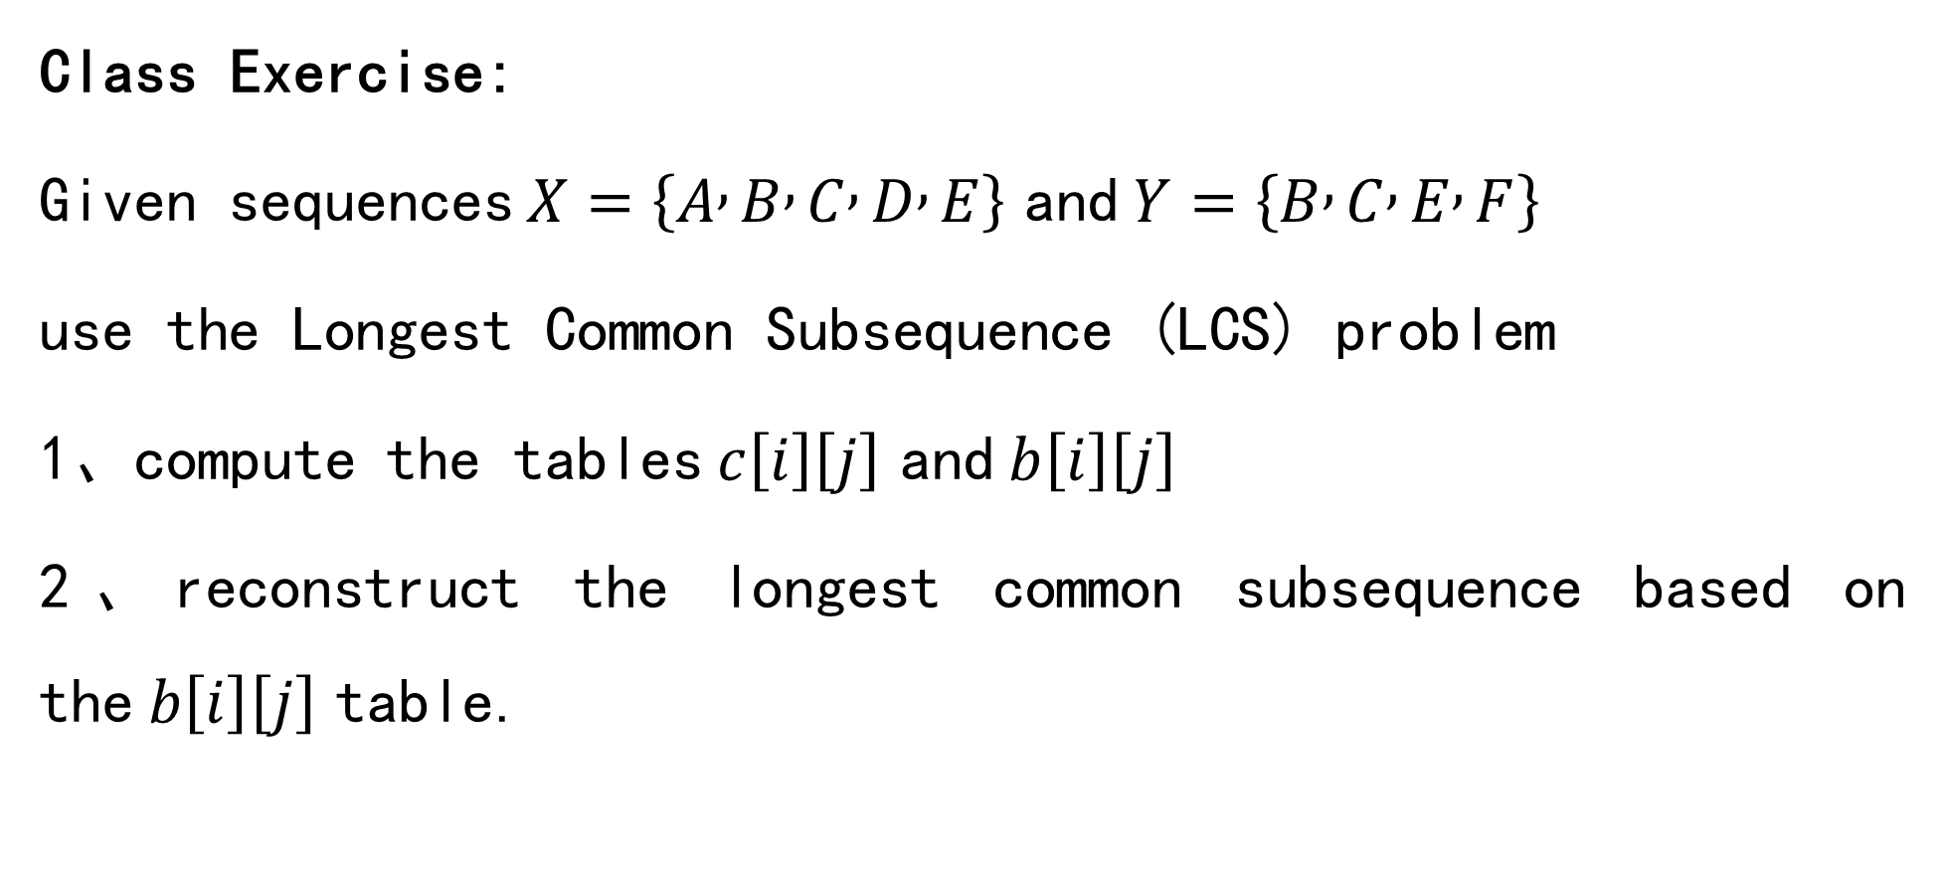
Structure of the longest common subsequence
Class Exercise:
Given sequences $X=\left\{A , B , C , D , E\right\}$ and $Y=\left\{B , C , E , F\right\}$
use the Longest Common Subsequence (LCS) problem
1、compute the tables $c\left[i\right]\left[j\right]$ and $b\left[i\right]\left[j\right]$
2、reconstruct the longest common subsequence based on the $b\left[i\right]\left[j\right]$ table.

Slide 21
Structure of the longest common subsequence
X={A, B, C, D, E} (5)
Y={B, C, E, F} (4)
c[i][j]
b[i][j]
void LCSLength(int m，int n，char *x，char *y，int **c，int **b)
{
int i，j;
for (i = 1; i <= m; i++) c[i][0] = 0;
for (i = 1; i <= n; i++) c[0][i] = 0;
for (i = 1; i <= m; i++)
for (j = 1; j <= n; j++) {
if (x[i]==y[j]) {
c[i][j]=c[i-1][j-1]+1; b[i][j]=1;}
else if (c[i-1][j]>=c[i][j-1]) {
c[i][j]=c[i-1][j]; b[i][j]=2;} else { c[i][j]=c[i][j-1]; b[i][j]=3; }
}
}
 | 0 | 1 | 2 | 3 | 4
0 | 0 | 0 | 0 | 0 | 0
1 | 0 | 0 | 0 | 0 | 0
2 | 0 | 1 | 1 | 1 | 1
3 | 0 | 1 | 2 | 2 | 2
4 | 0 | 1 | 2 | 2 | 2
5 | 0 | 1 | 2 | 3 | 3
 | 0 | 1 | 2 | 3 | 4
0
1 |  | 2 | 2 | 2 | 2
2 |  | 1 | 3 | 3 | 3
3 |  | 2 | 1 | 3 | 3
4 |  | 2 | 2 | 2 | 2
5 |  | 2 | 2 | 1 | 3

