Slide 1
Dynamic programming

Slide 2
Learning Point
Understand the concept of dynamic programming algorithms.
Master the basic elements of dynamic programming algorithms
(1) Properties of optimal substructure
(2) Properties of overlapping subproblems
Master the steps of designing dynamic programming algorithms.
(1) Find out the properties of the optimal solution and characterize its structural features.
(2) Define the optimal value recursively.
(3) Calculate the optimal value in a bottom-up manner.
(4) Construct the optimal solution according to the information obtained when calculating the optimal value.

Slide 3
Examplar-based Learning
Learn the design strategy of dynamic programming algorithm by applying examples.
Matrix-chain multiplication
Longest Common Subsequence
Maximum Interval Sum
Image Compression
Flow Shop Scheduling
Knapsack problem
Optimal Binary Search Trees

Slide 4
Chapter 3 Dynamic programming
Dynamic programming, like the divide-and-conquer method, solves problems by combining the solutions to subproblems.
However, the subproblems obtained by decomposition are often not independent of each other. The number of different subproblems is often polynomial in magnitude. In the divide-and-conquer method, some subproblems are recomputed many times. If we can save the answers to the solved subproblems and then find the answers when needed, we can avoid a lot of repeated computations and get a polynomial-time algorithm.
分解
多项式量级

Slide 5
Basic steps
1. Characterize the structure of an optimal solution.
2. Recursively define the value of an optimal solution.
3. The optimal value is calculated in a bottom-up manner.
4. Construct an optimal solution from computed information.

Slide 6
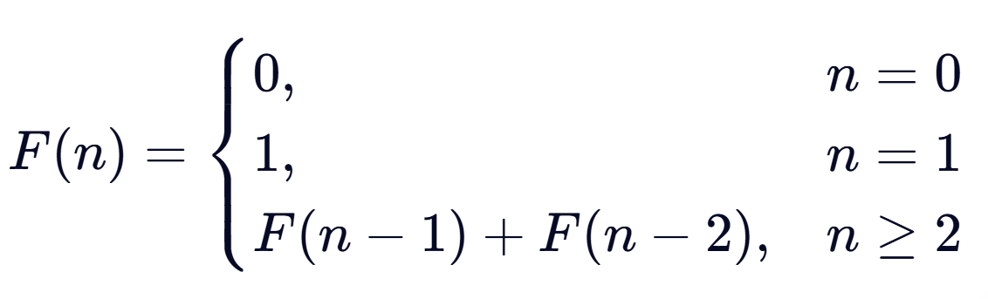

Basic steps
Step 1: Characterize the Structure of an Optimal Solution
$F\left(0\right)=0$
$F\left(1\right)=1$
$F\left(n\right)=F\left(n−1\right)+F\left(n−2\right)$ , $n≥2$
Step 2: Recursively Define the Value of an Optimal Solution

Slide 7
Basic steps
Step 3: Compute the Optimal Value in a Bottom-up Manner
Step 4: Construct an Optimal Solution from Computed Information
int fib_dp(int n) {
if (n == 0) return 0;
if (n == 1) return 1;
int dp[n + 1];
dp[0] = 0;
dp[1] = 1;
for (int i = 2; i <= n; i++) {
dp[i] = dp[i - 1] + dp[i - 2];
}
return dp[n];
}

Slide 8
Matrix-chain multiplication

Slide 9
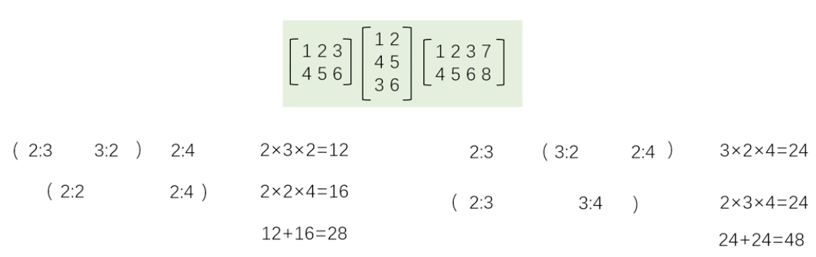

Slide 10
Matrix-chain multiplication
Given n matrices {A₁,A₂,…,A_{n}}, where A_{i} and A_{i+1} are multiplicative (i =1, 2... , n-1). Consider the continuous product of these n matrices A₁*A₂*…*A_{n}.
Problem analysis: Since matrix multiplication satisfies associative law, there can be many different order of calculation for the continuous multiplication of matrices. This order of calculation can be determined by parentheses. If the computation order of a matrix continued product is completely determined, that is, the continued product is fully parenthesized, then the standard algorithm of multiplying two matrices can be repeatedly invoked to calculate the matrix continued product according to the order.
可乘的
乘积
结合律
括号
调用

Slide 11
Matrix-chain multiplication
Complete parentheses:
(1) The single matrix is completely parentheses;
(2) Matrix continuous product A is fully parentheses, then A can be expressed as the product of two fully parentheses matrix continuous product B and C with parentheses, that is, A=(BC)

Slide 12
Matrix-chain multiplication
Example: There are 5 different ways to fully parentheses the matrix continuous product A1A2A3A4:
(A1(A2(A3A4)))，(A1((A2A3)A4))，((A1A2)(A3A4))，((A1(A2A3))A4)，(((A1A2)A3)A4)。
Each complete parenthesis corresponds to the order in which a continuous product of matrices is computed, which determines the amount of computation required to perform the product.
How to determine the order of calculation of the matrix continued product, so that the number of multiplication required to calculate the matrix continued product in this order is the least?
代表了

Slide 13
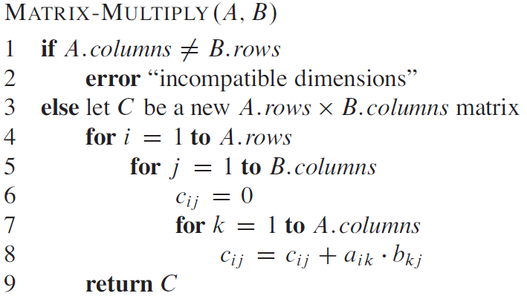
Matrix-chain multiplication
Standard Calculations

Slide 14
Matrix-chain multiplication
Solution 1: The exhaustive method
Enumerate all possible calculation orders, calculate the number of multiplications required by each calculation order, and find out a calculation order with the least number of multiplications.
枚举

Slide 15
Matrix-chain multiplication
Solution 2: Dynamic programming
Investigate the optimal order of computing A[i:j]. Set this order of computation break the chain of matrices between Ak and Ak+1, i≤k<j, then its corresponding complete parenthesis is
Computation: The computation of A[i:k] plus the computation of A[k+1:j], plus the computation of multiplying A[i:k] and A[k+1:j].

Slide 16
Matrix-chain multiplication
1. Analyze the optimal solution structure
Feature: The optimal order of computing A[i:j] is also optimal for the subchains A[i:k] and A[k+1:j] of the computation matrix.
The optimal solution of the matrix-chain multiplication computation order problem contains the optimal solution of its subproblems.
This property is called the optimal substructure property.
The optimal substructure property of the problem is a prominent feature that can be solved by dynamic programming algorithm.
显著的
Notes:
特征：计算A[i:j]的最优次序所包含的计算矩阵子链 A[i:k]和A[k+1:j]的次序也是最优的。
矩阵连乘计算次序问题的最优解包含着其子问题的最优解。这种性质称为最优子结构性质。问题的最优子结构性质是该问题可用动态规划算法求解的显著特征。

Slide 17
Matrix-chain multiplication
2. Set up a recursive solution
Set calculating A[i:j]，1≤i≤j≤n，the minimum number of multiplications required m[i, j]，so the optimal value of original is m[1,n].
When i=j，A[i:j]=Ai，thus，m[i,i]=0，i=1,2,…,n
When i<j，if the optimal sequence is interrupted fromA[k] to A[k+1]，then
m[i, j] = m[i, k]+m[k+1, j]+ p_{i-1}p_{k}p_{j}

Slide 18
Matrix-chain multiplication
2. Set up a recursive solution
When i<j，if the sequence is interrupted from Ak to Ak+1, then
m[i, j] = m[i, k]+m[k+1, j]+ p_{i-1}p_{k}p_{j}
Calculate p_{i-1}p_{k}p_{j}
The dimension of Ai is P_{i-1}P_{i}，then
(A_{i}*A_{i+1}*…*A_{k})= P_{i-1}P_{i} *P_{i}P_{i+1}*…. P_{k-1}P_{k}=P_{i-1}P_{k}
(A_{k+1}*A_{k+2}*…*A_{j})= P_{k}P_{k+1} *P_{k+1}P_{k+2}*…. P_{j-1}P_{j}=P_{k}P_{j}
(A_{i}*A_{i+1}*…*A_{k})(A_{k+1}*A_{k+2}*…*A_{j})=P_{i-1}P_{k}P_{j}

Slide 19
Matrix-chain multiplication
2. Set up a recursive solution
k∈{i, i+1，…，j-1}
m[i, j] gives the optimal value, that is, the minimum number of multiplications needed to compute A[i,j], and at the same time determines the optimal disconnection position. Two markers are required, one to record the value break position and one to record m[i, j].

Slide 20
Matrix-chain multiplication
3 Calculate the optimal value
The dynamic programming algorithm can be used to solve this problem in a bottom-up way according to its recurrence. During the computation, the solved subproblem answers are saved. Each subproblem is computed only once, and it is simply looked up later when needed, thus avoiding a large number of repeated computations and finally obtaining a polynomial-time algorithm.

Slide 21
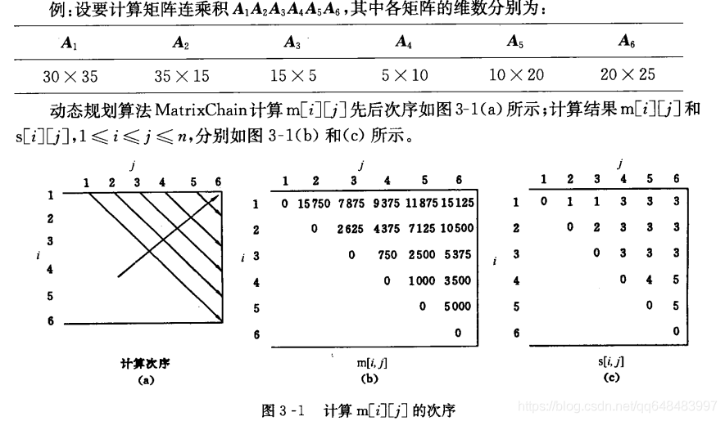
Matrix-chain multiplication
3 Calculate the optimal value

Slide 22
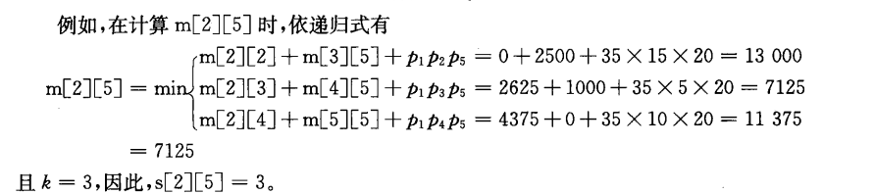
Matrix-chain multiplication
4 Construct the optimal solution
2：5
2：2
2：3
2：4
3：5
4：5
5：5

Slide 23
Matrix-chain multiplication
/**
* 矩阵链乘法动态规划算法
* p: 维度数组，矩阵Ai的维度为 p[i-1] * p[i]
* n: 矩阵数量
* m: 二维数组，存储最优值 m[i][j]
* s: 二维数组，存储最优断开位置 s[i][j]
*/
void MatrixChain(int *p, int n, int **m, int **s) {
// 1. 初始化：单个矩阵不需要乘法，代价为0
for (int i = 1; i <= n; i++) {
m[i][i] = 0;
}

Slide 24
Matrix-chain multiplication
// 2. 自底向上计算：r 为当前处理的链长（子问题规模）
for (int r = 2; r <= n; r++) {
// i 为链的起始位置
for (int i = 1; i <= n - r + 1; i++) {
int j = i + r - 1; // j 为链的结束位置
// 初始化：假设在第一个位置断开，计算代价
m[i][j] = m[i+1][j] + p[i-1]*p[i]*p[j];
s[i][j] = i;
// 遍历所有可能的断开位置 k，寻找最小代价
for (int k = i + 1; k < j; k++) {
int t = m[i][k] + m[k+1][j] + p[i-1]*p[k]*p[j];
if (t < m[i][j]) {
m[i][j] = t; // 更新最优值
s[i][j] = k; // 更新断开位置
}
}
}
}
}

Slide 25
Matrix-chain multiplication
Algorithm complexity analysis
The main computation of matrixChain depends on the three cycles of r, i and k in the algorithm. The amount of calculation in the circulatory body is O(1), and the total number of three cycles is O(n³). Therefore, the upper bound of the computation time of the algorithm is O(n³).
void MatrixChain(int *p，int n，int **m，int **s)
{
for (int i = 1; i <= n; i++) m[i][i] = 0;
for (int r = 2; r <= n; r++)
for (int i = 1; i <= n - r+1; i++) {
int j=i+r-1;
m[i][j] = m[i+1][j]+ p[i-1]*p[i]*p[j];
s[i][j] = i;
for (int k = i+1; k < j; k++) {
int t = m[i][k] + m[k+1][j] + p[i-1]*p[k]*p[j];
if (t < m[i][j]) { m[i][j] = t; s[i][j] = k;}
}
}
}

Slide 26
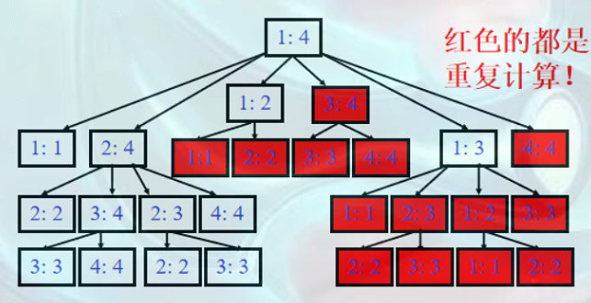
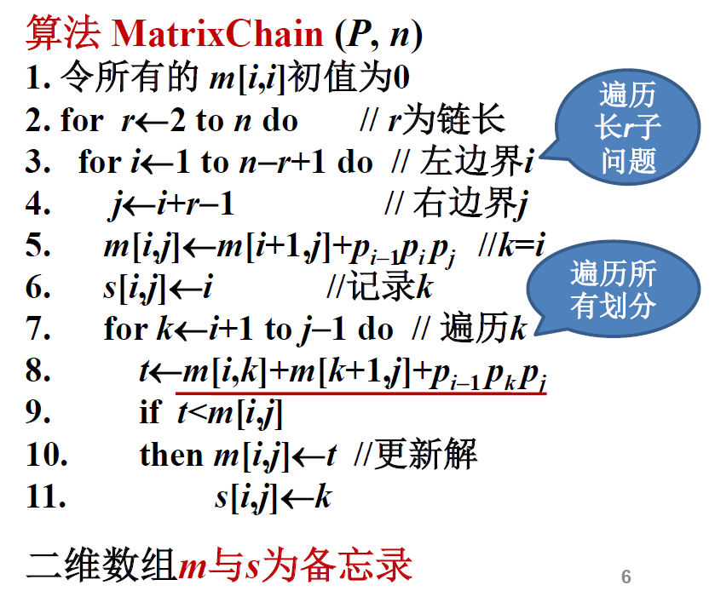
Matrix-chain multiplication
1
n
i=1
j
j = i+r-1
i=n-r+1
j=n
r
r
r = 2:n

Slide 27
Matrix-chain multiplication
Recursion will produce a lot of repeated computation, the complexity is too high, use memos to reduce the complexity, it is better to establish a recursive relationship.

Slide 28
Matrix-chain multiplication
The memo method is a variant of the dynamic programming algorithm.
Like the dynamic programming algorithm, the memo method uses a table to store the answers to the solved subproblems, so the next time we need to solve the subproblem, we can simply look at the solution to the subproblem instead of recomputing it.
Different from the dynamic programming algorithm, the memo method is recursive in a top-down manner, while the dynamic programming algorithm is recursive in a bottom-up way. Therefore, the control structure of the memo method is the same as that of the direct recursive method. The difference is that the memo method creates a memorization for each solved subproblem to be viewed when needed, so as to avoid the repeated solution of the same subproblem.
变形
Notes:
备忘录方法是动态规划算法的变形。
与动态规划算法一样，备忘录方法用表格保存已解决的子问题的答案，在下次需要解此子问题时，只要简单地查看该子问题的解答，而不必重新计算。
与动态规划算法不同的是，备忘录方法的递归方式是自顶向下的，而动态规划算法则是自底向上递归的。
因此，备忘录方法的控制结构与直接递归方法的控制结构相同，区别在于备忘录方法为每个解过的子问题建立了备忘录以备需要时查看，避免了相同子问题的重复求解。

Slide 29
Matrix-chain multiplication
The memo method creates a record entry for each subproblem, which is initialized with a special value indicating that the subproblem has not been solved. In the process of solving, for each sub-problem to be solved, first check its corresponding record item. If it is a special value that saved during initialization in the record item, it indicates that the subproblem is encountered for the first time. At this time, the solution of the subproblem is calculated and saved in the corresponding record item for future reference. If the value stored in the record item is not the special value stored in the initialization, it means that the subproblem has been calculated, and the corresponding record item contains the answer to the subproblem. Instead of recalculating, we simply take the solution to the subproblem from the record.
Notes:
备忘录方法为每个子问题建立一个记录项，初始化时，该记录项存入一个特殊的值，表示该子问题尚未求解。
在求解过程中，对每个待求的子问题，首先查看其相应的记录项。
若记录项中存储的是初始化时存入的特殊值，则表示该子问题是第一次遇到，此时计算出该子问题的解，并保存在其相应的记录项中，以备以后查看。
若记录项中存储的已不是初始化时存入的特殊值，则表示该子问题已被计算过，其相应的记录项中存储的是该子问题的解答。此时，只要从记录项中取出该子问题的解答即可，而不必重新计算。

Slide 30
Matrix-chain multiplication
long memo[MAX_SIZE];
// 初始化备忘录数组，-1表示尚未计算的值
void initMemo() {
for(int i = 0; i < MAX_SIZE; ++i) {
memo[i] = -1;
}
}
// 使用带备忘录的递归方法计算斐波那契数
long fib(int n) {
// 基本情况：F(0)=0, F(1)=1
if(n == 0) return 0;
if(n == 1) return 1;
// 如果已经计算过，则直接返回保存的结果，避免重复计算
if(memo[n] != -1) return memo[n];
// 计算新的斐波那契数，并将其保存到备忘录中
memo[n] = fib(n-1) + fib(n-2);
// 返回计算结果
return memo[n];
}

