Slide 1
Algorithm Design and Analysis
潘啸晨

Slide 2

QQ群备注:学号+姓名

Slide 3
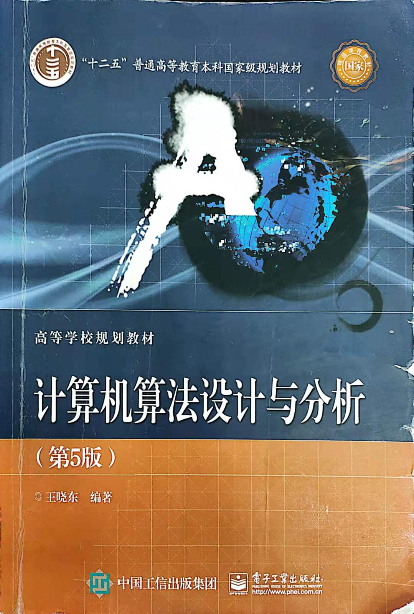
Teaching materials
Chapter 1 Algorithm overview
Chapter 2 Recursion and divide-and-conquer strategy
Chapter 3 Dynamic programming
Chapter 4 Greedy algorithm
Chapter 5 Backtracking
Chapter 6 Branch and limit method

Slide 4
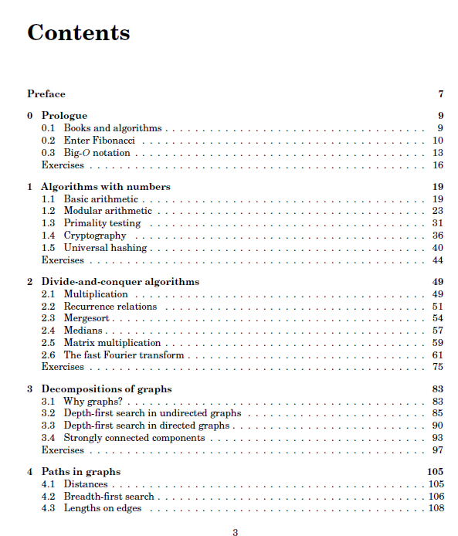
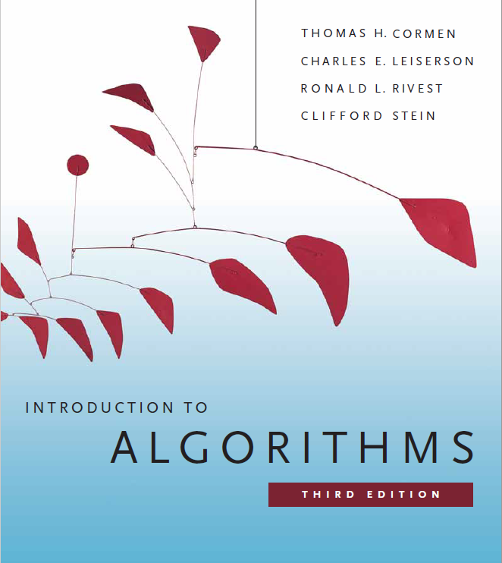
Teaching materials

Slide 5
Before there were computers, there were algorithms. But now that there are computers, there are even more algorithms, and algorithms lie at the heart of computing.

Slide 6
Chapter 1 Algorithm overview
Learning Points:
Understand the concept of algorithms.
Understand what is the program, and difference and inner link of the algorithm.
Grasp the concept of computational complexity of algorithms.
Grasp the mathematical representation of asymptotic complexity of algorithms.
Master the method of describing algorithm with Computer language.
掌握
计算复杂度
渐近复杂性

Slide 7
Chapter 1 Algorithm overview
What are algorithms? Why is the study of algorithms worthwhile? What is the role of algorithms relative to other technologies used in computers?
Informally, an algorithm is any well-defined computational procedure that takes some value, or set of values, as input and produces some value, or set of values, as output. An algorithm is thus a sequence of computational steps that transform the input into the output.

Slide 8
1.1 Algorithms and procedures
An algorithm is a method or process for solving a problem. An algorithm is a finite sequence of instructions, which satisfies the properties:
(1)Input: an external quantity is provided as the input of the algorithm.
(2)Output: The algorithm produces at least one quantity as output.
(3)Determinacy: Each instruction that makes up the algorithm is clear and unambiguous.
(4)Finiteness: the execution times of each instruction in the algorithm are limited, and the execution time of each instruction is also limited.
确定性
有限性

Slide 9
1.1 Algorithms and procedures
Program is a concrete realization of algorithm in some programming language. The nature of the program can not satisfy the algorithm (4).
An operating system, for example, is a program that executes in an infinite loop, not an algorithm. The various tasks of the operating system can be viewed as separate problems, and each problem is implemented by a subroutine of the operating system through a specific algorithm. The subroutine gets the output and then terminates.

Slide 10
1.2 Algorithm complexity analysis
Algorithm complexity = computer resources required by the algorithm: time and space (i.e. memory) resources;
The time complexity of the algorithm is T and the space complexity of the algorithm is S.

Slide 11
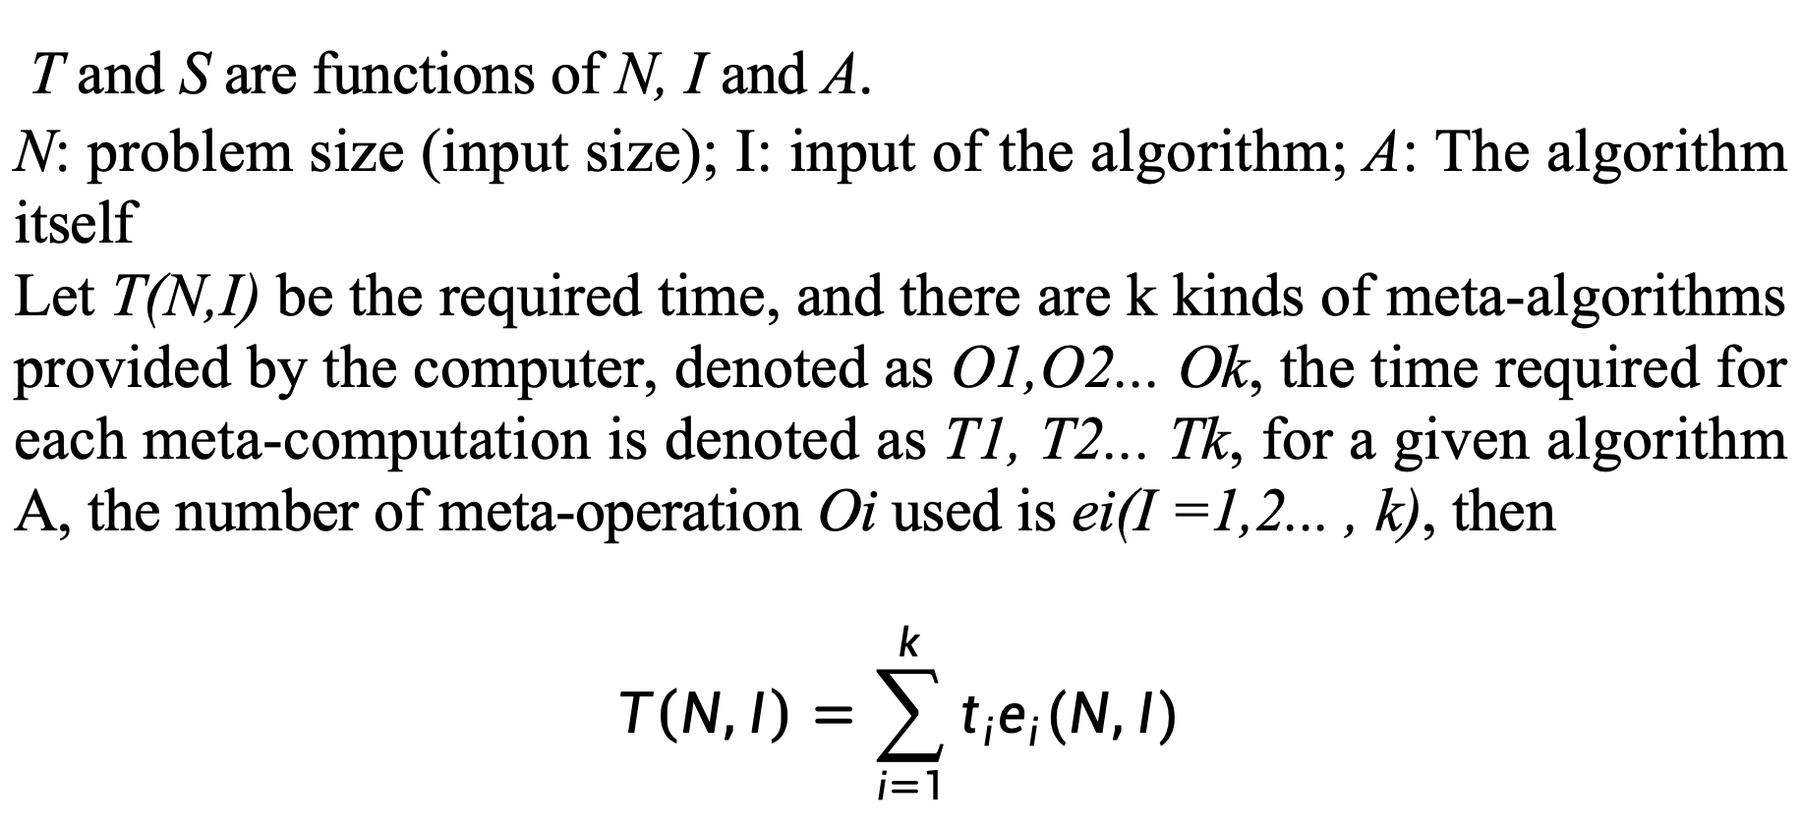
1.2 Algorithm complexity analysis
T and S are functions of N, I and A.
N: problem size (input size); I: input of the algorithm; A: The algorithm itself
Let T(N,I) be the required time, and there are k kinds of meta-algorithms provided by the computer, denoted as O1,O2... Ok, the time required for each meta-computation is denoted as T1, T2... Tk, for a given algorithm A, the number of meta-operation Oi used is ei(I =1,2... , k), then
$$T\left(N,I\right)=\sum_{i=1}^{k}{t_{i}e_{i}(N,I)}$$

Slide 12
1.2 Algorithm complexity analysis
Considering the time complexity of the three situations, that is the worst, the best conditions and the time complexity of the average case
（1）Worst-case time complexity
T_{max}(n) = max{ T(I) | size(I)=n }
（2）Best-case time complexity
T_{min}(n) = min{ T(I) | size(I)=n }
（3）Time complexity in the average case
T_{avg}(n) =
Where I is the instance of the problem (size n), and p(I) is the probability of occurrence of real example I. The most maneuverable and practical value is the worst-case time complexity.

Slide 13
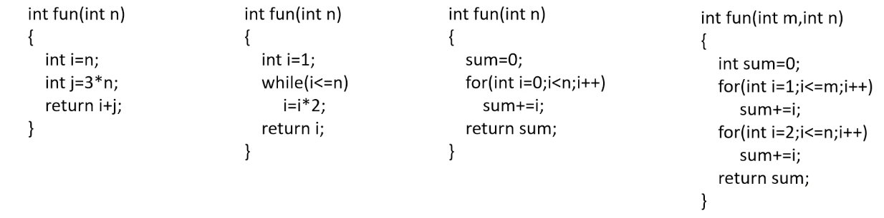

1.2 Algorithm complexity analysis
Time Complexity
O(1) O(log$n$) O(n) O(m+n)
Notes:
板书一个书上公式

Slide 14
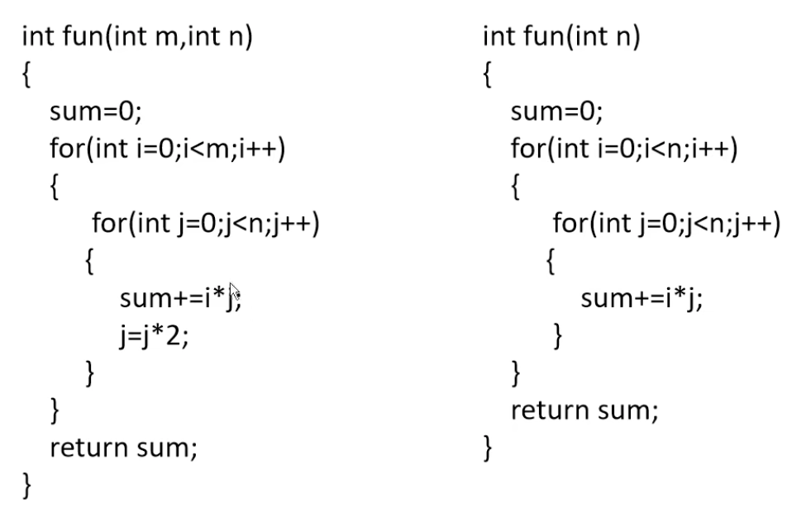
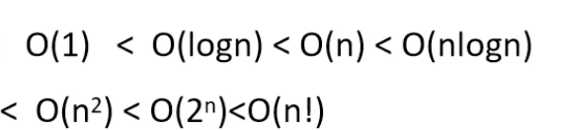

1.2 Algorithm complexity analysis
Time Complexity
O(mlog$n$) O($n^{2}$)
Notes:
板书一个书上公式

Slide 15
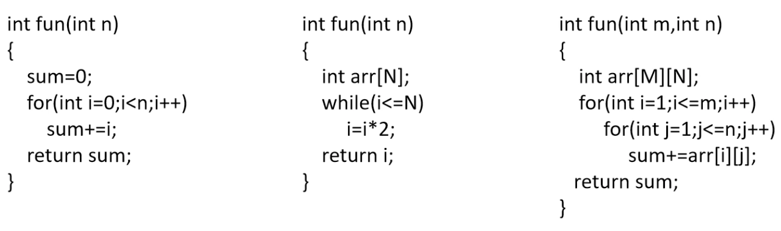

1.2 Algorithm complexity analysis
Space Complexity
O(1) O(N) O(MN)
Notes:
板书一个书上公式

Slide 16
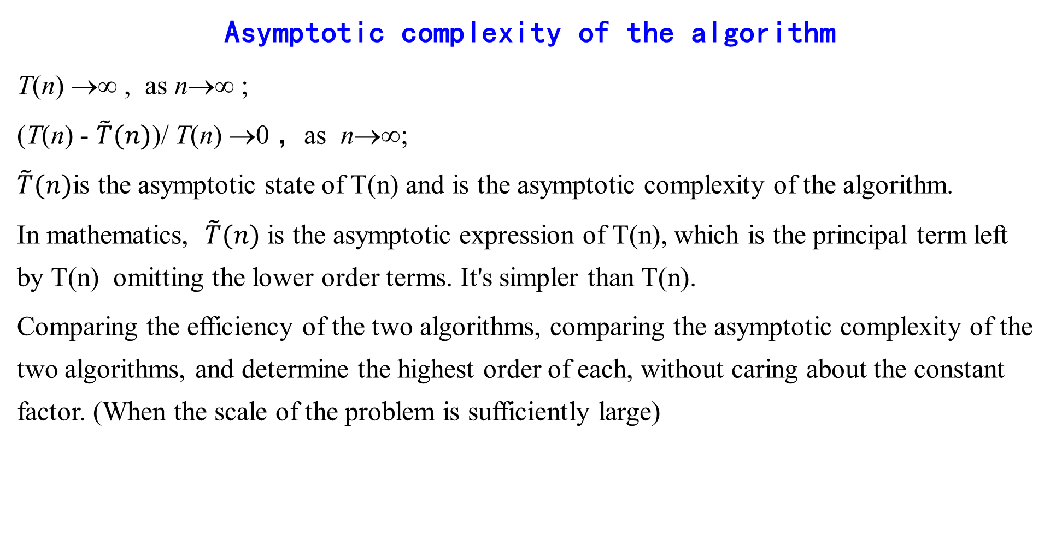
1.2 Algorithm complexity analysis
Asymptotic complexity of the algorithm
T(n) →∞ , as n→∞ ;
(T(n) - $\tilde{T}(n)$)/ T(n) →0 ，as n→∞;
$\tilde{T}(n)$is the asymptotic state of T(n) and is the asymptotic complexity of the algorithm.
In mathematics, $\tilde{T}(n)$ is the asymptotic expression of T(n), which is the principal term left by T(n) omitting the lower order terms. It's simpler than T(n).
Comparing the efficiency of the two algorithms, comparing the asymptotic complexity of the two algorithms, and determine the highest order of each, without caring about the constant factor. (When the scale of the problem is sufficiently large)
忽略
Notes:
板书一个书上公式

Slide 17
1.2 Algorithm complexity analysis
Notation for asymptotic analysis
In the following discussion, for all n，f(n) ≥ 0，g(n) ≥ 0。
（1）Asymptotic upper bound notationO – Give an upper bound on the function f
O(g(n)) = { f(n) | there are positive constant c and n₀ such that for all n≥ n₀ there is：0 ≤ f(n) ≤ cg(n) }
E.g.：f(n) = 3n+2
When n>=2，3n+2 <= 3n+n = 4n，so f(n) = O(n)，f(n) is a linearly varying function.
Similarly, 100n+6 = O(n).
In particular, when f(n) is a constant c，for example f(n)=9，can be written as f(n) = O(1)

Slide 18
1.2 Algorithm complexity analysis
f(n) = 10n² + 4n + 2
When n>=2，10n² + 4n + 2 <= 10n² + 5n
When n>=5， 10n² + 5n <= 10n² + n² = 11n² ，so f(n) = O(n²)

Slide 19
1.2 Algorithm complexity analysis
（2）Asymptotic lower bound notation Ω
(g(n)) = { f(n) | there are positive constant c and n₀ such that for all n≥ n₀ there is：0≤ cg(n) ≤ f(n) }
3n+2 >=3n 3n+2 = Ω (n)
100n+6 >=100n 100n+6 = Ω (n)
10n²+4n+2 >=10n² 10n²+4n+2 = Ω (n²)

Slide 20
1.2 Algorithm complexity analysis
（3）Noncompact upper bound notation o
o(g(n)) = { f(n) | for any positive constant c>0, there are positive numbers n₀ >0 such that for all n≥ n_{0,} there is：0 ≤ f(n)<cg(n) }
Equivalent to f(n) / g(n) →0 ，as n→∞。
（4）Noncompact lower bound notation ω
ω (g(n)) = { f(n) | for any positive constant c>0, there are positive numbers n₀ >0 such that for all n≥ n_{0,} there is：0 ≤ cg(n) < f(n) }
Equivalent to f(n) / g(n) →∞ ，as n→∞。
f(n) ∈ ω (g(n)) ⇔ g(n) ∈ o (f(n))

Slide 21
1.2 Algorithm complexity analysis
（5）Compact asymptotic bound notation θ
θ (g(n)) = { f(n) | there are positive constant c₁,c₂ and n₀ such that for all n≥ n₀ there is：c₁g(n) ≤ f(n) ≤ c₂g(n) }
Theory 1： θ (g(n)) = O (g(n)) ∩ Ω (g(n))

Slide 22
1.2 Algorithm complexity analysis
Comparison of functions in asymptotic analysis
The rank of f(n)= O(g(n)) ≈ f(n) is not higher than the rank of g(n)
The rank of f(n)= Ω(g(n)) ≈ f(n) is not lower than the rank of g(n)
The rank of f(n)= θ (g(n)) ≈ f(n) equals to the rank of g(n)
The rank of f(n)= o(g(n)) ≈ f(n) is less than the rank of g(n)
The rank of f(n)= ω(g(n)) ≈ f(n) is greater than the rank of g(n)

Slide 23
1.2 Algorithm complexity analysis
Some properties of asymptotic analysis notation
（1）Transitivity：
f(n)= θ(g(n))， g(n)= θ(h(n)) ⇒ f(n)= θ(h(n))；
f(n)= O(g(n))， g(n)= O (h(n)) ⇒ f(n)= O (h(n))；
f(n)= Ω(g(n))， g(n)= Ω (h(n)) ⇒ f(n)= Ω(h(n))；
f(n)= o(g(n))， g(n)= o(h(n)) ⇒ f(n)= o(h(n))；
f(n)= ω(g(n))， g(n)= ω (h(n)) ⇒ f(n)= ω (h(n))；
传递性

Slide 24
1.2 Algorithm complexity analysis
（2）Reflexivity：
f(n)= θ(f(n))；
f(n)= O(f(n))；
f(n)= Ω(f(n)).
（3）Symmetry：
f(n)= θ(g(n)) ⇔ g(n)= θ (f(n)) .
（4）Mutual symmetry：
f(n)= O(g(n)) ⇔ g(n)= Ω (f(n)) ；
f(n)= o(g(n)) ⇔ g(n)= ω (f(n)) ；
反身性
对称性
互对称性

Slide 25
1.2 Algorithm complexity analysis
（5）Arithmetic operations：
O(f(n))+O(g(n)) = O(max{f(n),g(n)}) ；
O(f(n))+O(g(n)) = O(f(n)+g(n)) ；
O(f(n))*O(g(n)) = O(f(n)*g(n)) ；
O(cf(n)) = O(f(n)) ；
g(n)= O(f(n)) ⇒ O(f(n))+O(g(n)) = O(f(n)) 。
算数运算

Slide 26
1.2 Algorithm complexity analysis
Basic principles of algorithm analysis
Non-recursive algorithm：
（1）For/while loop
Circulatory body calculation time * number of cycles;
（2）Nested loop
Circulatory body calculation time * all cycles;
（3）Sequential statement
Sum the computation time of each statement;
（4）If-else statements
The greater of the if statement computation time and the else statement computation time.

Slide 27
1.2 Algorithm complexity analysis
Recursive algorithm: establish the recursive relation of the execution times of the basic operation of the algorithm, and then determine its increment times
int factorial(int n)
{
if (n == 0) return 1;
return n*factorial(n-1);
}
递归

Slide 28
NP-complete theory
All decision problems that can be solved in polynomial time constitute class P problems. Polynomial time is in view of the problem scale, that is, the time required to solve the problem is the size of the problem of polynomial.
NP problems: nondeterministic polynomial problems.
All deterministic polynomial-time solvable decision problems constitute NP class problems.
多项式
非确定性

Slide 29
NP-complete theory
Nondeterministic algorithm: Problem solving is divided into two stages: guess and verify. The guess phase of the algorithm is nondeterministic and gives a guess of the problem. The verification stage of the algorithm is deterministic and verifies the correctness of the solution of the previous stage. If the verification stage can be completed in polynomial, the algorithm is said to be a polynomial-time nondeterministic algorithm, and the problem is also said to be nondeterministic polynomial-time solvable.

Slide 30
Summary
An "algorithm" is a clear sequence of instructions for solving a problem in limited time. The input of the algorithm determines an instance of the problem solved by the algorithm.
The algorithm can be described in detail in natural language or pseudocode, or it can be implemented as a computer program.
伪代码

Slide 31
Summary
There are two kinds of algorithm complexity (efficiency) : time complexity and space complexity.
There are three types of time complexity: worst, best, and average

Slide 32
Summary
The complexity of most algorithms falls into several categories: constant (1), logarithmic (logn), linear (n), nearly linear (nlogn), square (n²), cubic (n³), exponential (mⁿ, n!). .

Slide 33
Summary
1, logn, n, nlogn, n², n³ are collectively called polynomial time efficient algorithms or good algorithms; mⁿ, n! collectively known as exponential time invalid algorithms or bad algorithms.

