Slide 1
Investigation on the use of mobile phones among college students

Slide 2
Component part​​
1. Personal background
2. Mobile phone use behavior
3. Consumption and equipment
4. Dependence and psychology
5. Learning and classroom
6. Openness and suggestions

Slide 3
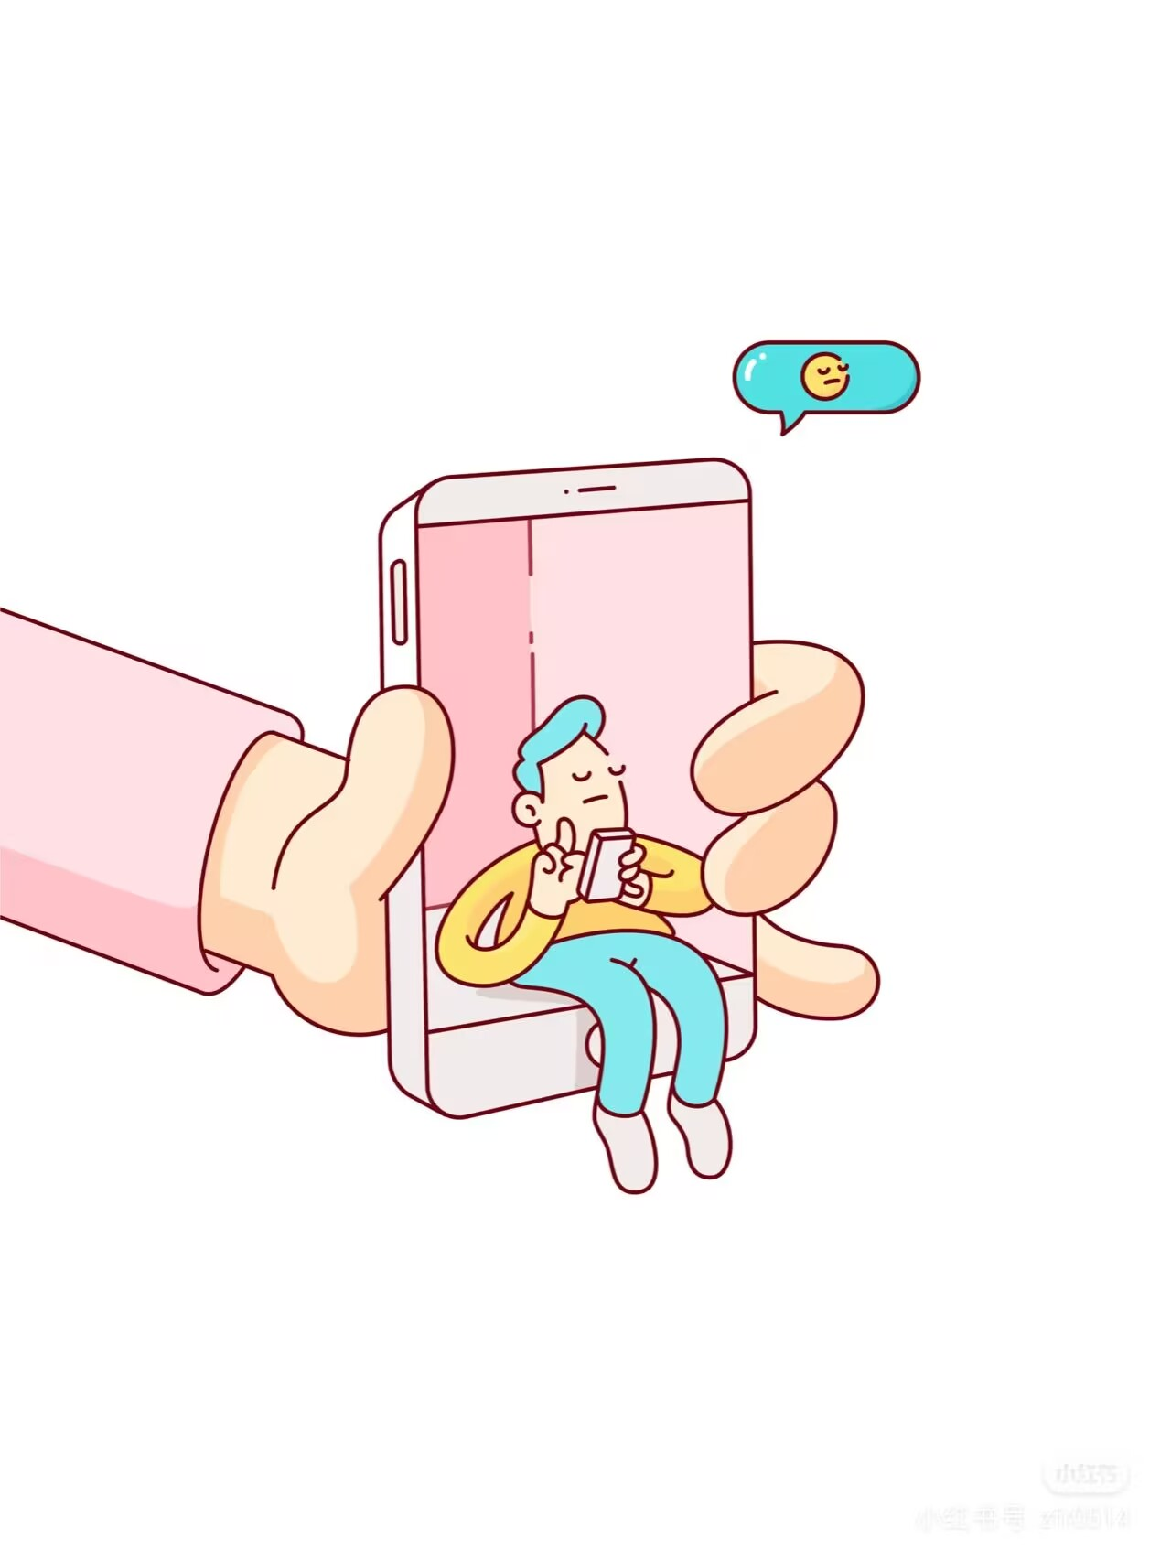
Personal background

Slide 4
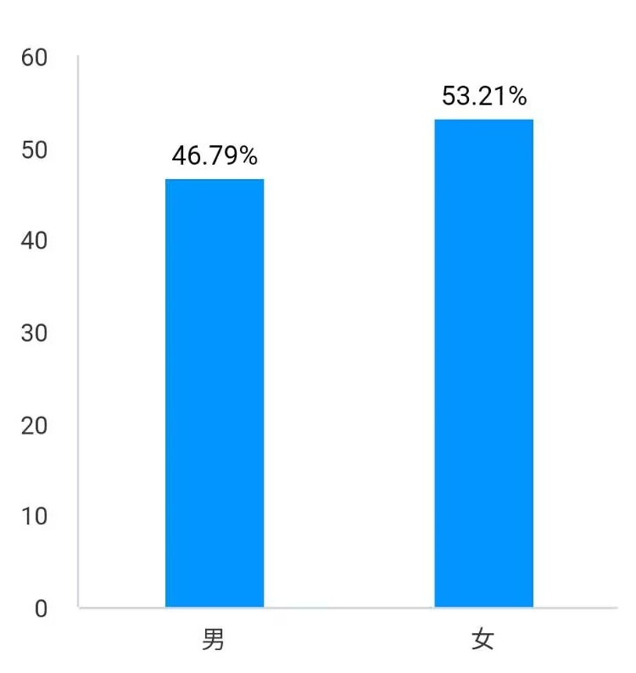
1. Your gender
The gender ratio is nearly balanced, with female students slightly outnumbering males . This balance enhances the reliability of gender-related conclusions in broader analyses.
Writed By Hou Kaimin

Slide 5
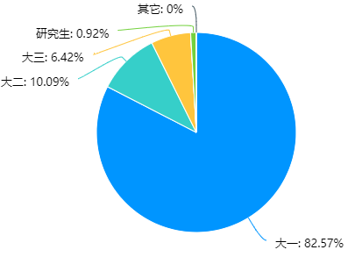
2. Grade and Identity
The primary insight from the data is the overwhelming dominance of freshmen in the survey. As shown in this chart, 82.57% of the respondents are first-year students, far surpassing other groups. Sophomores and juniors account for only 10.09% and 6.42%, respectively, while seniors and "other" categories register zero participation. Notably, graduate students represent a mere 0.92%.
Writed By Hou Kaimin

Slide 6
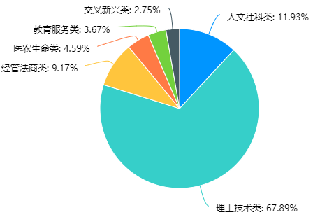
3. Major Type
The survey received 109 valid responses. In terms of major types, students majoring in science and technology - related fields accounted for a whopping 67.89%, making them the largest group. Students of humanities and social sciences accounted for 11.93%, those in business, law and economics - related majors made up 9.17%, students in medicine, agriculture and life - sciences - related majors took 4.59%, those in education and service - related majors accounted for 3.67%, and students in emerging interdisciplinary majors made up 2.75%.
Writed By Liu Guochen

Slide 7
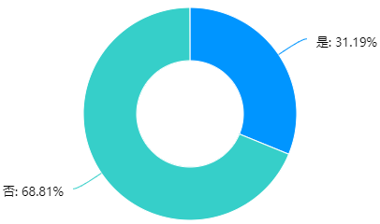
4. Do you hold a student position or are you the head of a club?
Regarding the role of student leaders, 31.19% of 109 respondents are student cadres or club heads, while 68.81% are not. This shows a minority engage in leadership duties that may influence phone use for work - related tasks.
Writed By Liu Yongsheng

Slide 8
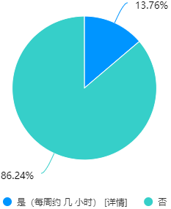
5. Apart from studying, do you have any part-time/internship jobs?
The first survey focuses on part - time jobs or internships among college students. A striking 86.24% of the 109 respondents indicated that they do not engage in such activities outside of study. This might suggest that a majority of students prioritize their academic pursuits, devoting most of their time to coursework, research, and study - related tasks. The remaining 13.76% who do participate in part - time jobs or internships show a different approach, perhaps aiming to gain practical experience and financial independence.
Writed By Pei Keyi

Slide 9
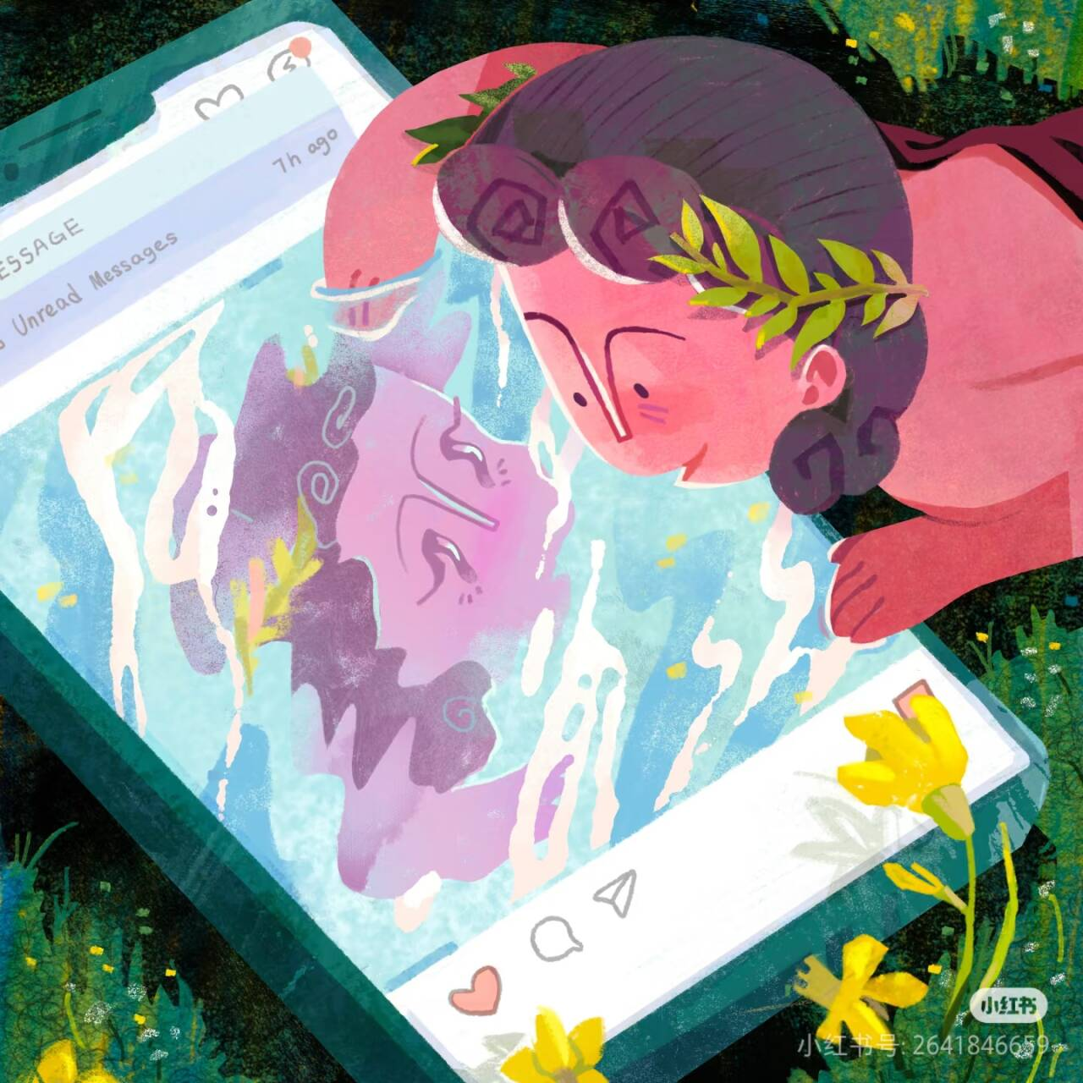
Mobile phone use behavior

Slide 10
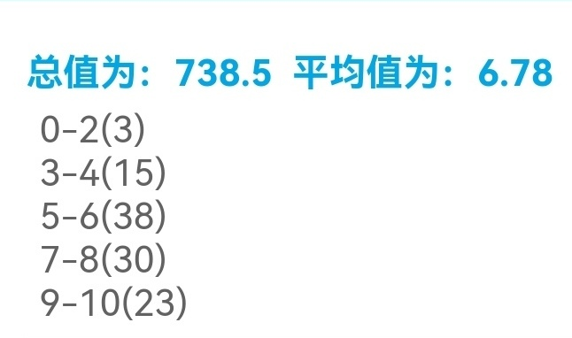
6. How many hours do you use your mobile phone on average each day from Monday to Friday?
The provided data showcases the average daily mobile - phone usage duration from Monday to Friday. The total score of all responses is 738.5, with an average value of 6.78 hours, indicating that, on average, respondents spend about 6.78 hours a day on their mobile phones during weekdays.
The data is further categorized into different time - ranges. There are 3 respondents whose daily usage is within the 0 - 2 - hour range, 15 in the 3 - 4 - hour range, 38 in the 5 - 6 - hour range, 30 in the 7 - 8 - hour range, and 23 in the 9 - 10 - hour range.
Writed By Tang Yuanhao

Slide 11
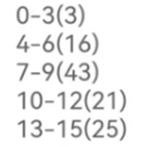
7. How many hours do you use your mobile phone on average each day over the weekend?
The bar chart illustrates the average daily smartphone usage duration among respondents during weekends, revealing significant variations in digital habits. Based on data collected from 108 participants with a total score of 1063, the average usage time stands at 9.75 hours per day, showing the substantial role smartphones play in weekend activities.
The most prominent pattern emerges in the 7-9 hour bracket, accounting for 39.8% of respondents (43 individuals). This is followed by two notable groups: 25 people (23.1%) reporting intensive usage of 13-15 hours, and 21 participants (19.4%) in the 10-12 hour range. Moderate users (4-6 hours) constitute 14.8% (16 individuals), while minimal users (0-3 hours) form the smallest group at just 2.8% (3 people).
Notably, the average duration (9.75 hours) exceeds the median range of 7-9 hours, possibly influenced by the substantial 13-15 hour group pulling the mean upward.
In conclusion, this usage distribution reveals a polarized pattern where most respondents cluster around moderate-to-heavy usage levels, with a significant minority exhibiting extreme usage behaviors. These findings emphasize the need for balanced digital habits and awareness campaigns about healthy screen time management, particularly regarding weekend smartphone overuse that might affect sleep quality and real-world social interactions.
Writed By Xu Heran

Slide 12
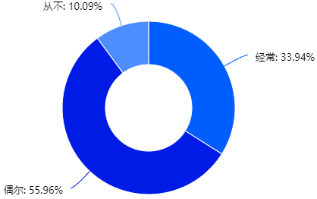
8. Do you have the habit of multitasking (such as listening to a lecture while scrolling through your phone)?
For multitasking during study, like using phones in class, 33.94% often do it, 55.96% occasionally, and only 10.09% never. It's evident that most students struggle to focus solely on learning.
Writed By Liu Yongsheng

Slide 13
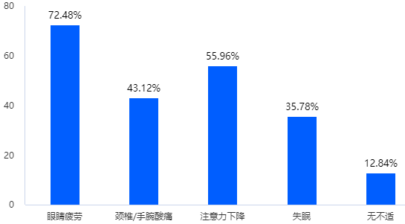
9. Which of the following symptoms have you experienced due to prolonged mobile phone use? (You can select multiple options)
The most prevalent problem is eye fatigue. A staggering 79 students, accounting for 72.48% of the respondents, reported experiencing this discomfort.
Next in line is a decrease in concentration. As many as 61 students, which is 55.96% of the total, indicated that they struggle to focus.
Moreover, 47 students, making up 43.12% of the surveyed group, complained of pain in their necks or wrists.
Additionally, 39 students, representing 35.78% of the sample, suffer from insomnia. Using mobile phones before bedtime, especially in a dark room, can disrupt the body's internal clock, making it hard to fall asleep.
Writed By Liu Yang

Slide 14
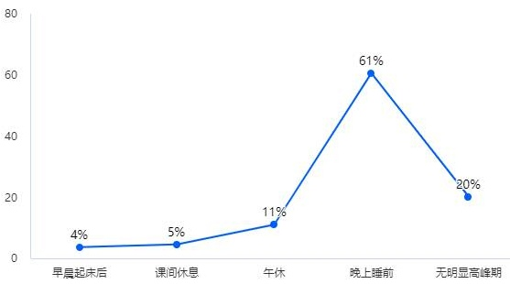
10. The peak hours you use your mobile phone are usually:
This table focuses on usage peaks: 60.55% use phones before bedtime, likely for relaxation (e.g., social media or videos). 20.18% have no fixed peak, showing flexible habits. 11.01% use phones during lunch breaks, while morning (3.67%) and short breaks (4.59%) see low usage, possibly due to tight schedules
Writed By Sun Yuncheng

Slide 15
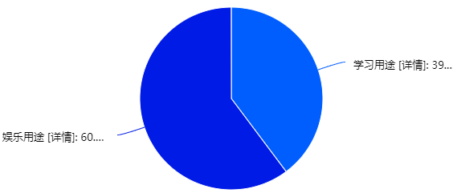
11. The proportion of time you spend on learning and entertainment purposes when using your mobile phone
When it comes to the purpose of using mobile, from our survey statistics, about 39.78% people use for study. The rest prefers to play for fun. It reflects a phenomenon that more teenagers devote themselves to mobile with the technology developing.
Writed By Zhang Jiayu

Slide 16
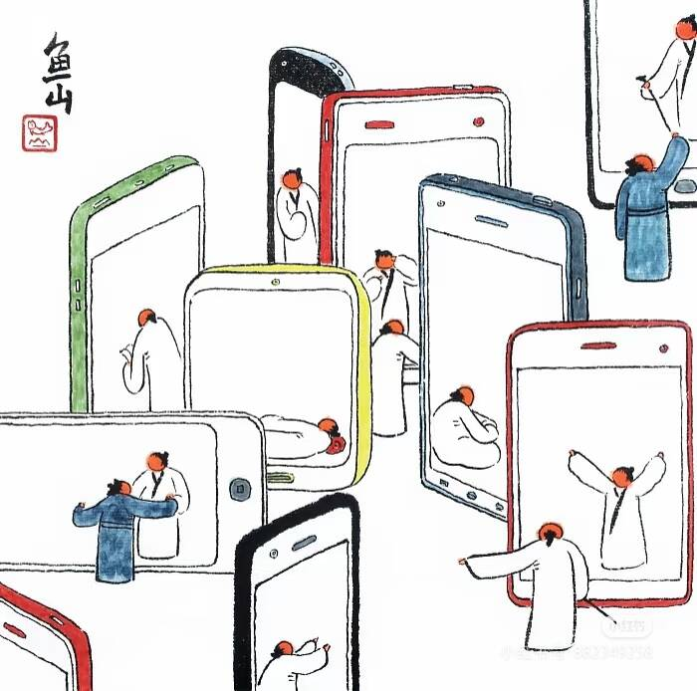
Consumption and equipment

Slide 17
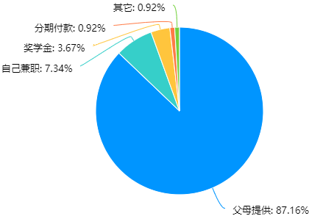
12. The budget source of your last purchase of mobile phone.
As is depicted in the graph,students' money for buying cellphone is mainly from their parents.The proportion of them have soared to 87.16%.This date is very shocking.
Although my cellphone is the gift from my relatives,but in my opinion, the students who can rely on themselves is more admirable. Although the rate of them is 12.84%.Nowadays, there are many ways to make money, such as working to make money or use the scholoarship as the source. But some dangerous ways such as loan money or installments is the way that we should get away.
In conclusion,although most of us depends on our parents,there are always some independent person exist in our school.We should set examples like them to advocate the spirit of independence.
Writed By Wang Zhongjun

Slide 18
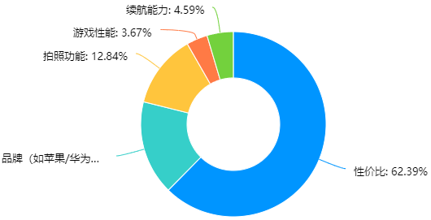
13. The most important factors you consider when choosing a mobile phone.
The bar graph shows which factor do students value most when it comes to choosing a mobile phone.Cost perfermance tops the list,account for 62.39%，highlighting their pursuit of value for money.Brand comes second at 16.51%.Photo - taking function is also significant, accounting for 12.84%In contrast, gaming performance and battery life are less emphasized, at 3.67% and 4.59% respectively.In conclusion,this chart shows that cost perfermance is a major concern for students when choosing a mobile phone.
Writed By Zhao Chenxi

Slide 19
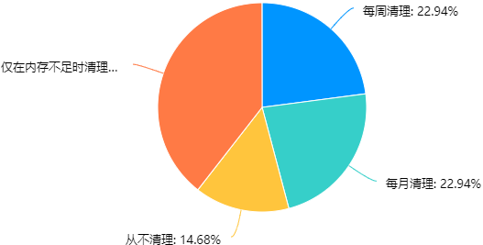
14. Do you regularly clean up your phone's privacy data (such as chat records, browsing history)?
The second survey delves into how students manage their smartphone privacy data. 39.45% of the respondents only clean up privacy data like chat records and browsing history when their phone memory is insufficient. This reflects a reactive attitude towards privacy management, indicating that many students are more concerned with the functionality of their phones rather than privacy protection on a regular basis. Meanwhile, 22.94% clean their data weekly and another 22.94% do it monthly, showing a more proactive stance. Only 14.68% never clean their data, which might expose them to potential privacy risks.
Writed By Pei Keyi

Slide 20
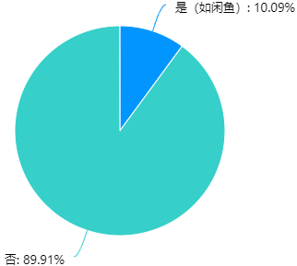
15. Have you ever used a "second-hand platform" to buy or sell mobile phones or accessories？
As for the question of wether you have used the second-hand platform (such as XianYu) to trade mobile phones or accessories, 89.91% percent of people answered"No",only 10.09% percent of People answered"Yes".
Writed By Li Qianqian

Slide 21
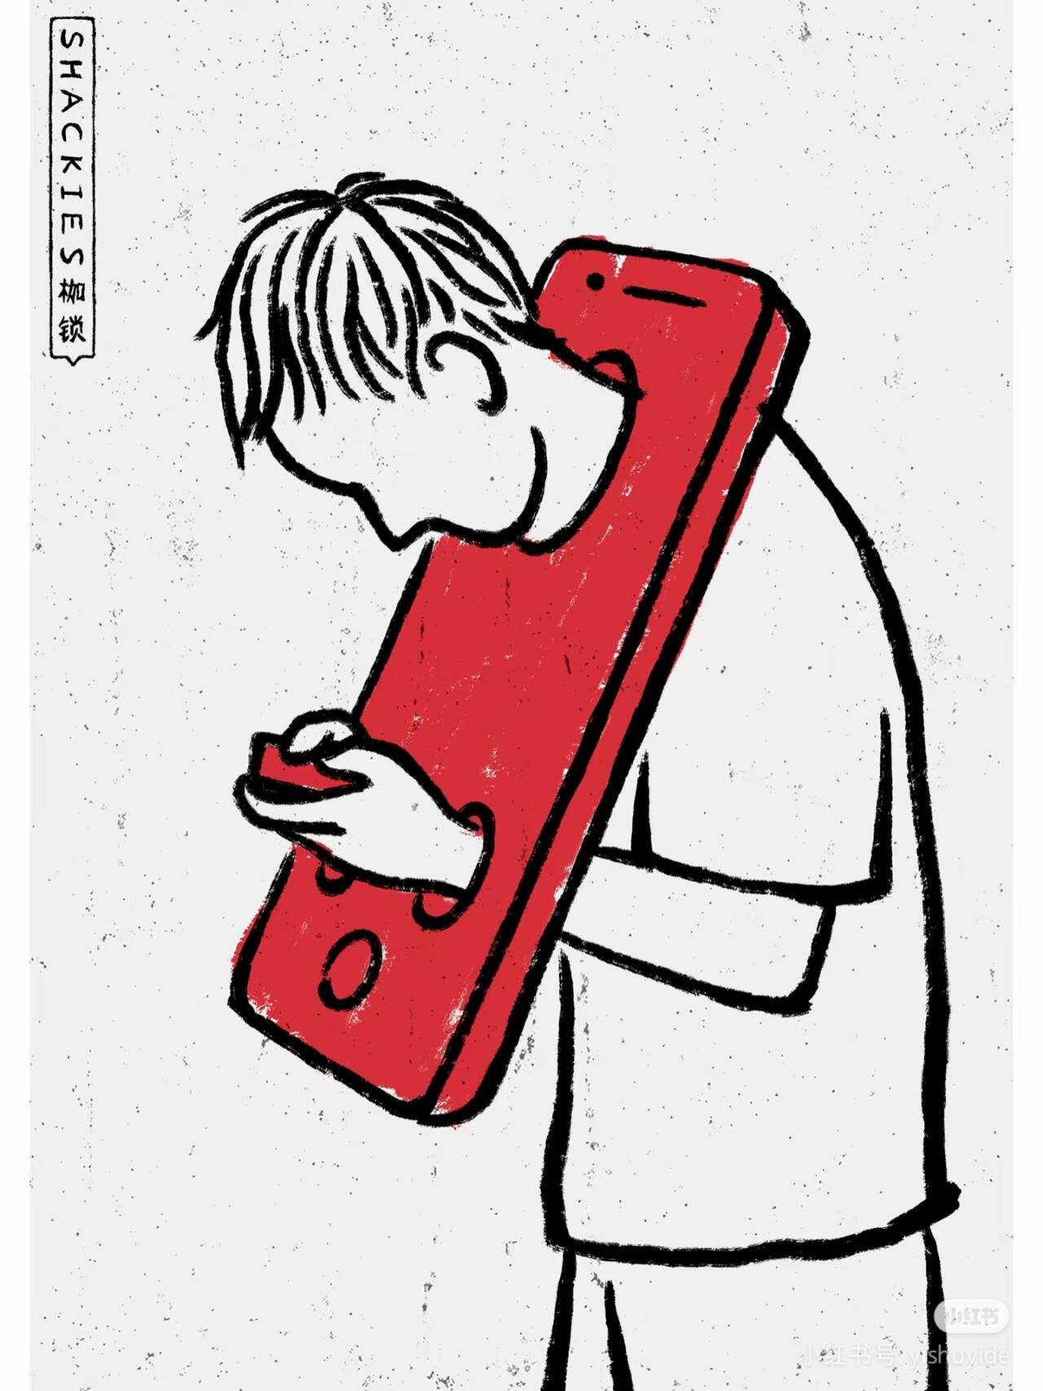
Dependence and psychology

Slide 22
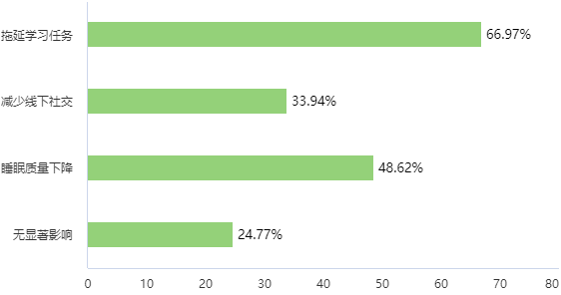
16. What do you think is the main impact of mobile phone dependence on you (multiple choices)?
Among the participants, 73 students, which accounts for a large part, believe that mobile phone dependence delays their study tasks. They often spend too much time on their phones, like watching videos or chatting, and then have little time or energy left for studying.
Moreover, 37 students think that it reduces offline social activities. They are so busy with their phones that they don't communicate with others face to face as much as before. Also, 53 students find that their sleep quality has declined. They usually use their phones late at night, and this makes it hard for them to fall asleep and have a good rest.
However, 27 students say that mobile phone dependence has no significant influence on them. They can control their phone use well and balance study, social life, and rest.
Writed By Cui Xiaoya

Slide 23
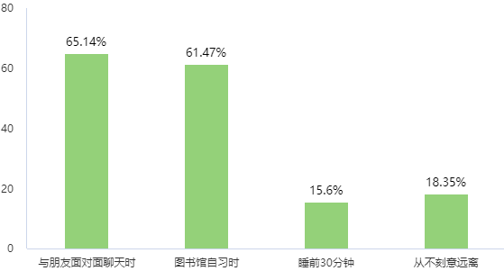
17. Do you deliberately stay away from your mobile phone in the following scenarios ？(multiple choices are allowed)
Most of people will deliberately stay away from mobile phone when chatting with friends face to face and studying in the library. 15.6% percent of people can do this 30 minutes before beds.But there still have 18.35% percent of people never deliberately stay away from mobile phone.
Writed By Li Qianqian

Slide 24
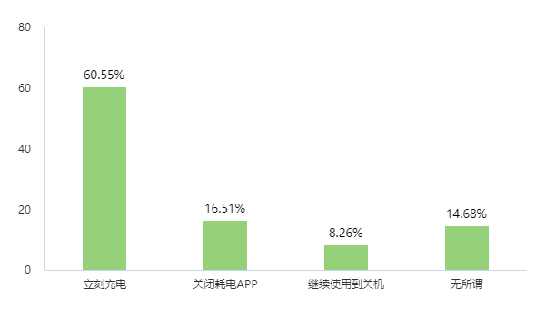
18. If the battery level of your mobile phone is below 20%, your first reaction is:
The most prevalent response, accounting for 60.55% of the respondents, is to "Immediately charge" the phone. Next, 16.51% of people choose to "Close power - consuming apps".Only 8.26% of the respondents opt to "Continue using until the phone shuts down“.Lastly, 14.68% of people claim to be "Indifferent".
Writed By Tang Yuanhao

Slide 25
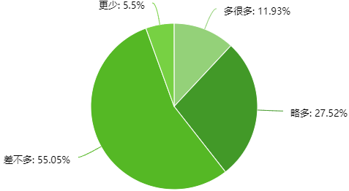
19. How do you think your mobile phone usage time compared to that of your classmates?
More than half of respondents (55.05%) believed their phone usage duration matched their peers' habits exactly, forming the dominant portion of responses. A substantial minority (27.52%) reported slightly heavier usage than classmates, while significantly fewer respondents fell into extreme categories - 11.93% claimed "much more" frequent use and merely 5.5% perceived themselves as lighter users.
Writed By Xu Heran

Slide 26

Learning and classroom

Slide 27
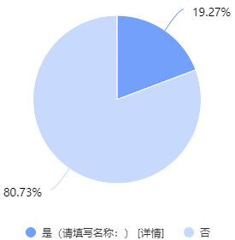
20. Have you ever used "mobile management apps" (such as Forest, Tomato Todo)?
So should we need self-control Apps? We investigate 109 persons; only 21 person download the app to help control themselves. 88 persons don't want to be limited.
Writed By Zhang Jiayu

Slide 28
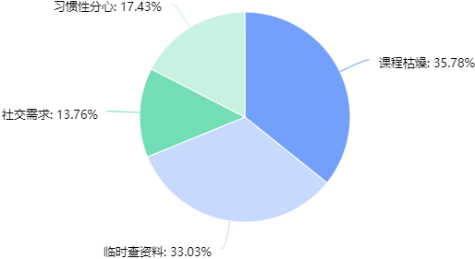
21. What are the main reasons for using mobile phones in class?
This table shows classroom phone - use reasons: 35.78% cite "boring lessons" as the main cause, indicating a need for engaging teaching methods. 33.03% use phones to "search for information," suggesting teachers could provide pre - class materials to reduce reliance. 17.43% admit to "habitual distraction," while 13.76% use phones for social interaction, highlighting self - discipline and social needs in class.
Writed By Sun Yuncheng

Slide 29
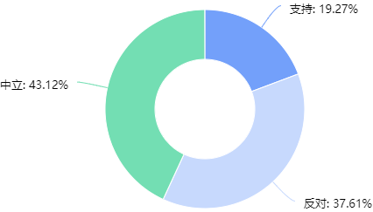
22. Do you support the mobile phone storage bag set in the classroom?
For the mobile phone storage bag set in classroom.There are19.25% percent of people support,37.61% percent of people oppose and 43.12% percent of people neither on one side nor the other.
Writed By Li Qianqian

Slide 30
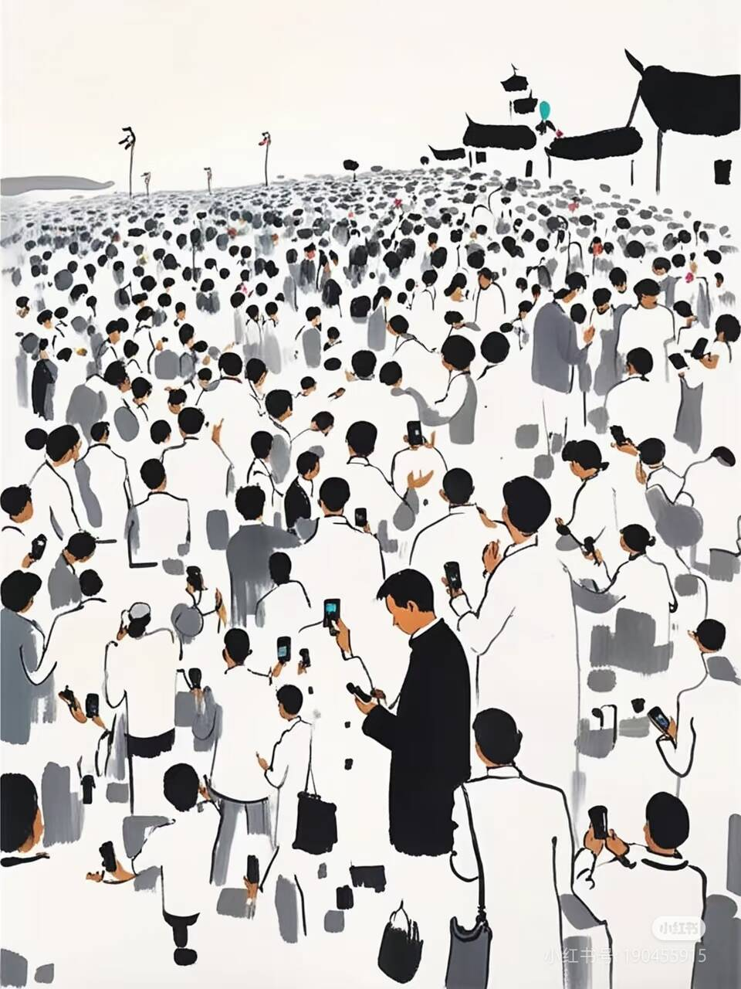
Openness and suggestions

Slide 31
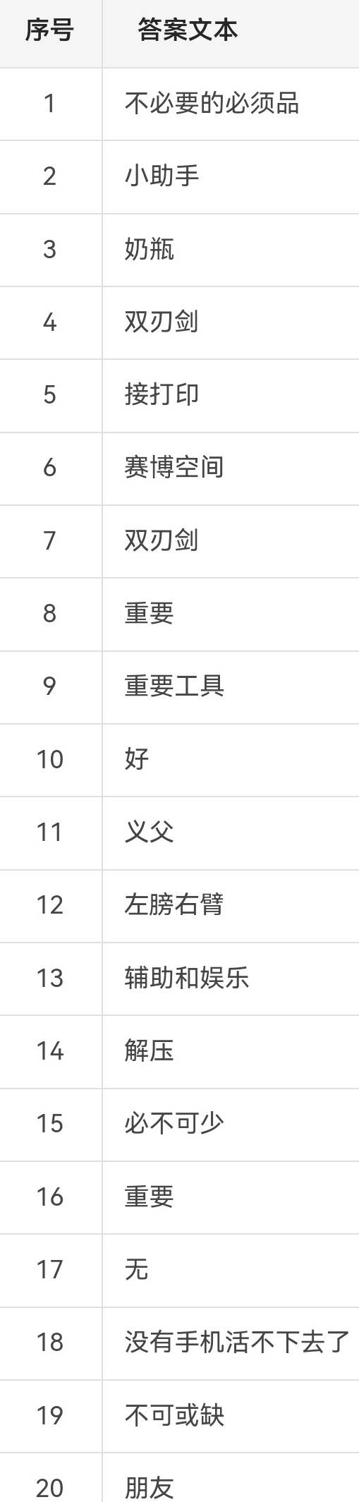
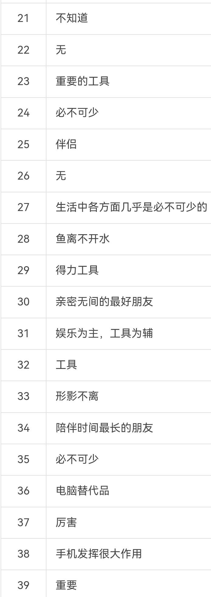
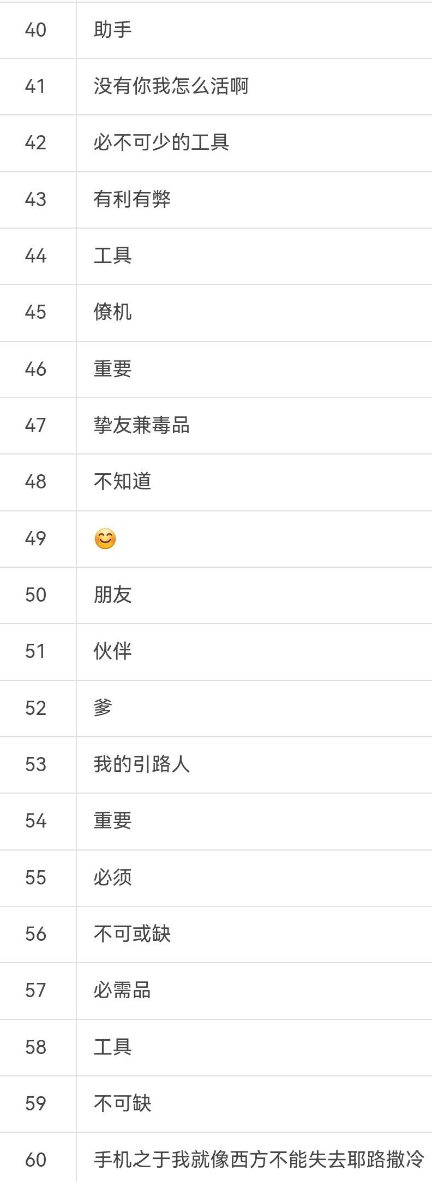
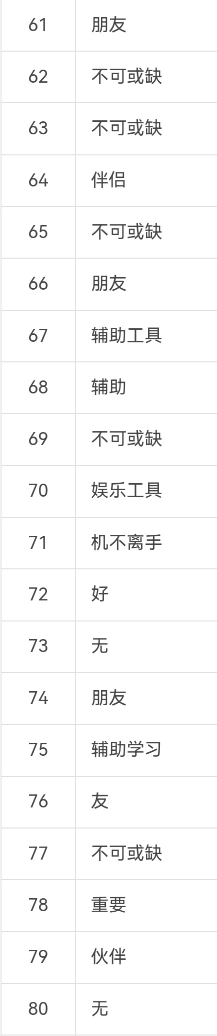
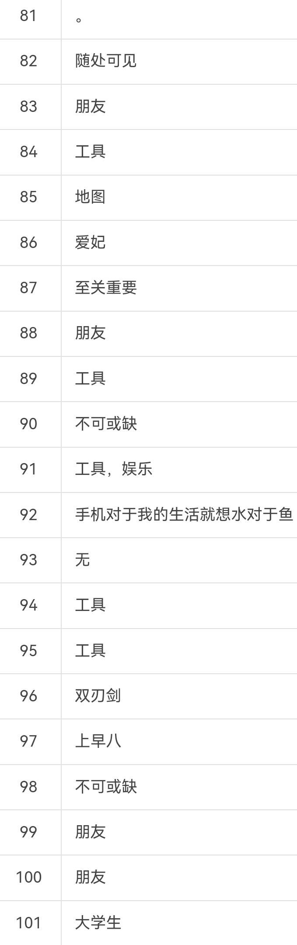
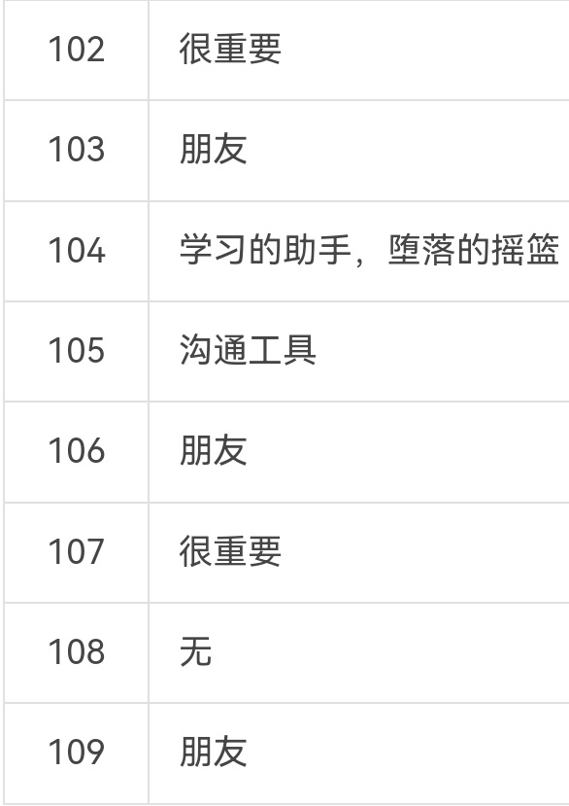
23. Please describe the role of mobile phone in your life in one sentence.

Slide 32

24.If you design an ideal mobile phone for college students, what functions do you most want to add?

Slide 33

25. How do you think schools and society should help college students reduce their dependence on mobile phones?

Slide 34
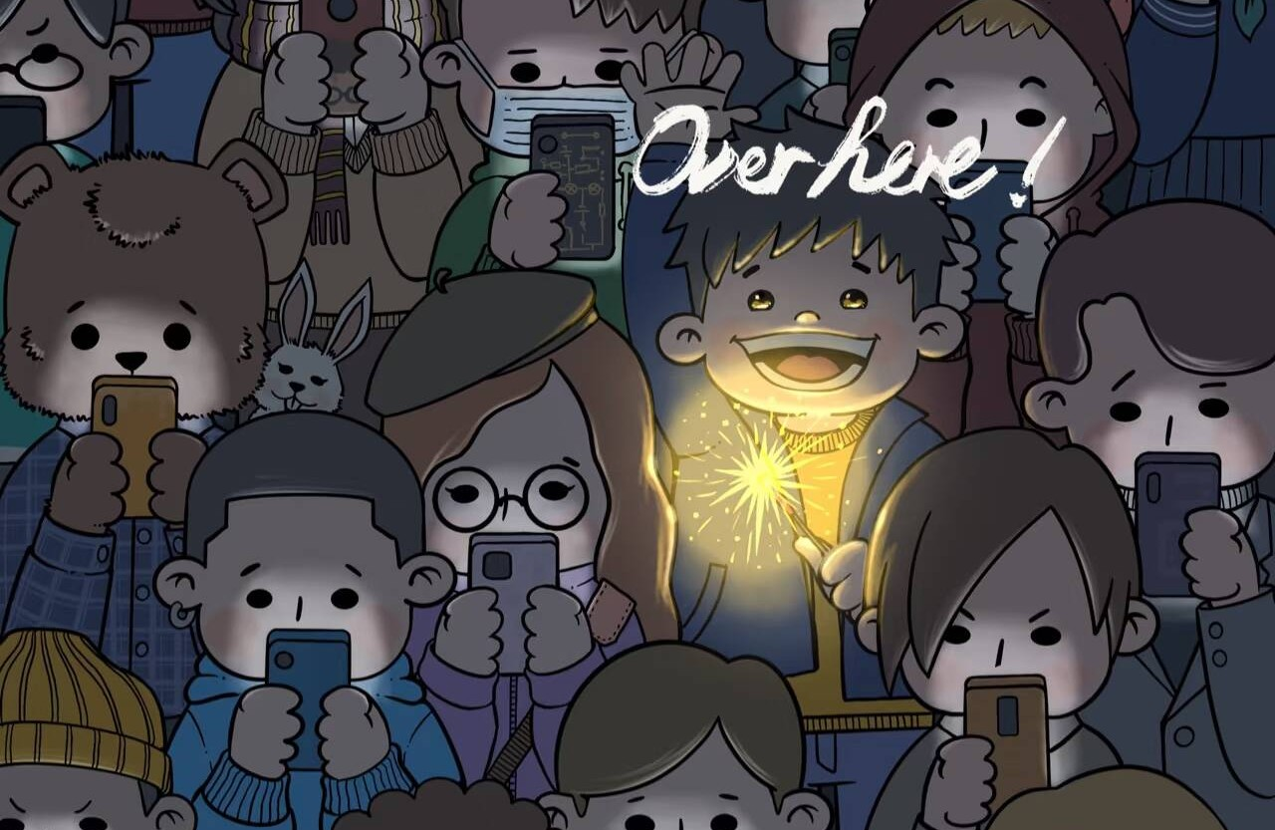
THANKS

